Slide 1
Daring Leadership—A Natural Fit for Advancing CPM
Learning Session 6
September 23, 2019

Slide 2
Dare to Lead™ Is Based On Research
Brené and her team interviewed 150 executives on the future of leadership.
Key findings:
It is not about titles or the corner office.
It is about the willingness to step up, put yourself out there, and lean into courage.
Predominant theme: “We need braver leaders and more courageous cultures.”
Notes:
Brené Brown spent twenty years studying courage, vulnerability, shame, and empathy. Her research now extends to leadership and organizational cultures and recently completed a seven-year study on brave leadership. She did this by interviewing 150 global C-suite level executives on the future of leadership, asking: “What, if anything, about the way people are leading today needs to change in order for leaders to be successful in a complex, rapidly changing environment?”

Slide 3
Notes:
One of the big reasons we try to avoid vulnerability is our fear of experiencing shame AKA “not good enough” or “who do you think you are.” Definition: ”Shame is the intensely painful feeling or experience of believing that we are flawed and therefore unworthy of love and belonging.”

Slide 4
Notes:
How do we grow braver leaders and more courageous cultures? Engage in Daring Leadership, which is comprised of four skill sets that are 100% teachable, observable, and measurable.

Slide 5
Rumbling with Vulnerability
It is the foundational skill set of courage.
It is defined in the research as
Risk, uncertainty, emotional exposure.
Our attitudes about vulnerability are often informed by vulnerability myths.
When we aren’t willing and able to “rumble with vulnerability,” we often resort to using “armor” to protect ourselves.
Notes:
Rumbling with Vulnerability: Facing risk, uncertainty, and emotional exposure with courage and clarity.
The greatest barrier to courageous leadership is not fear—it’s how we respond to our fear. Our armor—the thoughts, emotions, and behaviors that we use to protect ourselves when we aren’t willing and able to rumble with vulnerability—move us out of alignment with our values, corrode trust with our colleagues and teams, and prevent us from being our most courageous selves.
REFER TO CROSSWALK HANDOUT

Slide 6
The Myths of Vulnerability
Myth #1: Vulnerability is weakness
Myth #2: I don’t do vulnerability
Myth #3: I can go it alone
Myth #4: You can engineer the uncertainty and discomfort out of vulnerability
Myth #5: Trust comes before vulnerability
Myth #6: Vulnerability is disclosure
Notes:
REFER TO HANDOUT

Slide 7
Notes:
Followed by HANDOUT

Slide 11
What Does Daring Leadership Require?
To scale daring leadership and build courage in teams and organizations…
We have to cultivate a culture in which brave work, tough conversations, and whole hearts are the expectation and armor is not necessary or rewarded.
Notes:
Our ability to be daring leaders will never be greater than our capacity for vulnerability. It does require leaders to exercise integrity and practice engaged feedback. Clear is kind. Unclear is unkind. Daring leaders are never quiet about hard things. HANDOUT AL vs. DL

Slide 13
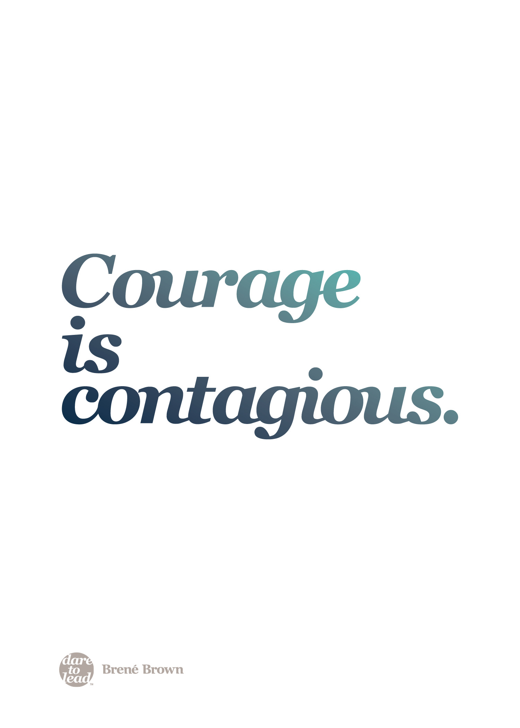

Slide 15
Notes:
Living into our Values: Identifying, operationalizing, and practicing the beliefs that we hold most important.
BRAVING Trust: Creating or deepening connections in relationships and teams based on the seven elements of trust.
Learning to Rise: Learning and growing from the failures, setbacks, and disappointments that are inevitable when we are brave with our lives.

