Slide 1
Welcome New CW Directors
CA Child Welfare Core Practice Model (CPM)
Directors’ Institute Webinar
Thursday, Sept 5, 2019 10:00-11:30 AM
Supporting Your Journey as Leaders of the Core Practice Model
Notes:
Stuart [Slides 1-3] (10:00 – 10:05)

Slide 2
Webinar Goals
Reinforce the role of CW Directors as central leaders in creating and sustaining the organizational environment for the Core Practice Model (CPM) to thrive.
Orient new CW Directors (and those looking for a refresher) to the history, purpose, values, principles and behaviors of the CPM.
Become familiar with the resources & implementation support tools available on the CPM website.
Notes:
Stuart [Slides 1-3] (10:00 – 10:05)

Slide 3
Notes:
Stuart [Slides 1-3] (10:00 – 10:05)
I’d like to now introduce, Sylvia Deporto, former Child Welfare Director and one of the original contributors to the first planning efforts by counties to develop a behaviorally based child welfare core practice model for California. Sylvia’s going to share more about the history, background and concepts central to the CPM.

Slide 4
Core Practice Model History
California’s Child Welfare Directors were the driving force behind the desire to create a statewide practice model as a unifying framework for all initiatives
Built from shared values and principles evident in promising practices already happening successfully across counties
Committed to a behaviorally-based framework that makes visible the relational, family-centered, evidence informed nature of child welfare work to practitioners, partners and those we serve
Notes:
Sylvia [Slides 4 – 11] (10:05-10:20)
California’s child welfare community has a long and respected history of creating and implementing successful approaches to serving children and families. Our state-supervised and the county-administered system has provided numerous opportunities at both the state and local levels for the development of innovative practices and initiatives aimed at improving outcomes. However, multiple emerging and established initiatives and practices have impacted our ability to have a consistent statewide approach for child welfare practice.
In 2012, California’s public child welfare community began efforts to develop a California Child Welfare Core Practice Model that is intended as a framework to support our state’s child welfare social workers and leaders in sustaining and improving practice in all California counties. From the beginning, the goal of this work has been to create a practice model that guides service delivery and decision-making at all levels in Child Welfare. The CPM builds on the great work already taking place by integrating key elements of existing initiatives and proven practices such as the California Partners for Permanency (CAPP), Pathways to Permanency (the Katie A. Core Practice Model), and Safety Organized Practice (SOP). The California Child Welfare Core Practice Model amplifies the work that has taken place in California over the past decade-and-a-half to improve outcomes for children and families in all counties, across the state.

Slide 5
Core Practice Model Benefits
Defines California’s Child Welfare Services as a profession grounded in theory, with a set of core values, common elements, and identified behaviors
Engages Child Welfare leadership with Training partners in the statewide implementation of a consistent, comprehensive approach to Child Welfare practice
Helps us work more effectively with children, youth and families involved in child welfare services and our partners to achieve safety, permanency and well-being
Notes:
Sylvia [Slides 4 – 11] (10:05-10:20)

Slide 6
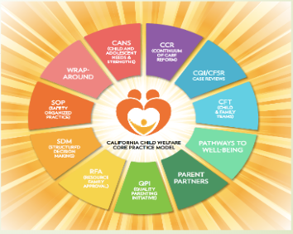
Notes:
Sylvia [Slides 4 – 11] (10:05-10:20)
The CPM provides a unifying framework that is informed by and consistent with the existing and emerging initiatives in use in California.
The goal is to create a practice model that guides practice, service delivery and decision-making and builds on the great work already taking place by integrating key elements of existing initiatives and proven practices such as the California Partners for Permanency (CAPP), the Katie A. Core Practice Model, and Safety Organized Practice (SOP). The model gives meaning to the work currently in practice and improve accountability and outcomes for children and families.

Slide 7

Let’s take a closer look at the model.
Notes:
Sylvia [Slides 4 – 11] (10:05-10:20)

Slide 8
Practice Model
Dimensions
Theoretical framework
Values and principles
Practice elements
Practice behaviors
Casework components
Notes:
Sylvia [Slides 4 – 11] (10:05-10:20)
The Core Practice Model consists of 5 dimensions:
A theoretical framework that explains why we think our model will help
Values and principles that ground our work in a shared belief system
Casework components that identify what we do in our work
Practice elements that define common element in all our work with children and families
Practice behaviors that describe how social workers use the model in their interactions with families, children, youth, caregivers, communities, tribes and partners

Slide 9
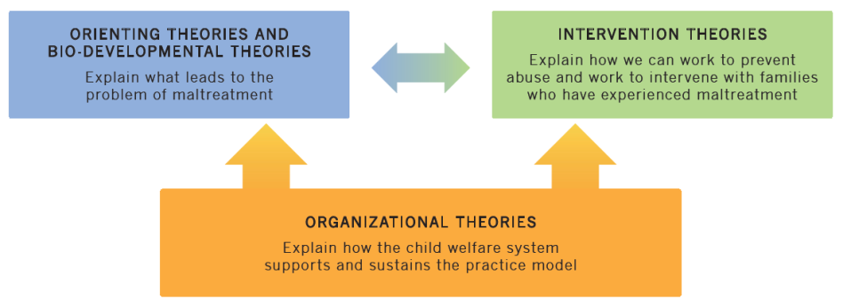
Theoretical Framework
Notes:
Sylvia [Slides 4 – 11] (10:05-10:20)
Our theoretical framework is an organized set of explanatory principles that help us ground our understanding of our work and guided the selection of values, practice approaches and behaviors for the model.
Orienting & Bio-Developmental Theories…help us understand:
• How/why key factors such as current & historical trauma and other stressors lead to maltreatment and hamper intervention efforts.
• Importance of protecting and promoting attachment bonds, family connections, and the cultural group as we work with families.
• That parenting is challenging, and all parents need help with discipline, transitions and milestones.
Using these theories leads to:
• Greater empathy and a shift in emotional reactions to families that enter the system.
• Develop and use strategies for building on strengths and working to enhance motivation for change.
Intervention Theories help us…
• Work with families to find and use services that will address the key factors to interrupt unsafe patterns: life situations, thinking patterns, emotions and triggers that contribute to maltreatment.
• Understand the sequence of events so we can help individual adults and entire families understand what needs to change and how to change it in order for children to be safe and remain with immediate or extended family.
• Understand the needs of children and youth in foster care and adoption and help them keep ties to family and community and develop new attachments.
• Understand how to help families, children, and youth through transitions and delayed reactions to prevent placement disruptions.
Organizational - These theories help us understand how our system will support and sustain the practice model.
More info about the theoretical framework is available at https://calswec.berkeley.edu/programs-and-services/child-welfare-service-training-program/core-practice-model/about

Slide 10
Our Values
Evidence-Informed
Organizational Support
Respectful Engagement
Cultural Responsiveness
Partnership
Professional Competency
Permanency
Well-Being
Growth and Change
Safety
This is What We Believe
Notes:
Sylvia [Slides 4 – 11] (10:05-10:20)
We value safety, partnership, permanency, well-being, etc.
For each value, we have a further statement, or supporting principle.
For example, in support of the Well-being value, we say “Children, youth, and young adults are supported to achieve their full developmental potential. We work to help families function at their best. We offer effective, assessment-based services and supports that address well-being.”
We use “We believe…” statements to convey our values and principles.
For example, for our well-being value, “We believe participating in culturally relevant, effective, assessment-based services can help children, youth, and families achieve their goals and be their best.”

Slide 11
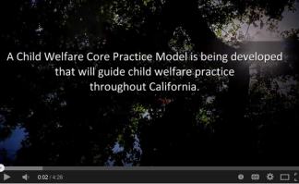
WE BELIEVE
Social Workers, Family Members, Advocates, and Agency Executives
Reflects the values and principles that have laid the foundation for the development of the Core Practice Model and reflect the ideal that we seek for vulnerable children and families.
Notes:
Sylvia [Slides 4 – 11] (10:05-10:20)
The video captures the spirit, beliefs and ideals that have informed development of the Core Practice Model.
After video, turn over to Gary…

Slide 12
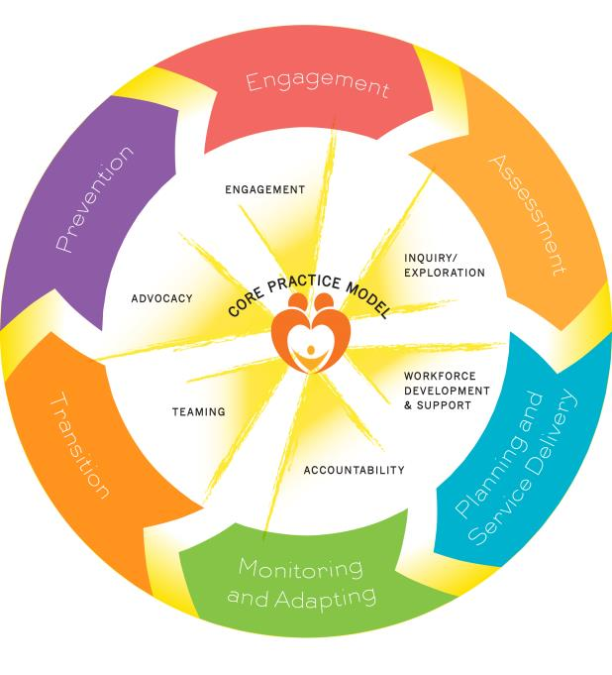
Casework
Components:
This is What
We Do
Notes:
Gary [Slides 12-17] (10:20-10:35)
Every intervention and involvement with children and families that we do in child welfare is grounded in these Casework Components:
Prevention
Engagement
Assessment
Planning and Service Delivery
Monitoring and Adapting
Transition
These components may be familiar to you as they are also identified in the Katie A. Core Practice Model (which fits under the umbrella of the California Child Welfare Core Practice Model).
Remember…casework components are not linear, but represent the ongoing work of social workers and families.

Slide 13

Practice Elements: This is How We Do It
Engagement
Inquiry / Exploration
Advocacy
Teaming
Accountability
Workforce Development and Support
Notes:
Gary [Slides 12-17] (10:20-10:35)
Practice elements define how the model embodies its values and enact its theoretical basis at the practice level and they link the model’s values and principles to the core aspects of practice that are essential to the model's success.
The practice elements in the California Child Welfare Core Practice Model are the broad actions we take to promote safety, permanency and well-being for all children and youth. We address safety, permanency, health, education, spiritual, and other family and youth needs through engagement, inquiry and exploration, and ongoing partnerships with families, youth, and their supportive communities and tribes.
For each of these elements, we identify HOW we do the work and the HOW is informed by our theoretical framework and our values. For example, within the Teaming element, we include: “We facilitate dialogue with families and their teams to ensure that we understand their point of view. We collaborate with youth, families, and their teams in assessment, decision-making, and planning.”
Similarly, the practice elements are also not linear, but represent a description of how we practice in every interaction as we work with families.

Slide 14

Practice Behaviors:
This is how practitioners bring it to life
Provide direction to practitioners about how it will look to express the values and principles of the model in their social work practice.
Notes:
Gary [Slides 12-17] (10:20-10:35)
In order to function effectively and collaboratively, our system needs to have clearly defined practice expectations.
Practice behaviors inform social workers, families and partners exactly what they can expect behaviorally from social workers and other child welfare staff who serve children and families.
This helps at dual levels of practice. At the macro level it help us know what practice looks like so we can:
create coordinated efforts with other systems
measure fidelity and effectiveness
have guidance for our training system
At a micro level, the practice behaviors gives social workers a clearer idea of how to do their job.
Think back to your first day on a new job… Wouldn’t it have been nice to know what you were doing?

Slide 15
Leadership Behaviors:
This is how leaders bring it to life
Provide parallel guidance to Directors, Managers, Supervisors, and others in bringing the model’s theoretical framework, values, and elements to life
Clearly describe the interactions between agency leadership and staff, and also between agency leadership and external stakeholders, in implementing the Core Practice Model
Notes:
Gary [Slides 12-17] (10:20-10:35)
Leadership behaviors provide parallel guidance to Directors, Managers, Supervisors, and others in bringing the model’s theoretical framework, values, and elements to life by clearly describing the interactions between agency leadership and staff, and also between agency leadership and external stakeholders, in implementing the California Child Welfare Core Practice Model.
Keep in mind that as Child Welfare Directors you are an important, visible role model Only the Director can play the critical, key role to set the expectations, model the values and establish the organizational culture that together, create, support and maintain the conditions within and across the organization that will help CPM thrive.

Slide 16
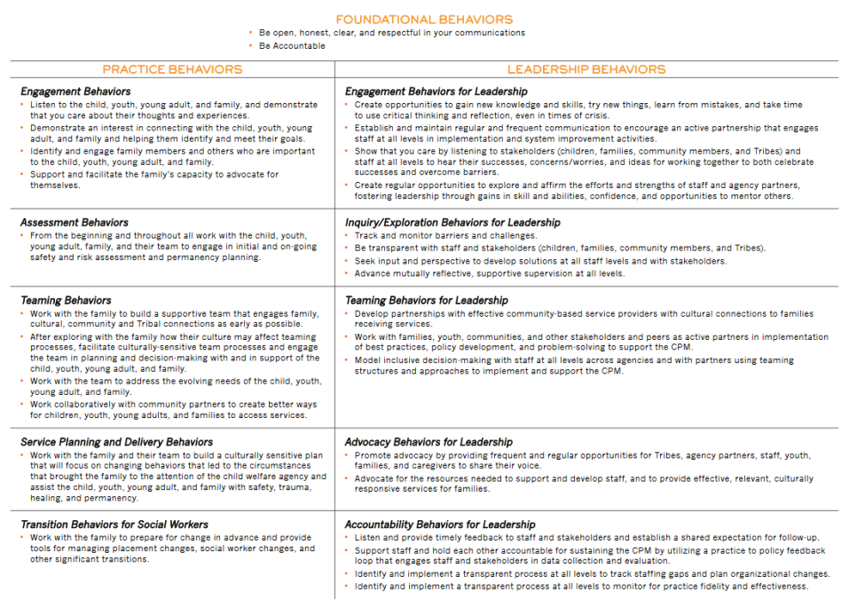
Notes:
Gary [Slides 12-17] (10:20-10:35)
Here is a summary of both the Practice Behaviors and Leadership Behaviors for your reference. We’ll take a look later at where you can find this document online.

Slide 17
To Sum Up…What Is CPM?
CPM is the way we do our work! Through exploration, engagement, inquiry, teaming, and advocacy we can better meet the needs of those we serve.
CPM defines the observable behaviors in our interactions with families, our workforce and our partners.
CPM is a catalyst for system, leadership and practice change that supports a consistent child welfare practice statewide.
Notes:
Gary [Slides 12-17] (10:20-10:35)
Most importantly for you all as leaders of child welfare practice and operations, it gives you a unifying framework from which you can exercise your role as leaders and by extension, the mid-level managers and supervisors in your organization. Regardless of the program area or scope of responsibilities, the Core Practice Model provides a common set of values, principles and behavioral expectations to help your entire leadership team guide your staff to do their best work.
Let me turn it back over to Stuart now for a few final thoughts about CPM.

Slide 18
But Wait…then what is ICPM?
ICPM = Integrated Core Practice Model
Recognizing that…
Child Welfare Services works in partnership with other public child serving systems such as Behavioral Health and Juvenile Probation to meet the needs of those it serves.
The principles, values and behaviors of the CPM apply to the partner systems as well, ensuring children, youth & their families can expect a consistent experience regardless of which system is managing their care.
In implementing the Child Welfare Core Practice Model, County Child Welfare agencies are implementing the ICPM for the children and families whom they serve
Notes:
Stuart [Slides 18-22] (10:35-10:45)

Slide 19
Implementation Focus
We defined the model—Then What?
Critical to understand the principles of Implementation Science
  Implementation is a process, not an event, and takes time to ensure success
  Implementation requires purposeful focus on
    Leadership
    Organizational Culture and Climate
    Workforce Development
    Partnerships
Notes:
Stuart [Slides 18-22] (10:35-10:45)

Slide 20

Implementation: It Takes a Village
County Child Welfare Agency Leadership
IN & WITH COMMUNITY
Supervisors
& Workers
How can we improve our chances of CPM taking hold?
Children
& Families
Notes:
Stuart [Slides 18-22] (10:35-10:45)
Chances for successful implementation are greatly increased through supporting both people and organizations. In fact, research shows that without leaders working in and with community to put a new innovation on the ground, there’s only a 10 – 15% chance of success.

Slide 21
Child Welfare Directors Institute
First steps towards implementation in 2017
GOAL : All 58 County Child Welfare Directors will have the personal and organizational resources to begin systematically implementing the California Child Welfare Core Practice Model.
3 –tiered structure to engage CWS Directors and their Implementation Teams in achieving that goal
Statewide Faculty, including Implementation Consultants from UNC and University of Louisville
Notes:
Stuart [Slides 18-22] (10:35-10:45)

Slide 22
Child Welfare CPM Directors Institute Structure
Child Welfare Director Learning Sessions
  Peer Learning and Mentoring Sessions specifically designed for CW Directors
  Five sessions since Mar 2017
  Over 40 Directors attended
Development Circles
    Staff from most counties participated in the creation of implementation tools
    3 statewide meetings
    Many, many conference calls, webinars, in-person meetings
    Developed specific implementation tools for each of 4 dimensions of implementation
County Specific Work
  Testing products produced in the Development Circles
  Led by County Active Implementation Teams
  Each county progresses at their own rate, according to the specific circumstances in their county
Notes:
Stuart [Slides 18-22] (10:35-10:45)
Briefly describe 4 dimensions of implementation capacity building:
Organizational Readiness Building: Building organizational capacity for assessing, monitoring, and improving organizational culture, climate, and functional structures and processes that support implementation of CPM.
Workforce Development: Building the confidence and skills of staff at all levels – those delivering the innovation and the supervisors, managers, and other leadership who support them. Tools and resources relate to assessing diverse staff needs, supporting the coaching role of supervisors, and strengthening staff retention.
Quality Outcomes and System Improvement: Informs how well CPM is being implemented (e.g., fidelity) and achieving desired outcomes. Tools and resources focus on “What do we want to know? How will we know it?” and using data to understand and reinforce what is going well and to address challenges.
Engagement, Relationships and Partnership: Implementation of CPM relies on strong partnerships within their agencies, systems and communities. Tools and resources include a set of 20 principles organized into 5 phases of partnering and collaboration. Over a dozen concrete tools/resources accompany the principles to help counties meaningfully engage with partners to put the values and principles of CPM into action.
This has been a very quick overview of 7+ years of work to support improving practice for California child welfare and its partners. We know there’s much more to share and to that end, CFPIC has partnered with CalSWEC to create a web-based repository for “all things CPM”. We’d like to spend the rest of our time showing you some of the resources and tools you have at your fingertips to help orient you further to CPM and how this can support your role as a child welfare leader. Let me turn it over to Leslie Ann Hay, one of our CPM Faculty, who will take you on a tour of some of the key features of the website.…

Slide 23
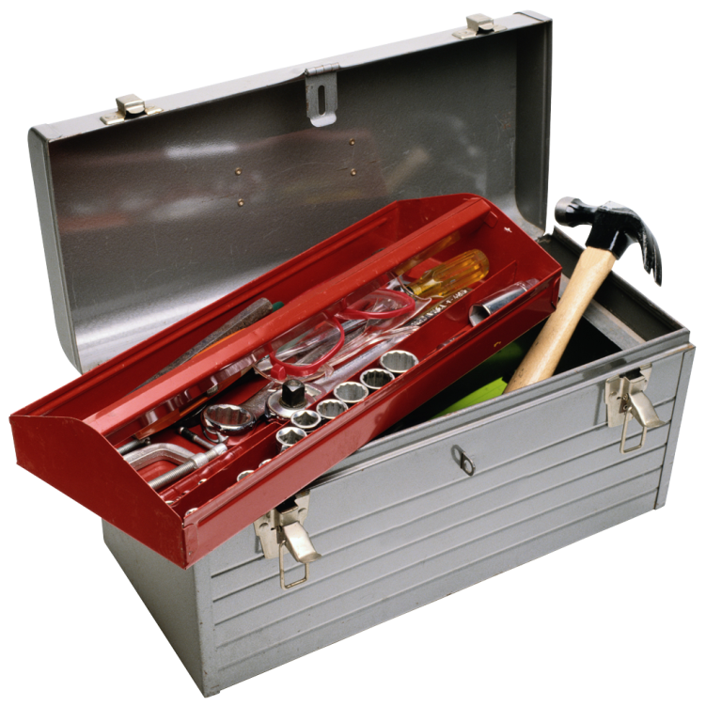
CPM Website
Overview
Notes:
Leslie Ann [Slides 23-36] (10:45-11:20)
Thank CFPIC, CalSWEC and everyone who has and continues to participate in this journey for the rich content and growing set of tools, resources and local examples that helps strengthen a truly statewide community of practice and leadership for CPM across the State.

Slide 24

How Familiar Are You with the CPM Website?
It’s Voting Time!
I’ve been using the new CPM website & feel comfortable getting around in it.
I’ve poked around the website a couple of times.
I haven’t visited the website at all yet.
Notes:
Leslie Ann [Slides 23-36] (10:45-11:20)
Mia will use the polling feature to collect responses to each question.
Based on responses, make a general comment about what appears to be familiarity with the website.
MIA—PLEASE TURN THIS INTO A POLL USING THE 3 OPTIONS APPEARING ON THIS SLIDE

Slide 25





Features of the CPM Website
CPM Background
Implementation Planning Materials
Toolbox with 4 Distinct Toolkits
Learning Sessions & Webinars Archive
Search Bar
Notes:
Leslie Ann [Slides 23-36] (10:45-11:20)
The CPM website contains a host of information about CPM and how to put it into practice.
CPM Background & History: Provides the historical perspective on how we arrived at CPM in California.
Implementation Planning Materials: Counties can access guidance for strategically planning their CPM Implementation efforts.
Toolbox with 4 Toolkits: Generated by the great work of the Development Circles these toolkits help counties build their capacity for putting implementation on the ground. They focus on 4 key domains of capacity building: organizational readiness, outcomes & system improvement, workforce development and partnerships.
Learning Sessions & Webinars Archive: A repository for all the Directors Institute sponsored events that have occurred. New materials are added as they happen.
Search Bar: A word search feature to quickly find anything you might be looking for on the site.

Slide 26
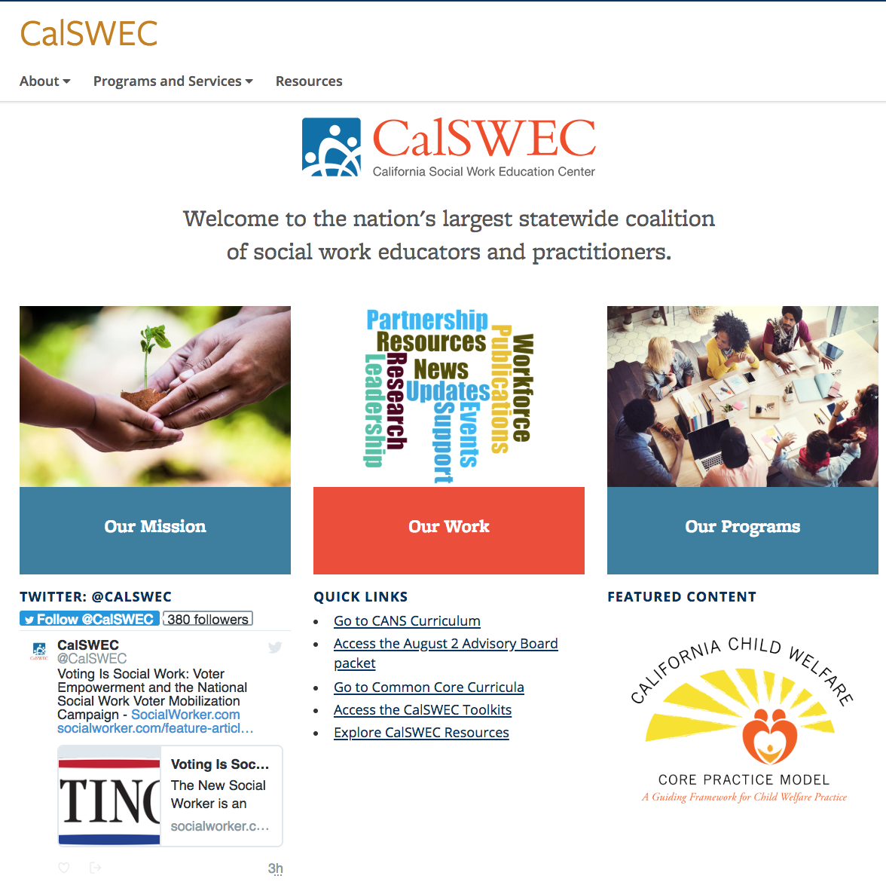
Head to calswec.berkeley.edu
Notes:
Leslie Ann [Slides 23-36] (10:45-11:20)
Let’s head right into the website. We’ll show you how to get in, then we’ll make it easy for you to get back there anytime you want. Either now (or on your own time), type calswec.berkeley.edu into your browser. You’ll arrive at this page click.
This is CalSWEC’s home page – they cover a lot of territory on their website. We’re just going to the bottom right [click] where the CPM logo is. Click on it.
You’ll arrive at what we call the “CPM Home Page”

Slide 27
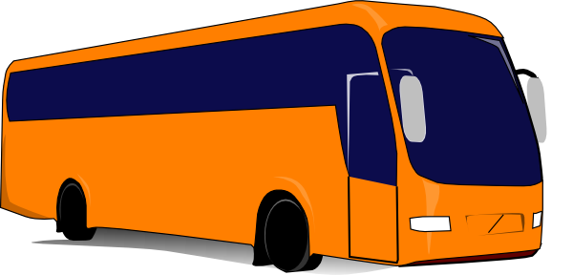
Let’s Take a Quick Tour
CPM
website
Notes:
Leslie Ann [Slides 23-36] (10:45-11:20)
So now let’s leave the webinar and head over to the website to take a deeper look.

Slide 28
Notes on CPM Website: Show the Following
CPM Home Page: CPM website lives within larger CalSWEC site; Note easy access to:
  Left navigation bar & breadcrumb trail & search box
  Latest material posted
  Leadership and Practice Behaviors
5 CPM main pages (go to each & show/tell)
  About the CPM
  Director's Institute
  CPM Implementation Planning
  CPM Implementation Toolbox
  Reference Materials
Continue onto CPM Implementation Toolbox…
Notes:
Leslie Ann / Mia
As we’ve seen, the CPM website lives within the larger CalSWEC website. There are several features on the site that make navigation and finding frequently used information easy to find.
(S L O W D O W N !! MAKE SURE THE AUDIENCE IS FOLLOWING YOU. USE MOUSE TO CIRCLE, POINT & INDICATE WHAT YOU’RE TALKING ABOUT ON THE PAGE.)
Notice that navigation runs down the left frame (circle your mouse to show the left frame)…and also across the top of all pages in what’s called the Breadcrumb Trail (circle with your mouse). Finally, there’s a search function that’s always available where you can find a specific item—we’ll use this feature a bit later (point to Site Map Search Box at top of page).
Point out the “What’s New” feature on the home page for quick access to the latest posting on the site. (Hover over Learning Session V hyperlink, then click to show where it goes. Return to home page.)
There are 5 main pages on the CPM Website (circle mouse around 5 main page accordion bars on home page). Let’s take a peek at each one.
About the CPM (click on +): The About page gives overview and background to the whole CPM project. (click on hyperlink) You’ll find 3 sections on this page, some of which have further materials attached: What is the CPM? Background of CPM Development and Who’s Who in CPM? (back to home page)
Director’s Institute (click on +): Here we find all things related to the Directors Institute (click on link), including a section about what it is, an archive of Leading Edge newsletters and a collection of our shared learning events such as Learning Sessions and Webinars. (slowly scroll down the page to highlight each section; back to home page)
CPM Implementation Planning (click on +): This is one-stop shopping for everything your county needs for CPM Implementation Planning (click on link). In addition to the Overview and Approach sections, there are three Parts, each with a full complement of materials and guidelines for whatever stage of CPM implementation planning your county may find itself. (scroll back to top of page) There’s also a downloadable pdf of the Implementation Planning Guide and related materials for sharing with others.
CPM Implementation Toolbox (click on +): In the Implementation Toolbox are 4 distinct Toolkits: Organizational Readiness Building, Quality, Outcomes & System Improvement, Workforce Development, Engagement, Relationships & Partnership. (back to home page)
Reference Materials (click on +): Finally, there’s the Reference Materials page with a useful collection of materials related to the CPM. (back to home page)

Slide 29
Notes on Toolbox: Show the Following
CPM Toolbox page
Go to each of the following 3 pages for each one Toolkit at a time, starting with ORB:
  Toolkit Overview
  Background & Context page
  Tools/Resources page
Go back through each toolkit a second time showing the Tools & Resources pages in more depth (open one or two tools as examples)
Back to Webinar
Notes:
Leslie Ann / Mia
Now let’s get into the features of the Implementation Toolbox.
Each DC has created tools & resources that support implementation. These 4 toolkits all follow a similar convention. Each has 3 sub-pages related to (1) background & context to frame this area of implementation, (2) tools & resources for counties to adapt and use as they implement CPM, and (3) webinar link to offer a ‘deeper dive’ into how to take advantage of the toolkit materials.
Let’s start with ORB. It has an overview page, which also links to a relevant webinar and two additional pages. This is what the Background & Content pages looks like for ORB (look it over) and now we’ll go to the Tools/Resources page for a quick glance. Something for you to notice:
PDFs open in your browser and can be downloaded
Word docs automatically download and can be used as templates
Use left navigation frame to quickly go to another Toolkit
(Repeat with each Toolkit)
Now that you have a sense of the overall structure and content of the Toolkits, let’s look at a couple of key tools & resources themselves to get an idea of what you might find helpful. (Go to each Toolkit “Tools & Resources” page and open the following links):
ORB – Key Messages and County Profile Summaries
QOSI – Logic Model (PDF) and related resources in additional links
WD – Leadership Practice Profile (PDF) and Supervisor All Practice Behaviors (PDF)
ERP – How Well Are We Partnering? and 6 R’s of Partnership Participation (return to ERP landing page for Principles Only document)

Slide 30
Making the Website Work for You
Notes:
Leslie Ann [Slides 23-36] (10:45-11:20)
Let’s explore a little deeper into the website now with some typical queries that may come up for you as a new Director.

Slide 31
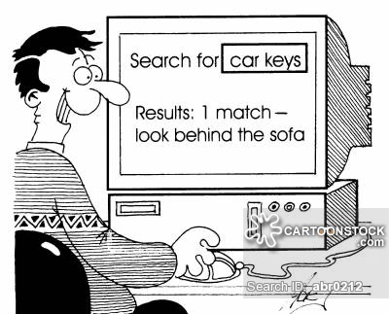
Sample Inquiries
Notes:
Leslie Ann [Slides 23-36] (10:45-11:20)
First, a quick reminder about the nature of searching the Website for information…
The best way to approach your search is with a clear, specific question. Are you looking for a specific document, some samples of other county’s work or planning guidance? It’s like when you do an internet search—getting the information you want has to do with either getting your question right or using clues in the results that aren’t exactly what you want to help you refine the question further.
What follows are examples of inquiries you might have that the Website can help answer.

Slide 32
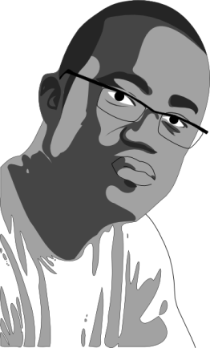
Leadership and CPM
“There’s so much information on this website and I’m always pressed for time…
What’s the most efficient way for me to learn more about my role in leading CPM implementation in my location?”
Notes:
Leslie Ann [Slides 23-36] (10:45-11:20)
Here’s something that might be on your mind as a Director at this point…[read slide]. Let’s see how the website might help answer this question.
Pathway through Toolbox / Website to answer this question:
Navigate to Directors Institute page, scroll down to Shared Learning Events, click on hyperlink. Click on Learning Session 1 and point out the following resources:
A Common Leadership Framework – Adaptive Leadership (Heifitz)
“What It Takes for Implementation: Aligning Structures and Processes for Strengthening Systems” (Boothroyd et. al.)
Short videos: “Greatness” by David Marquet and “Let Go and Lead” by Margaret Wheatley
Return to webinar…

Slide 33
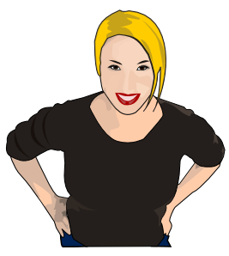
Communicating About CPM
  “I’m looking for practical ways to focus our county’s energy and attention on CPM.
  How can I communicate to staff and partners what CPM is all about?”
Notes:
Leslie Ann [Slides 23-36] (10:45-11:20)
Here’s someone who’s eager to learn more about how to solve a common challenge…
Pathway through Toolbox / Website to answer this question:
Return to References Materials home page and under CPM Foundational Materials click on Messaging the CPM. Return to web page and scroll up to Search box and type in “CPM Messaging”…select Messaging Webinar from the top of the list of search results. On Messaging Webinar page, click on Communication for Engagement-Key Messages to highlight CPM messages for targeted audiences.

Slide 34
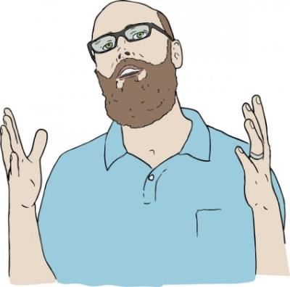
CPM Implementation Strategies
“Our staff are familiar with the practice behaviors, but it feels like it takes more than training for the CPM to take hold...
How do I learn more about strategies for successful implementation of CPM?”
Notes:
Leslie Ann [Slides 23-36] (10:45-11:20)
Here’s an interesting question about something many of us are experiencing right now.
Pathway through Toolbox / Website to answer this question:
Return to CPM home page. If it were up to me to answer this question, I’d go to the Directors Institute page. There are so many resources there, including the Shared Learning Events page, where you can find the Implementation Planning Webinar. Point out resources on this webinar page. Also, if you type in CPM Implementation Strategies into the Search Box, you will be guided back to all 4 Toolkits in addition to the Implementation Planning Webinar page we just visited.

Slide 35

Preparing for Learning Session VI
“This will be the first time I’ve attended a Learning Session sponsored by the Directors Institute...
What’s the best information I can review in advance to help me feel prepared?”
Notes:
Leslie Ann [Slides 23-36] (10:45-11:20)
Here’s another question that some new Directors may be wanting to know…
Pathway through Toolbox / Website to answer this question:
Return to Shared Learning Events page. Click on Pre-Session 1 Materials as a resource to help ensure foundational understanding of the practice model, implementation science key concepts, adaptive leadership and other topics. Click on Introduction and recommend folks start with this document to see what background materials may be most relevant for your needs.
Return to webinar…

Slide 36

SCAVENGER HUNT
“Where can I find that CPM color brochure that has nice photos and lists the practice & leadership behaviors?”
Notes:
Leslie Ann [Slides 23-36] (10:45-11:20)
Okay, you’ve all had a pretty good look around the CPM website. Let’s see if anyone can lead me to find the answer to this scavenger hunt question. [Read question.] Where do you suggest I go?
Open the lines for discussion
Those are some good ideas you all contributed. Here’s what I was thinking of for the answer: DEMONSTRATE USING THE SEARCH BAR; or head to the Reference page, to the CPM Materials section and find the CPM Overview.
Back to the webinar…Let me turn it back over to Stuart now to talk about other available supports and upcoming events.

Slide 37
How Can I Learn More?
Notes:
Stuart [Slides 37-41] (11:20-11:30)
Hopefully, this webinar has provided you with an overview of the CPM as well as the related tools and resources for implementation of CPM available on the CalSWEC website.
Let’s take a look now at how RTAs are moving forward with becoming a key resource for implementation support of CPM, what other supports you can access, and what’s on tap for the next Directors Institute Learning Session.

Slide 38

Regional Training Academies Want to Help!
    Your points of contact for CPM Implementation Support:
RTA | Point of Contact | Email
Northern | Alison Book | apbook@ucdavis.edu
Bay Area | Jennifer Buchholz | jbuchholz@mail.fresnostate.edu
Central | Andrea Sobrado | ansobrado@gmail.com
Southern | Nancy Satterwhite | nsatterwhite@sdsu.edu
Notes:
Stuart [Slides 37-41] (11:20-11:30)
RTAs are focusing on both building their internal capacity to be able to support each other, the counties, the regions and the state in implementing the CPM as well as considering the integration of other major statewide initiatives and the foundational role the CPM plays in supporting those initiatives.
Each of the regions have periodic forums within their own meeting structures (gathering county directors, managers, training specialists, etc.), to provide CPM implementation support to counties in addition to responding to individual support requests from counties
The RTA points of contact are: Northern, Alison Book; Bay Area, Jennifer Buchholz; Central, Andrea Sobrado and Southern, Nancy Satterwhite

Slide 39
What Other Supports Are Available?
Regional Child Welfare Directors Meetings
Development Program for New CW Directors
CWDA Children’s Committee
Webinars, Learning Sessions and other shared learning events sponsored by CFPIC
Technical assistance and coaching from CPM Faculty, RTA representatives, retired CW Directors, and UNC implementation consultants
Notes:
Stuart [Slides 37-41] (11:20-11:30)

Slide 40


Questions…
Notes:
Stuart [Slides 37-41] (11:20-11:30)

Slide 41
Upcoming Events…
Fall 2019 Learning Session:
  LS VI: Sept 23-24, 2019; Westin Pasadena
  “Adaptive & Courageous Leadership in Action: Leading & Measuring Successful CPM Implementation”
  For CW Directors Only
Spring 2020 Learning Session:
  LS VII – date to be determined
  For Directors & members of their CPM implementation teams
Notes:
Stuart [Slides 37-41] (11:20-11:30)

