Slide 1
Creating Healthy Organizations
Creating experiences that transform the heart, mind and practice.

Slide 2
CORE PRACTICE MODEL (CPM)
As we move throughout this session, identify which CPM Leadership Behaviors apply and how they can be integrated into your work.
Review of Organization Culture and Climate from LS 2

Slide 3
Organizational Culture
Organizational Culture- Shared behavioral expectations and norms that characterize and direct behavior in a work environment
More ingrained, “unwritten rules,” personality of the organization
Glisson, C., Green, P., & Williams, N. J. (2012). Assessing the Organizational Social Context (OSC) of child welfare systems: implications for research and practice. Child Abuse & Neglect, 36(9), 621-632.
Notes:
These expectations are modeled for new employees and reinforced through formal and informal sanctions as employees’ adjust to social milieu of the agency or work unit
Climate is important because of its influence on employees: Motivation and work attitudes such as job satisfaction and organizational commitment. These relate to performance in the organization (James, et al., 2008; Judge, et al., 2001)

Slide 4
Softening Rigidity
While the bureaucracy may not go away, there are ways to decentralize decision making, cross train employees, enhance teamwork, and empower employees at all levels of the organization while still being responsive to federal and state laws, regulations and agency policies.
All components of undoing resistance and softening rigidity are part of Senge’s Learning Organization Model (Org. Readiness Building)
Senge, P. (1986). The fifth discipline: The art and practice of the learning organization. New York: Double-day.

Slide 5
Organizational Climate
Organizational Climate- Created by shared employee perceptions of how their work environment (policies, practices, protocols, behaviors that are supported, expected, rewarded) impacts their psychological well-being and functioning.
Collective sense of how we experience that organizational culture
If organizational culture is “personality,” organizational climate is the “mood” – easier to change
Glisson, C., Green, P., & Williams, N. J. (2012). Assessing the Organizational Social Context (OSC) of child welfare systems: implications for research and practice. Child Abuse & Neglect, 36(9), 621-632.
Notes:
These expectations are modeled for new employees and reinforced through formal and informal sanctions as employees’ adjust to social milieu of the agency or work unit
Climate is important because of its influence on employees: Motivation and work attitudes such as job satisfaction and organizational commitment. These relate to performance in the organization (James, et al., 2008; Judge, et al., 2001)

Slide 6
Key Organizational Climate Predictors of Outcomes
Impact three dimensions of organizational climate:
Engagement- Workers feel they are able to accomplish many personally meaningful things in their work, remain personally involved in their work and treat their clients in a personalized way.
Functionality- Workers feel they receive the support, cooperation, role clarity and resources they need to successfully perform their job duties.
Stress- Workers experience conflicting demands, feel as though they are unable to accomplish necessary job tasks and are emotionally exhausted.
Notes:
2 minutes

Slide 7
Impact of OCC on Retention
Positive overall OCC predicted higher rates of retention (Westbrook, Ellett & Asberg, 2012).
High proficiency and low resistance led to lower turnover (Aarons & Sawitzky, 2006; Glisson & Green, 2006).
Emphasis on rewards, preventing and attending to emotional exhaustion enhanced retention (Shim, 2010).
Lack of respect predicted turnover (Augsberger, et al, 2012).
Supportive environment, clear communication, enhanced collaboration, and use of data were associated with higher retention rates (Johnsco, et al., 2014).

Slide 8
Lencioni-Vulnerability Based Trust
Build a Cohesive Team
Create Clarity (what and how)
Over-communicate Clarity (why, what, how)
Reinforce Clarity (formalize)
Notes:
The Advantage by Patrick Lencioni
*This model originated from “The 5 Dysfunctions of a team

Slide 9
BUILD A COHESIVE TEAM
Building trust
Mastering conflict
Achieving Commitment
Embracing Accountability
Focusing on results
Notes:
Building Trust-Team members who trust one another are comfortable being open, even exposed to one another about their failures, weaknesses and fears
Mastering Conflict-When trust is present, teams are able to engage in unfiltered ideological debate around ideas, issues and decisions that must be made
Achieving Commitment-The ability to engage in conflict and provide input enables team members to buy-in or commit to decisions
Embracing Accountability-After commitment is established, team members must be willing to hold one another accountable and remind each other when actions are counterproductive to the team
Focusing on Results-Collective team results must supercede any departmental or personal objectives or pursuits

Slide 10
CREATE CLARITY
Why do we exist
How do we behave
What do we do
How will we succeed
What is most important, right now
Who must do what
Notes:
Creating alignment at the executive level is essential to building and maintain a healthy organization. There is probably no greater frustration for employees thatn having to navigate the politics and confusion caused by leaders who are misaligned. Even the slightest bit of daylight between executive team members can cause an overwhelming effect on employees below. These are the 6 critical questions that need to be answered, eliminating all discrepancies among team members.
Why do we exist? The answer to this question will yield a core purpose, or the fundamental reason the company is in business
How do we behave? This question examines behaviors and values required for success
What do we do? This answer provides a simple, direct explanation of the business.
How will we succeed? This question requires team members to develop a strategy.
What is most important right now? The answer to this question is the establishment of a unifying thematic goal and action plan.
Who must do what? This question addresses roles and responsibilities.

Slide 11
OVER-COMMUNICATE CLARITY
Commitment clarification
Cascading communication
Top down communication
Lateral and upward communication
Notes:
Once a leadership team has become cohesive and established clarity around the 6 critical questions, they need to communicate the answers to their employees over and over and over and over and over again. It was reported, employees won’t believe a leader’s message until they’ve heard it 7 times. Whether the real number is 5 or 55 doesn’t matter, the message is people are skeptical about what they hear unless they hear it repeatedly over time. For messaging to be consistent and absorbed by employees, the leadership team can employ the following communication strategies:
Commitment Clarification-This strategy requires the meetings’ discussion and decisions be reviewed for alignment and buy-in before they are communicated.
Cascading Communication-This communication concept provides a structure for personally disseminating information
Top Down Communication-This is the most common type of communication flow that needs to be consistent and supported by other communication vehicles.
Lateral and Upward Communication-It is important to acknowledge and leverage these communication methods without being overly formal or prescriptive.

Slide 12
REINFORCE CLARITY
The org has a simple way to ensure that new hires are carefully selected based on the company’s values
New people are brought into the organization by thoroughly teaching them about the 6 elements of clarity
Managers throughout the org have a simple, consistent and non-bureaucratic system for setting goals and reviewing progress with employees. That system is customized around the elements of clarity.

Slide 13
REINFORCE CLARITY
4. Employees who don’t fit the values are managed out of the org. Poor performers who do fit the values are given the coaching and assistance they need to succeed.
5. Compensation and reward systems are build around the values and goals of the org.
*If 2 or more of these statements are not true in your org, address your human systems.
Notes:
For an organization to be healthy, organization clarity (the 6 critical questions) must become embedded into the fabric of the organization. All human systems must reinforce the answers to the 6 critical questions in order to keep them alive and ingrained in the organization. Systems in the following areas need to tie to the 6 questions:
Recruiting and hiring
Managing performance
Compensation and rewards
Real time recognition
Human systems should be flexible and not overly bureaucratic. Instead, human systems should reflect and reinforce the uniqueness of the organization’s culture and operations.
Review the checklist to see if your company needs to address their human systems
If 2 or more of these statements are not true in your organization, address your human systems.

Slide 14
AS WE LOOK AT THE FOLLOWING SLIDES THINK ABOUT WHAT LEADERSHIP BEHAVIORS COULD ALIGN WITH EACH OF THE COMPONENTS NEEDED FOR A HEALTHY ORGANIZATION.
Notes:
Brief discussion in table groups-10 minutes

Slide 15
Notes:
Develop colleague maps-this is how well you know your colleague’s world both professional and personal
Provide positive feedback-exchanging genuine positive feedback with our colleagues is important as is having the presence of mind to regularly share positive impressions of performance
Respond and Engage-meeting bids to interact by regularly turning towards colleagues both in person and by email
Perception becomes reality-maintaining self and other awareness regarding being in positive or negative perspective with colleagues. If in negative perspective, repairing relationships appropriately.
Manage conflict-addressing both solvable and perpetual problems with colleagues in an open manner.
Facilitate career advancement-support your colleagues’ professional goals by being mindful of opportunities that consider the other person’s best interest and benefits them
Create a shared culture-developing work processes and procedures that respect each other’s personal and professional goals, while supporting the organization’s overall purpose.
Gottman

Slide 16
THE SOUND RELATIONSHIP WORKPLACE-Gottman
Develop colleague maps-this is how well you know your colleague’s world both professional and personal
Provide positive feedback-exchanging genuine positive feedback with our colleagues is important as is having the presence of mind to regularly share positive impressions of performance
Respond and Engage-meeting bids to interact by regularly turning towards colleagues both in person and by email

Slide 17
The Sound Relationship Workplace-Gottman
4. Perception becomes reality-maintaining self and other awareness regarding being in positive or negative perspective with colleagues. If in negative perspective, repairing relationships appropriately.
5. Manage conflict-addressing both solvable and perpetual problems with colleagues in an open manner.

Slide 18
The Sound Relationship Workplace-Gottman
6. Facilitate career advancement-support your colleagues’ professional goals by being mindful of opportunities that consider the other person’s best interest and benefits them
7. Create a shared culture-developing work processes and procedures that respect each other’s personal and professional goals, while supporting the organization’s overall purpose.

Slide 19
TWO SETS OF QUESTIONS
LEARNER QUESTIONS
JUDGER QUESTIONS
What do I want?
What are my goals?
What might work?
What can I learn?
What are the facts?
What am I assuming?
What are my best choices?
What action steps make the most sense?
What is possible?
What’s wrong with me?
What’s wrong with them?
Whose fault is it?
Why doesn’t anything work for me?
Why is everyone so annoying?
Why bother?
Notes:
Learner questions support a healthy org
In times of stress we tend to go to the judger because that’s most comfortable for us. It is a default for most people.

Slide 20
SCENARIO TABLE GROUP ACTIVITY
Identify where you see leadership behaviors
What are some things that trigger the learner mindset?
What actions can be taken to switch lanes from a judger mindset to a learner mindset?
Use the Choice Map handout and listed questions to guide conversations about the scenario
Notes:
40 minutes total
Table group-different scenarios
20-25 minutes
5 minute faff/orientation time
15 minutes engagement
5 minutes wrapping up
Sylvia and Nancy to walk the room during scenarios
10-15 minute report out

Slide 21
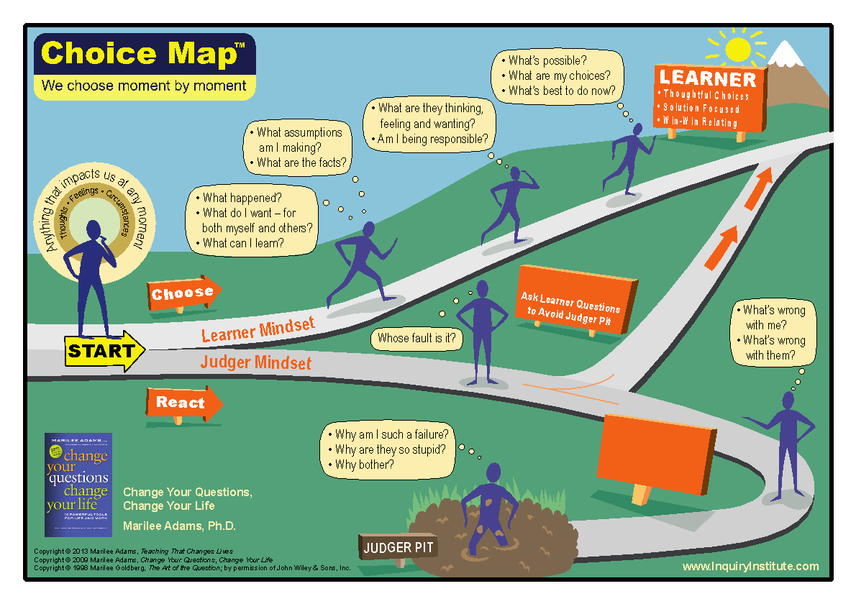
What would be
helpful about
using the
Choice Map?
Notes:
Handout-card stock
From Marilee Adams
2 different mindsets: judger-reactive, who’s fault is it? Learner-uses SFQ’s-similar to ones used in SOP
Judger mindset is the default. Daniel Goleman said neuroscience is clear that the emotional brain responds to an event more quickly that the thinking brain. When we are in judger mindset our amygdala (mindbrain) can be disconnected from the prefrontal cortex which is where the learning happens
The challenge is to use the switching lane questions to calms us down, self soothe, re-regulate, and reconnect to the prefrontal cortex where the learner mindset thrives
If we stop and observe what questions we are asking ourselves we give ourselves the power to switch paths/mindsets
Note that we were granted permission to use this graphic; please don’t make a bazillion copies or repost it on the internet. And consider buying the book for all your leaders!

Slide 22
Notes:
https://calswec.berkeley.edu/programs-and-services/child-welfare-service-training-program/core-practice-model
*SUGGESTION IS TO PLACE THIS SLIDE AT THE END OF THE POWERPOINTS BOTH DAYS*
Remind folks of where to find resources on the CalSWEC website
Use leadership behaviors to create a healthy culture

