Slide 1
Online Learning
Common Core 3.0
Field Activities
Classroom Skill Building
Notes:
Sample: 2 second animated, branded Core 3.0 eLearning intro (can have simple sound effect)

Slide 2
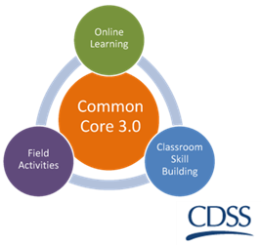
Training Title California Common Core Version 3.0 | 2016

Slide 3
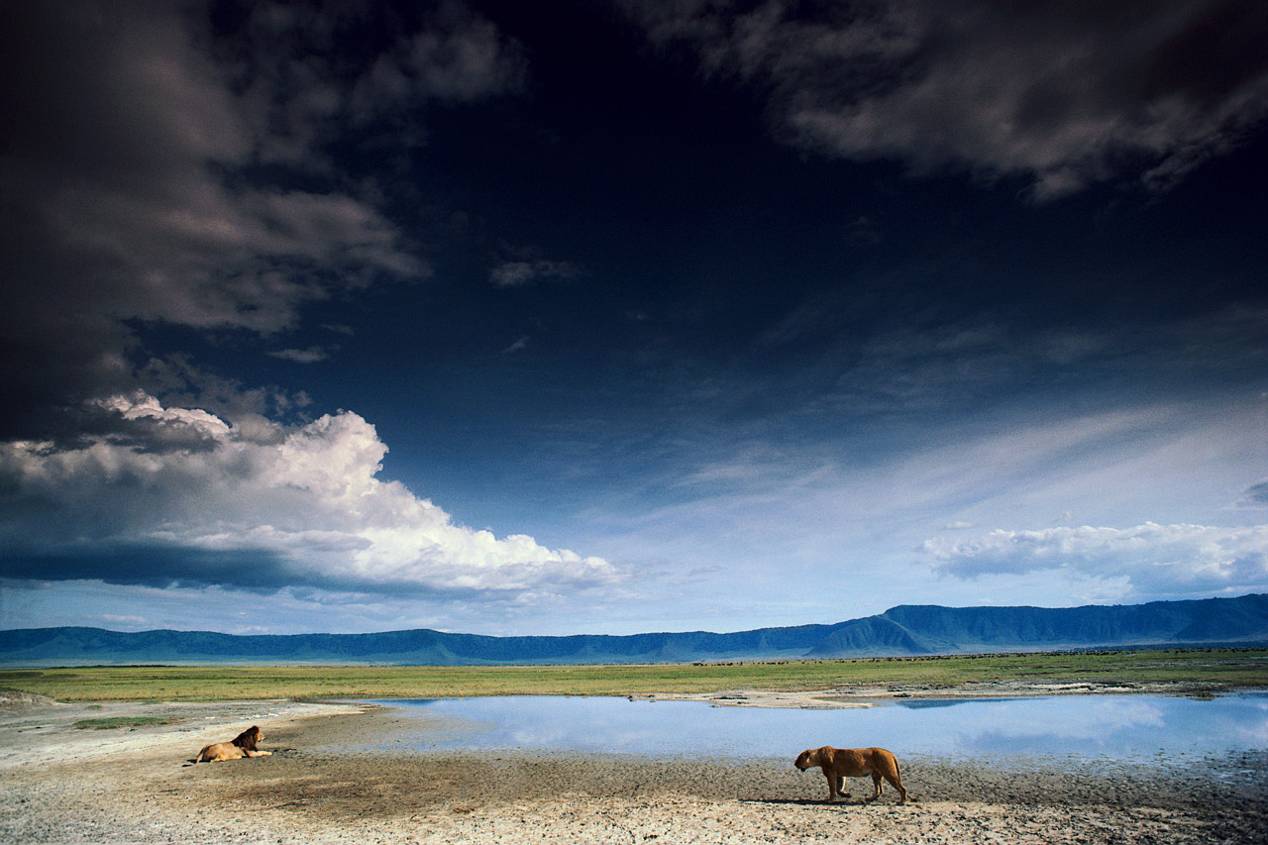
Overview of the Day
Welcome and Review of the Agenda
Learning Objectives

Slide 4
Group Agreements
Notes:
Be collaborative
Ask lots of questions – let us know what you think
Be open to trying new things
Be willing to make mistakes
Maintain confidentiality
Be responsible for your own learning

