Slide 1
Continuum of Care(CCR) Resource Family
Retention, Recruitment and Support Convening
August 21. 2015
CDSS 744 P Street, Sacramento
9:00 AM-3:00 PM

Slide 2
Meeting Goals
Explore Resource Family Recruitment & Support Strategies
Provide an Opportunity for County and State staff to discuss Challenges
Develop Statewide, Regional, and Local Action Steps
Identify Shared Learning Opportunities Going Forward

Slide 3
Today’s Agenda
Welcome
Core Practice Model (CPM) & Its Role in Retention, Recruitment and Support of Resource Families
CPM in Practice – Yolo County
Innovative Strategies in CA and Other States
  Lilliput, San Diego, CDSS and CWDA
Working Lunch: County Conversations (Four Regional Breakouts)
Large Group Discussion –Regional report out
Action Steps--Local, Regional, and Statewide

Slide 4
Welcome :
Karen Gunderson and Diana Boyer
Meeting Overview and Purpose
Resource Family Retention, Recruitment and Support Allocation and Planning Process

Slide 5
State Budget 2015-16
$17.8 million added for retention, recruitment and support
Activities may include – not limited to:
Staffing to provide and improve direct services to resource families (can be county staffing or hiring of foster parents as mentors or as trainers)
Removing barriers in areas found to be barriers to retention, recruitment and support locally.
Covering the costs of supporting the exceptional needs of children that is not covered by the caregiver-specific rate and that normalize the child’s experience, stabilize the placement, or enhance well-being.
Child Care
Intensive family finding, engagement and navigation.
Support for emerging technologies, evidence-informed strategies, or other nontraditional approaches to outreach to potential foster family homes, resource families and relatives.

Slide 6
Core Practice Model (CPM) & Its Role in Retention, Recruitment and Support of Resource Families

Slide 7


Child & Family Team
Collaborate with placing agency in:
Assessment
Case planning
Placement selection
California Child Welfare Core Practice Model
CCR Vision: All children live with a committed, permanent and nurturing family.
Services and supports are tailored to meet the needs of the individual child and family being served with the ultimate goal of maintaining the family or when this isn’t possible, transitioning the child or youth to a permanent family and/or preparing the youth for a successful transition into adulthood.
When needed, group home care is a short-term, specialized and intensive intervention that is just one part of a continuum of care available for children, youth and young adults.
Short-Term Residential Treatment
Home –Based Family Care
Specified Staffing Qualification & Training
Cores Services available, including access to specialty mental health services for eligible children
Accredited
FFAs: Cores Services available, including access to specialty mental health services for eligible children
FFAs Accredited
Statewide Resource Family Approval
Additional Retention & Recruitment Funding
FFAs: On county request, provide services and supports to children in county-approved resource families.
Ability to approve resource families to facilitate transition to permanency.
Publically Available Performance Data
Notes:
The CCR vision must be realized within a context. The proposed changes depend on a systemic shift in practice to be fully realized. Counties, in partnership with CDSS, are implementing a California Statewide Practice Model which will provide that context. A Practice Model articulates how each youth and their family will be engaged when they come in contact with the child welfare system anywhere on the continuum using a child and family team.
The visual depicts the linkages of the main CCR Components. What we are proposing now involves two major placement settings:
Home- Based Family Care – Foster Family Agencies, Foster Families, relatives, non-relative legal guardians
Short Term Residential Treatment –New category for congregate care, providing high quality, short term, intensive mental health services and other core services
and supports

Slide 8
Notes:
Welcome
Acknowledgements

Slide 9

Guiding Vision
  California’s 58 counties embrace one practice model that guides their individual Child Welfare Services programs by integrating successful practices into a framework that supports the achievement of safety, permanency and well-being for children and their families in the Child Welfare Services system.
Notes:
Stuart
Share the guiding vision.

Slide 10
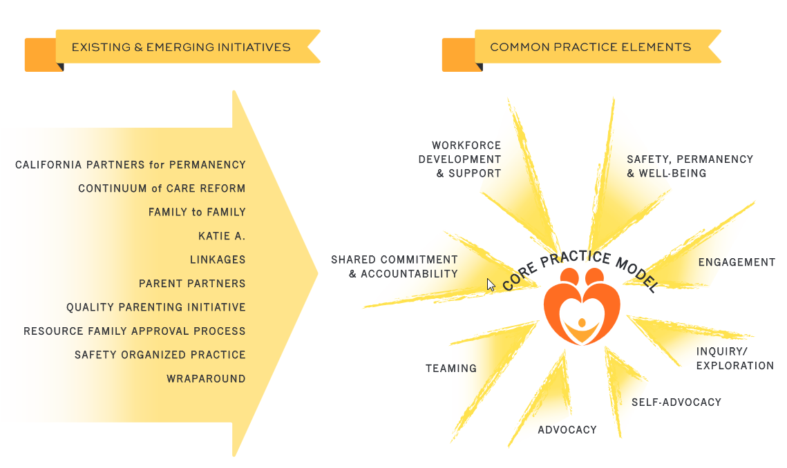
Notes:
Stuart
Our work has centered on building a model that is informed by and consistent with the existing and emerging initiatives in use in California.
The goal is to create a practice model that guides practice, service delivery and decision-making and builds on the great work already taking place by integrating key elements of existing initiatives and proven practices such as the California Partners for Permanency (CAPP), the Katie A. Core Practice Model, and Safety Organized Practice (SOP). The model will give meaning to the work currently in practice and improve accountability and outcomes for children and families.

Slide 11
Practice Model
Elements
Theoretical framework
Values and principles
Practice elements
Practice behaviors
Casework components
Notes:
Melissa
Explain that this model (like most) is made of 5 elements:
A theoretical framework that explains why we think our model will help
Values and principles that ground our work in a shared belief system
Casework components that identify what we do in our work
Practice elements that define key practices we use in our work
Practice behaviors that describe how social workers will use the model in their interactions with families, children, youth, caregivers, communities, and tribes

Slide 12

Theoretical Framework
Our theoretical framework is an organized set of explanatory principles that help us understand:
  What leads to the problem of child maltreatment?
  How can we work to prevent child maltreatment from starting or stop it once it has started?
Notes:
Melissa
Thank Dr. Anita Barbee from Kentucky for her expert consultation and assistance on this aspect of the model.
Our theoretical framework is an organized set of explanatory principles that help us ground our understanding of our work and guided us in our selection of values and practices.
We need this theoretical framework because our work involves preventing future abuse and neglect. In order to do this, we must try to understand:
What leads to the problem of child maltreatment?
What predictable processes are involved in child maltreatment?
How can our practice prevent the problem or process from starting or intervene once the problem has arisen?
How can we ensure our child welfare system that effectively sustain ongoing treatment and prevent future problems.

Slide 13
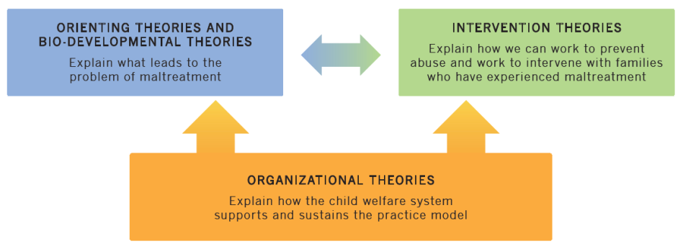
Theoretical Framework
Notes:
Melissa
We developed the framework in October-December 2013
Dr. Barbee reviewed relevant micro level and practice theories and presented them to the Practice Model Element Refinement Subcommittee
A subcommittee of the Practice Model Design Team reviewed the theories and identified the theories that best reflect practice in California
Dr. Barbee presented the identified theories to the Practice Model Design Team and to a statewide audience via webinar
Distribute theories handout. Explain theories.
We identified three types of micro theories:
Orienting Theories- These help set the orientation towards clients and work with clients in the child welfare system. Any child welfare casework practice model must choose at least one theory from this cluster to set the tone for all interactions with clients.
Neuro-Developmental Theories- These focus on the developmental nature of children and families. These approaches help us understand how and why maltreatment happens and how and why interventions work.
Intervention Theories- These help set an understanding of the process leading to maltreatment and specify what needs to change in order for maltreatment to end and safety to be ensured.
Plus a category for organization theories:
Organizational Theories- These help us understand how our system will support and sustain the practice model
Point out case example that can be used to operationalize the theoretical framework.
If anyone asks, explain that more information is available on the theoretical framework at http://calswec.berkeley.edu/california-child-welfare-core-practice-model
Explain that following the video Sylvia will talk about the next parts of the modes (values, components, elements). Transition to video.

Slide 14

Values
Our values provide an expression of an ideal or optimal state of being. They explain what we are striving for in our work with families.
Notes:
Sylvia
Explain that the values and principles were developed by a Design Team Subcommittee based on the work completed at a convening in the summer of 2013. This work included looking at the values identified in other efforts in CA such as CAPP and Katie A. to ensure the California Child Welfare Core Practice model was congruent with other practices and would encompass other practices in the state.
The values and principles have clear links to the identified theoretical framework.
The next slides lists our values.

Slide 15
Our Values
Evidence-Informed
Organizational Support
Respectful Engagement
Cultural Responsiveness
Partnership
Professional Competency
Permanency
Well-Being
Growth and Change
Safety
This is What We Believe
Notes:
Sylvia
Distribute handout with values, components, elements, and behaviors.
Point out the values in the handout.
We value safety, partnership, permanency, well-being, etc.
For each value, we have a further statement, or supporting principle.
For example, in support of the Well-being value, we say “Children, youth, and young adults are supported to achieve their full developmental potential. We work to help families function at their best. We offer effective, assessment-based services and supports that address well-being.”
We use “We believe” statements to convey our values and principles.
For example, the for our well-being value, “We believe participating in culturally relevant, effective, assessment based services can help children, youth, and families achieve their goals and be their best.”
Play video clip now if you didn’t play it before

Slide 16
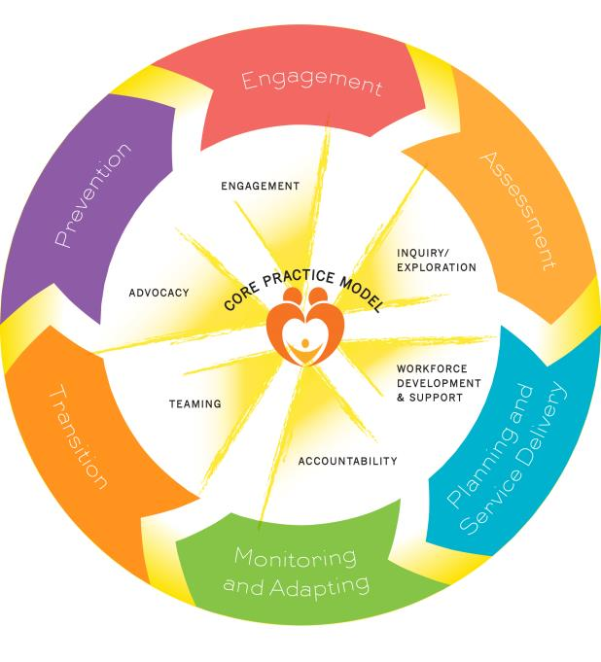
Casework
Components:
This is What
We Do
Notes:
Sylvia
With the Casework Components,
Prevention
Engagement
Assessment
Planning and Service Delivery
Monitoring and Adapting
Transition
we reach a more concrete level within the practice model in which we begin to define exactly what it is we do. These are the broad categories that describe WHAT we do in our work with families. The theories and values we discussed inform HOW we do these tasks – and you’ll see that expressed more clearly in the next slide when we talk about the Practice Elements.
These components may be familiar to you as they are also identified in the Katie A. Core Practice Model (which fits under the umbrella of the California Child Welfare Core Practice Model).
It is important to remember that the casework components are not linear, but represent the ongoing work of social workers and families.

Slide 17

Practice Elements: This is How We Do It
Engagement
Inquiry / Exploration
Advocacy
Teaming
Accountability
Workforce Development and Support
Notes:
Sylvia
Practice elements define how the model proposes to embody its values and enact its theoretical basis at the practice level and they link the model’s values and principles to the core aspects of practice that are essential to the model's success.
The practice elements in the California Child Welfare Core Practice Model are the broad actions we take to promote safety, permanency and well-being for all children and youth. We address safety, permanency, health, education, spiritual, and other family and youth needs through engagement, inquiry and exploration, and ongoing partnerships with families, youth, and their supportive communities and tribes.
For each of these elements, we identify HOW we do the work and the HOW is informed by our theoretical framework and our values. For example, within the Teaming element, we include: “We facilitate dialogue with families and their teams to ensure that we understand their point of view. We collaborate with youth, families, and their teams in assessment, decision-making, and planning.”
As with the casework components, it is important to remember that the practice elements are not linear, but represent a description of how we practice in every interaction as we work with families.
Transition to Jennie.

Slide 18

Practice Behaviors
Provide direction to practitioners about how they will practice social work using the practice model.
Notes:
Jennie
In addition to the macro benefits of practice behaviors, they also help on a micro level, by giving social workers a clear idea of how to do their job.
Think back to your first day on a new job… Wouldn’t it have been nice to know what you were doing?

Slide 19
Behaviors
Be open, honest, clear, and respectful in your communication.
Be accountable.
Listen to the child, youth, young adult, and family and demonstrate that you care about their thoughts and experiences.
Demonstrate an interest in connecting with the child, youth, young adult, and family and helping them identify and meet their goals.
Notes:
Jennie

Slide 20
Behaviors
Identify and engage family members and others who are important to the child, youth, young adult, and family.
Support and facilitate the family’s capacity to advocate for themselves.
From the beginning and throughout all work with the child, youth, young adult and their family, engage in initial and ongoing safety assessment, risk assessment, and permanency planning.
Notes:
Jennie

Slide 21
Behaviors
Work with the family to build a supportive team.
Facilitate the team process and engage the team in planning and decision-making with and in support of the child, youth, young adult, and family.
Work with the team to address the evolving needs of the child, youth, young adult, and family.
Work collaboratively with community partners to create better ways for children, youth, young adults, and families to access services.
Notes:
Jennie

Slide 22
Behaviors
Work with the family and their team to build a plan that will focus on changing behaviors that led to the circumstances that brought the family to the attention of the child welfare agency and assist the child, youth, young adult, and family with safety, trauma, healing, and permanency.
Work with the family to prepare for change in advance and provide tools for managing placement changes, social worker changes, and other significant transitions.
Notes:
Jennie
Transition to Melissa for crosswalk of practice model with IV-E MSW Competencies.

Slide 23
Next Steps
Counties and CDSS
  Identify organizational factors necessary to create environment for implementation
  Identify resources necessary to support counties in implementation
  Identify counties to pilot implementation
Notes:
Stuart

Slide 24
Relevance to CCR
Behavioral approaches that support the objective of engaging Resource Families in achieving the safety, permanence and well-being of children and youth
Many counties already embody the spirit of he Core Practice Model in their work with Resource Families
Yolo County has agreed to share their approach

Slide 25
Core Practice Model
In Practice:
Yolo County Resource Family
Approach
--Alissa Sykes
--Cherie Schroeder

Slide 26
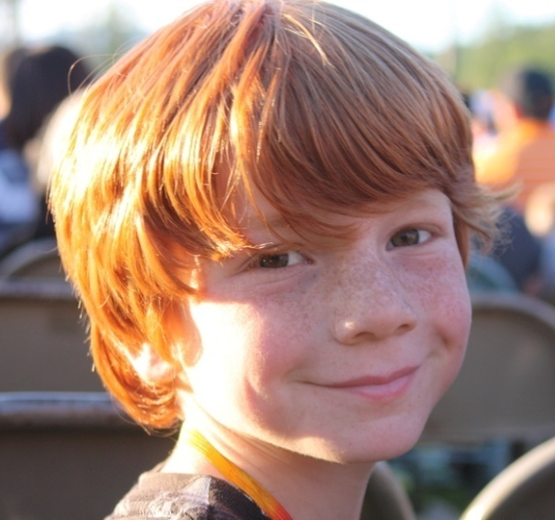
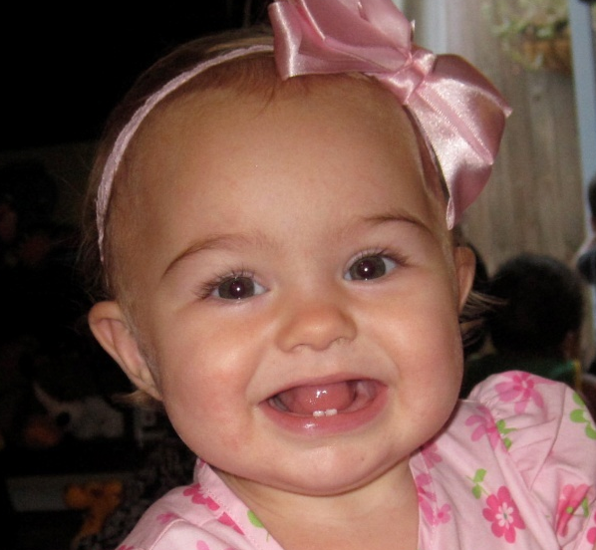
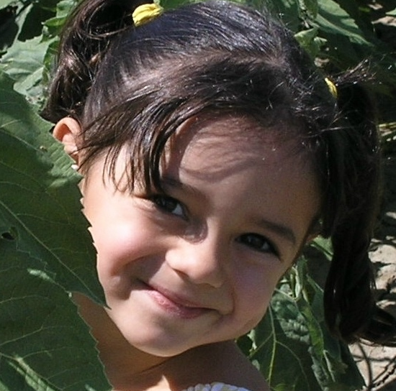
Yolo County Children Adopted from Foster Care
Because You Care…
Retention, Recruitment & Support
Yolo County and WCC Foster & Kinship Care Education
in Partnership

Slide 27
Our Goal is to Build a Sustainable System of Local Caregivers through:
    Recruitment
    Education
    Retention

Slide 28
Foster Parent Recruitment
www.yolofostercare.com webpage
Video
Press Releases in Local Papers
Regular Positive Articles
Calendar
Parent Recruiters & Word of Mouth
Banners, Posters, Billboards
Awareness: Presentations to School, Parents Groups, Service Clubs, Churches and more…

Slide 29

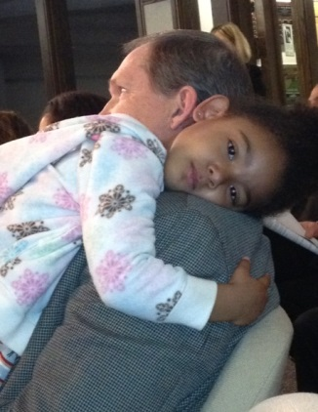
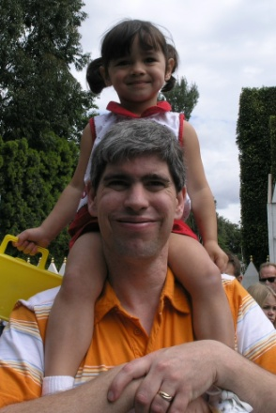
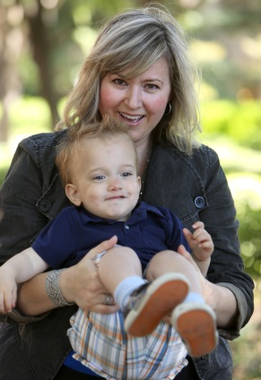
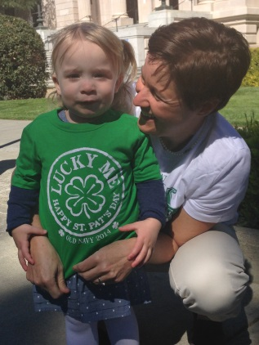
We Value Our Caregivers
Building a Fostering Community
Based on Mutual Respect

Slide 30



Program Enhancement through Grants
Board of Supervisors

Slide 31

When they “sit up and take notice”
We want to hold on to the respect of our Community
& to Build Public Awareness toward Foster Care

Slide 32

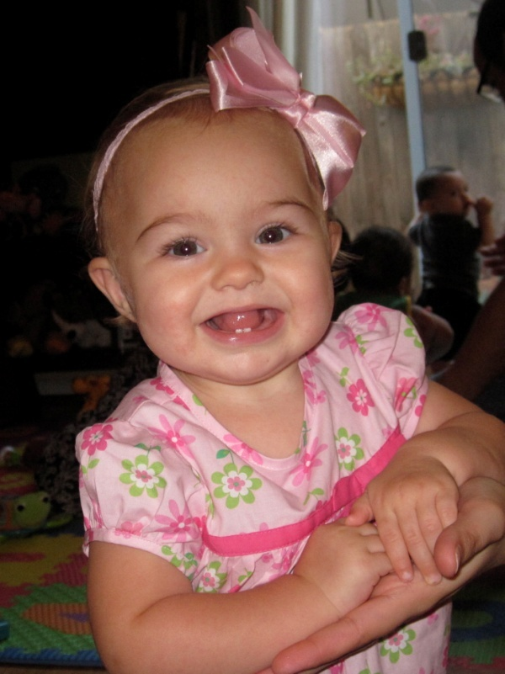

http://www.yolofostercare.com/
FKCE Stands For Care... .
The Woodland Community College Foster and Kinship Care Education (FKCE) program serves Yolo County foster parents, kinship/relative care providers, and individuals interested in becoming foster parents or in adopting a child.
Watch our video to meet several of our amazing families.

Slide 33
Recruitment Efforts

Slide 34
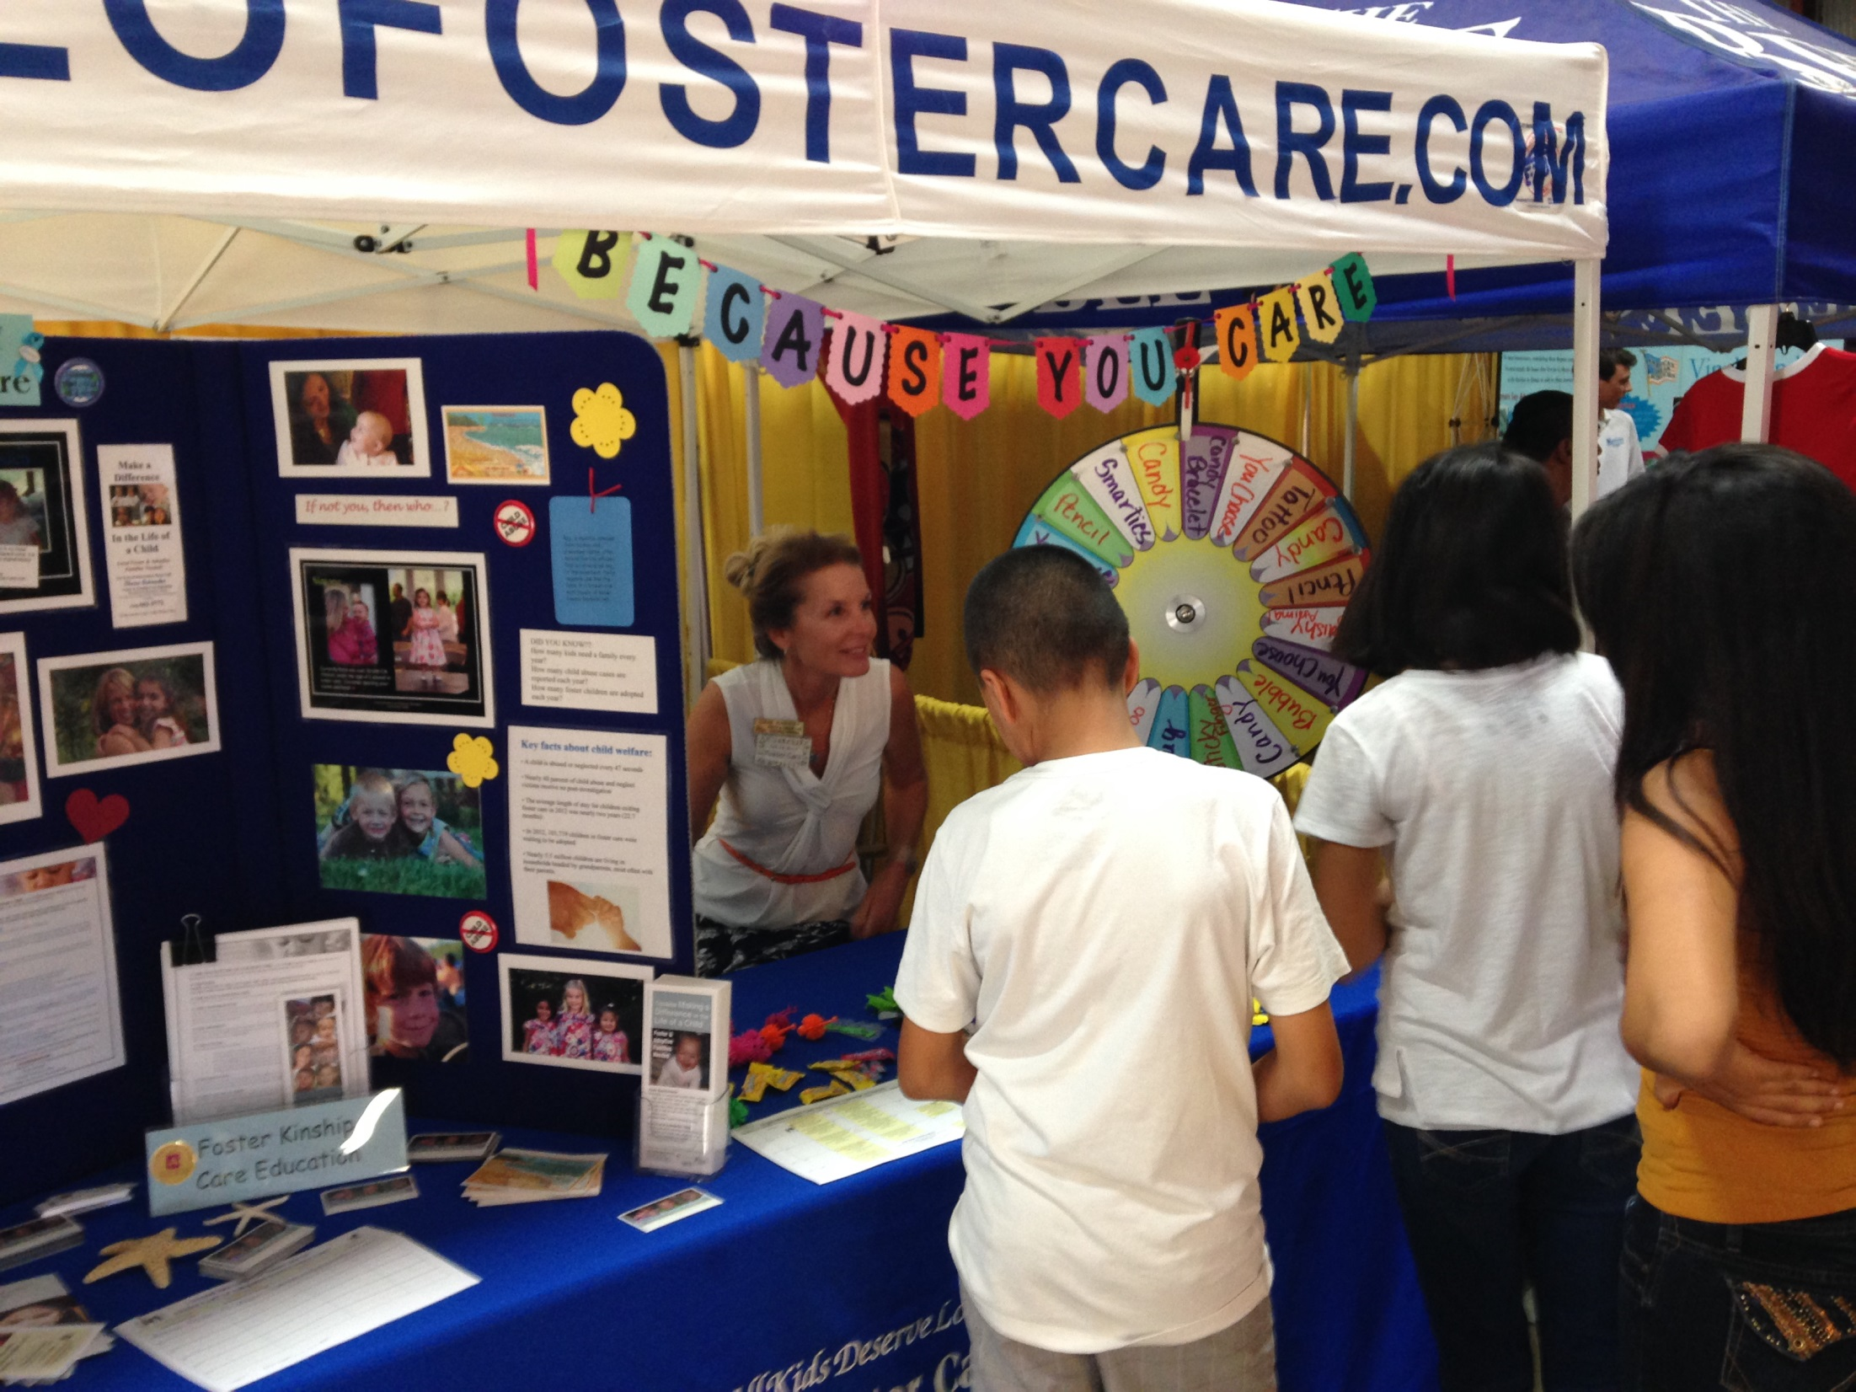

Slide 35
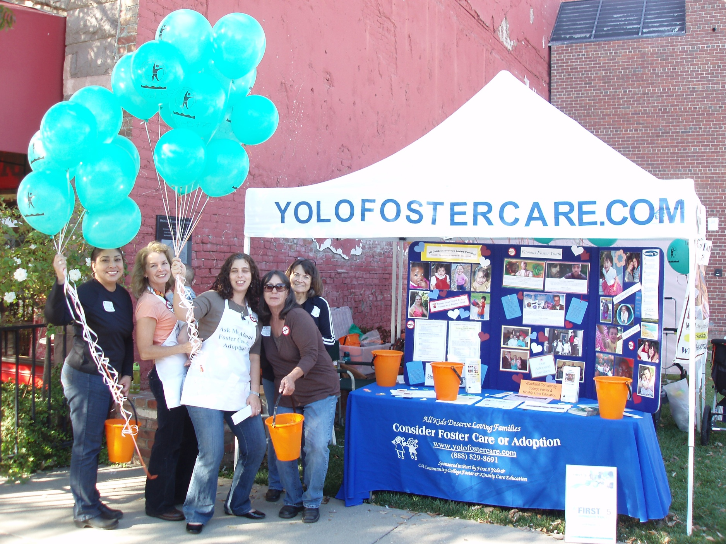
Recruitment Efforts

Slide 36
Foster & Kinship Care Education

Slide 37
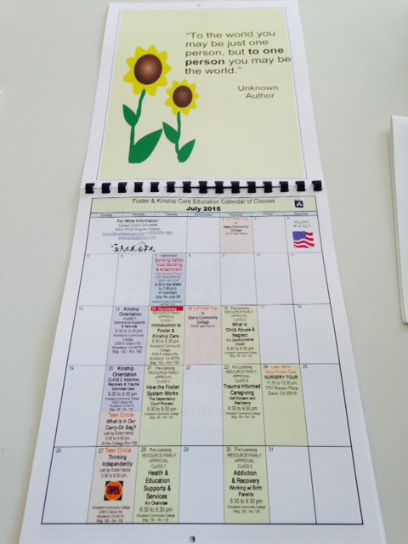
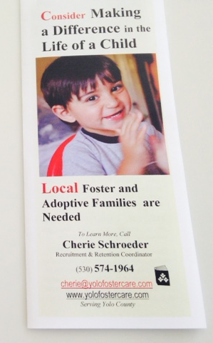

Slide 38
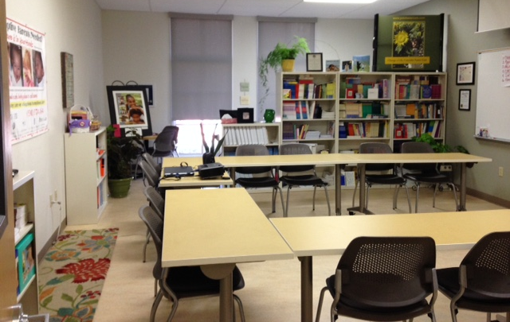
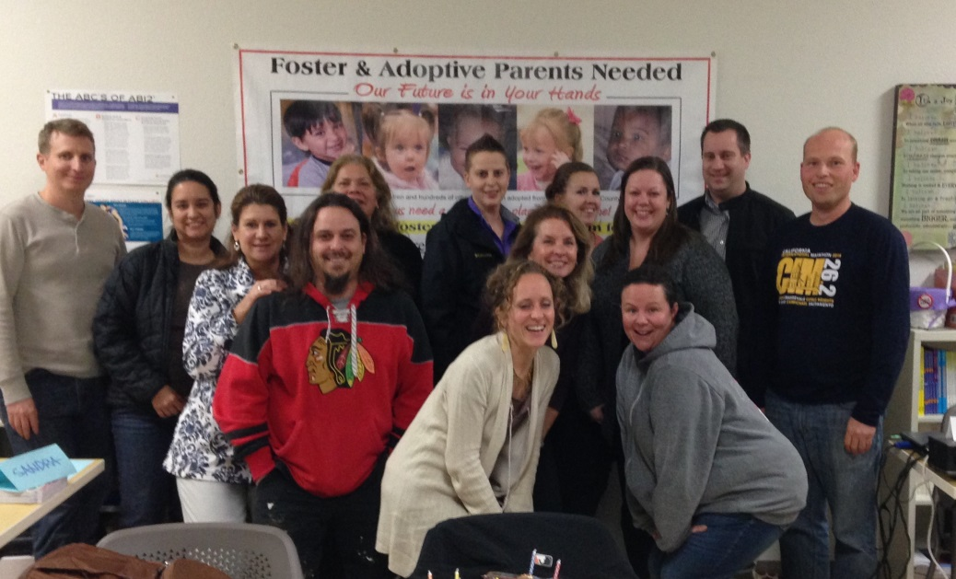
FKCE Program at WCC
Dedicated Foster Care Classroom
700 + hours of classes:
  Foster & Kinship
  Pre & Post Placement
  Caregiver & Youth
  Caregiver & Infant
  Lending Library
  Yearly FKCE Calendar

Slide 39
Foster & Kinship Care Education
Established at WCC in 1985
2014-2015 STATS: 581 Unduplicated Attendees 155 Foster Parents 102 Prospective F. Parents 60 County Social Worker 96 Professionals 71 Relatives 92 Other (Group Home, Nursery, staff, etc.) 201 Classes 766 Hours of Training Provided
SERVICES PROVIDED: Foster Care Education Pre-Licensing Classes Kinship Orientation On-going post foster care education Provides mandated curriculum areas: LGTBQQ, Non-Discrimination/Diversity Education, Self-Esteem, Child Development, Pregnancy Prevention, After 18 preparation Foster Parent Leadership

Slide 40
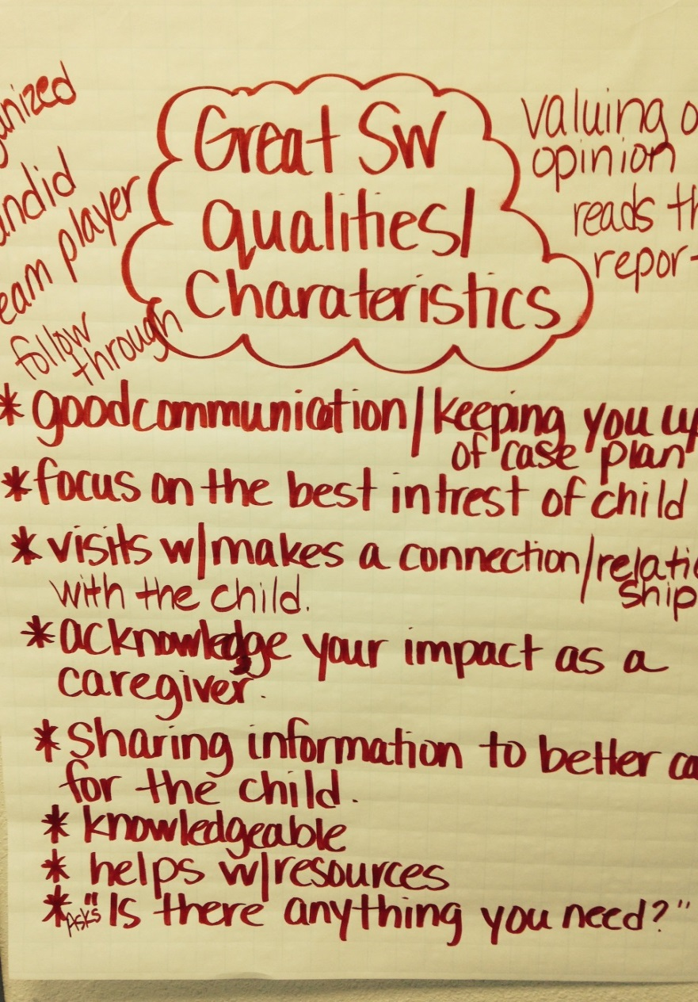
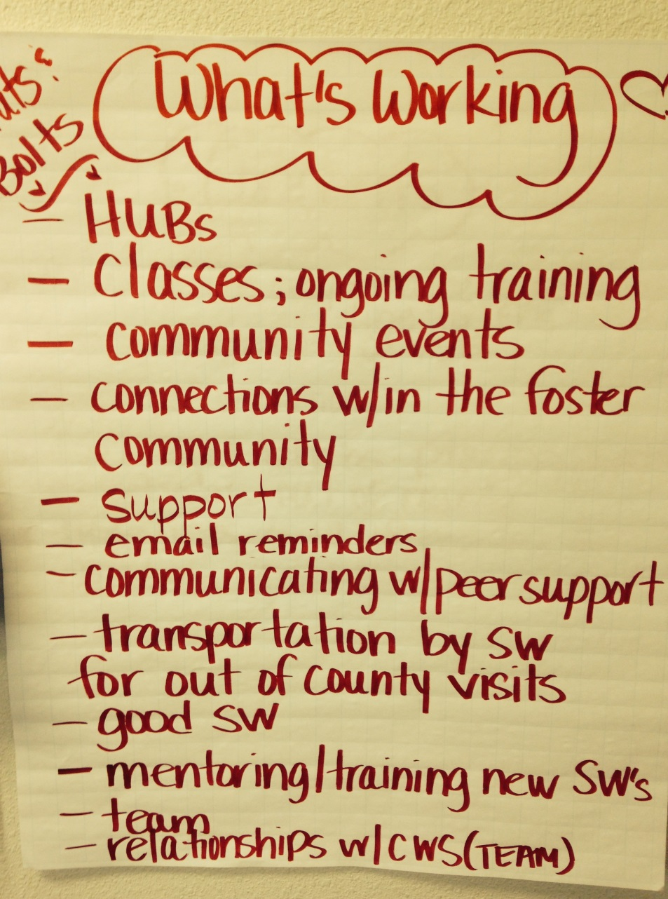
Nuts & Bolts Refresher Classes

Slide 41
Retention
Social Worker/Foster Parent System of Mutual Respect
Hubs – a Model for Support
Foster Parent Peer Mentors
Essential Placement Shopping $200 Target Gift Cards
Closed Foster Family Facebook Page
Foster Family Parties, Picnics & Gatherings
Recruitment & Retention Coordinator – a Direct Line

Slide 42
Foster Family Hubs
An experienced Foster Parent Peer Leader.
Organized by community & ages of children in placement.
In each principle city of Yolo County.
On-going contact, particularly at time of placement and transition.
Assist with FKCE training, leadership, advisory, and party planning.

Slide 43
Hub Goal
Formal System of Support
  Welcome in newly licensed foster parents.
  2. Support families when taking a new
  placement.
  3. Provide on-going connection of support.
  4. Facilitate retention with assisting as
  needed with visitation, respite, etc.

Slide 44
Chinese Proverb
Tell me and I forget.
Teach me and I remember.
Involve me and I learn.
Let me help, and I feel
valued.

Slide 45
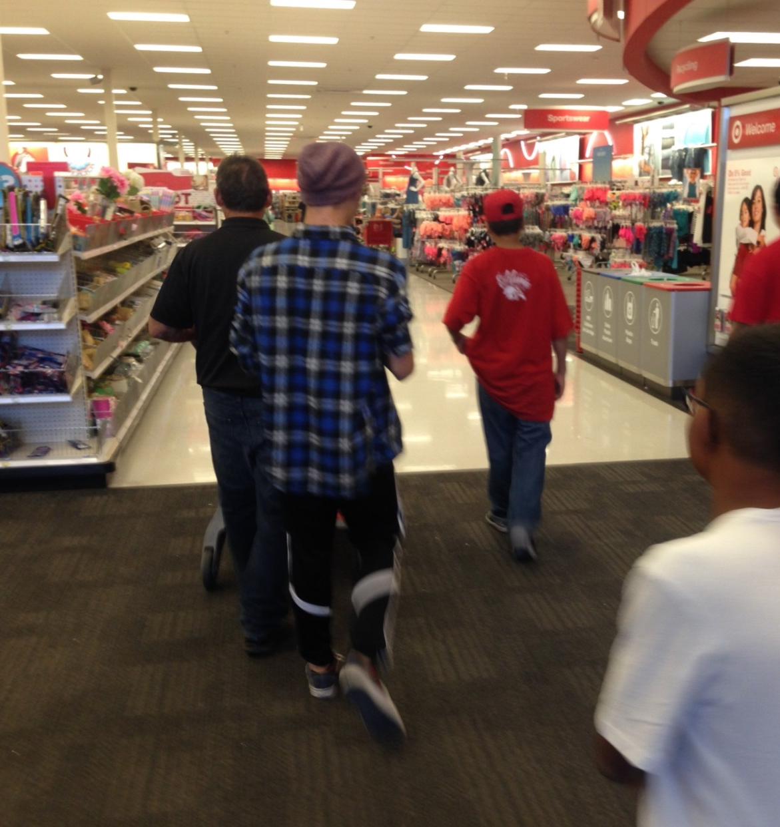
Target
Essential Shopping

Slide 46
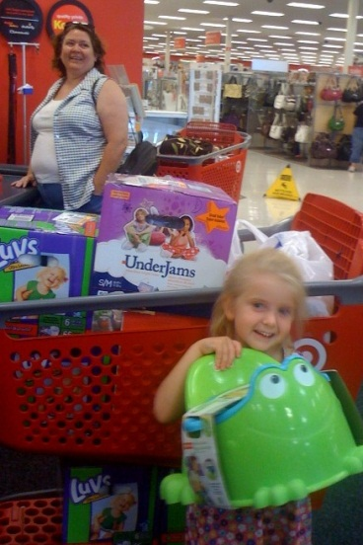
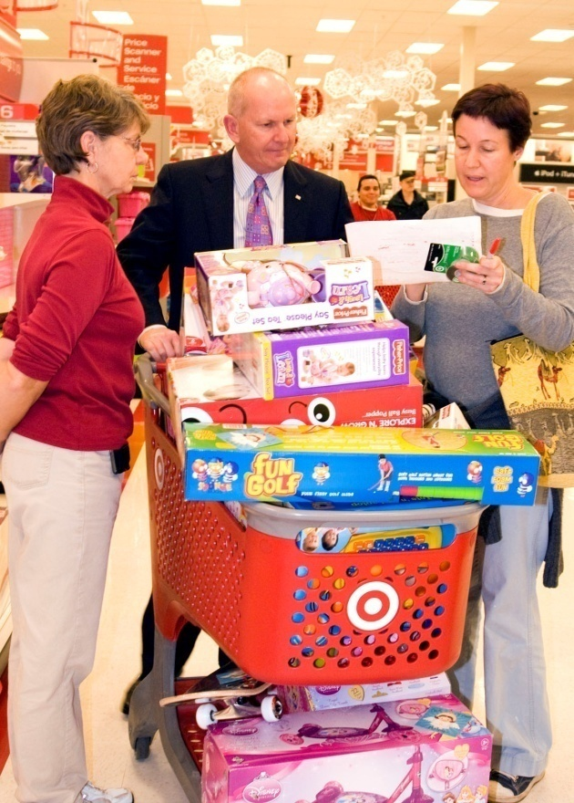
Retention & Support
Shopping at Target for Christmas Gifts
With Community Support we have Fantastic Gifts from Santa each Year!
Gifts are purchased and given to
children living in foster and relative care in Yolo
County
Partnership with Target Woodland
Promotes retention and a cherish love for children
who find themselves placed into foster care

Slide 47

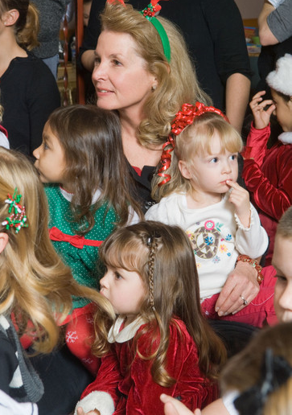
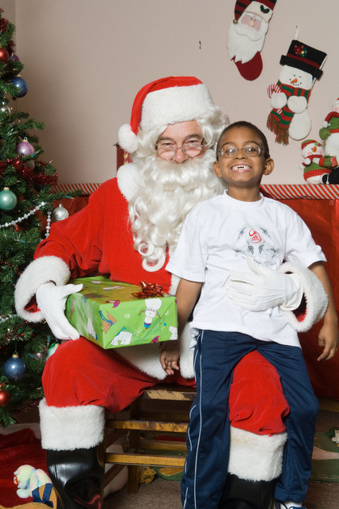
Holiday Parties
We Celebrate in Style
Foster Family Party with Santa

Slide 48
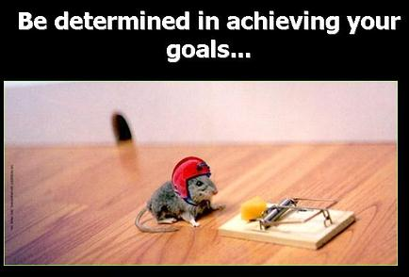
Don’t let fear stop you!

Slide 49
Contact Information
Alissa Sykes
Branch Director II
Child, Youth and Family Services
Yolo County
25 N. Cottonwood Street
Woodland, CA 95695
Alissa.Sykes@yolocounty.org
(530) 666-8483

Slide 50
Innovative Strategies in California
& Other States
Karen Alvord, Lilliput
Beverly Johnson Lilliput
Roseann Myers, San Diego County
Diana Boyer, CWDA
Karen Gunderson, CDSS
Jessie Wood, CDSS

Slide 51
Lilliput
Family Finding & Relative Support Efforts

Slide 52
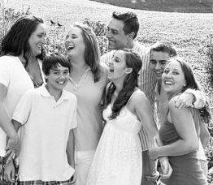

Slide 53
Our Journey into Kinship Care
History of partnership
  1990’s Foster Homes to Permanency
  2007 Kinship Support Services Programs
  2009-2012 Kinnections Initiative
  2013 Family Finding & Foster Certification of Relatives

Slide 54
Federal Connections Grant:
A Public/Private Partnership
Sacramento County (2008)
  4,000 children in foster care
  24% formal kinship placement rate
  Disproportionality
Major Goals
  Increase kinship placements & connections
  Support kinship placements
  Establish permanency

Slide 55
Guiding Principles
Prevention and early intervention
Relatives considered first
Strength-based with a strong value to keep children safely in their families of origin
Shared decision-making

Slide 56
Kinnections Initiative
Major Components
  Intensive Family-Finding
  Kinship Navigation & Support
Target Population
  AA youth 0-17 years, 1st time entries
  Sacramento County

Slide 57
Discharge from Family Finding (N=191)
9/30/2009 to 6/30/2012
Notes:
Initially we were surprised by the % of Reunification with Birth Parent
Also pleasantly surprised by the birth parent willingness to sign consents
18.3% unsuccessful—no birth father connections had a huge impact,
birth mother was only child and no father
older children with behavioral challenges

Slide 58
Foster Certification of Relatives
Sacramento County 18-month pilot (2013)
Foster Certifying Kinship Families
  50 children/youth initial entry into care
  Time-limited

Slide 59
Foster Certification of Relatives
Intensive Family Finding
Kinship Assessment & Supports
  SAFE: Structured Analysis Family Evaluation
  Kinship-specific training
  Protective Factors Framework
  All licensing requirements are met
  CANS: Child & Adolescent Needs & Strengths Tool

Slide 60
Challenges
Relative motivation
Certification requirements
Payment inequity- federal eligibility

Slide 61
Successes
Relatives accept support & training
Families receive emotional support and mental health needs are addressed
Understand how to access the resources the family needs to participate in child’s tx
Connection to other kin caregivers
Healthier relationships with extended family
Understanding of permanency options

Slide 62
Promising Outcomes
Timeliness to permanency
  27 kids discharge
  85% permanency
    52% adopted or guardianship
      Avg. Length of Time: 12 months
    48% reunified with birth parent
      Avg. Length of Time: 6 months

Slide 63
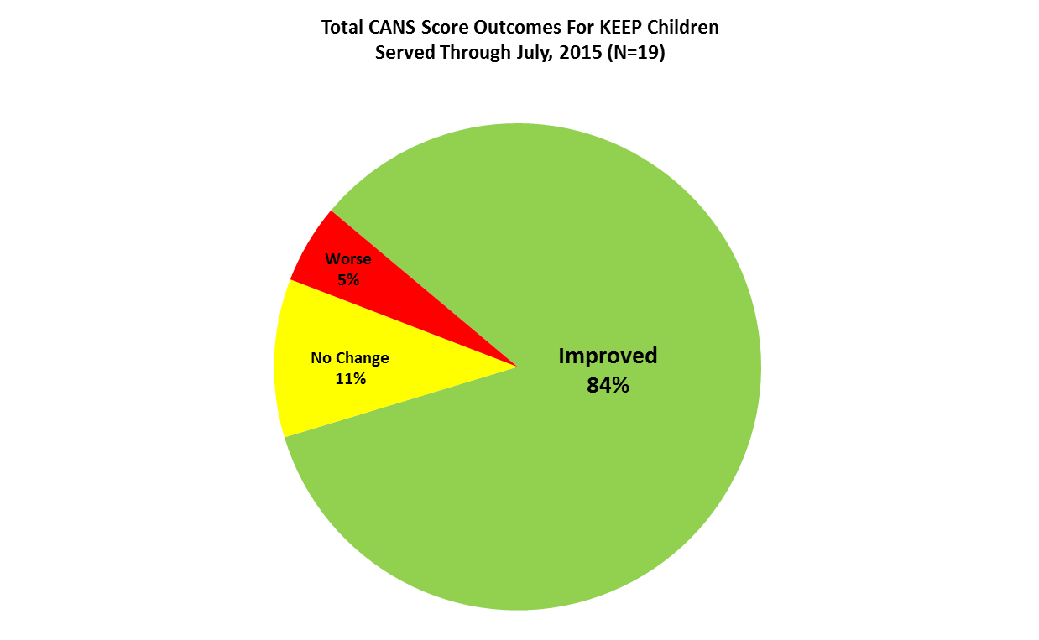
Promising Outcomes

Slide 64
“I don’t know what would have happened to my grandchild had it not been for Kinnections.” -Grandparent

Slide 65
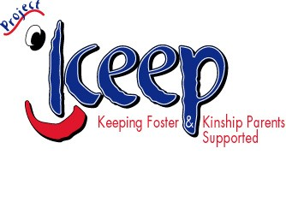


Project KEEP: San Diego

Slide 66
Evidenced Based Practice
Best Research Evidence
Best Clinical Experience
Consistent with Family/Client Values
“The world of social science does not speak with one voice, and even the best evidence can lead to multiple- and sometimes opposing conclusions.” Hoskins et al.

Slide 67
Overview
The need for addressing the behavior problems of children in foster care
Origins, content, and structure of KEEP Intervention
Summary of KEEP outcome research in San Diego County

Slide 68
Rationale for Interventions to Address Externalizing Behavior Problems
Externalizing behavior problems predict later maladjustment.
Bidirectional relationship between behavior problems and placement disruptions
  Reductions in behavior problems likely to lead to greater placement stability
  Placement stability likely to help prevent behavior problems
Surveys of foster parents indicate:
  Foster parents desire help in managing children’s behavior problems.
  Difficulties in managing behavior problems is one of the major reasons for foster parent drop out.

Slide 69
Predictors of Levels of Foster Parent Stress
(Perry & Price)
Level of Foster Parent Stress
Level of Child Behavior Problems
Level of Satisfaction in Being a Foster Parent
Perceived Support from Case Worker

Slide 70
Collaborative Relations Among KEEP Partners
Effectiveness Trial 1999 – 2005
Implementation Trail 2005- 2008
Social Advocates for Youth - Community Agency
Notes:
70

Slide 71
Intervention Model
Care givers provided with instruction and examples in Parent Management Training (PMT) and general group support by trained and supervised paraprofessionals.
Opportunities to practice skills with guided feedback.
Modeling of relationship style in group that is readily transferable to use with children.
In collaboration with caregivers, group leader stimulates parents to generate solutions based on their experiences with their child and with their family’s cultural and individual background.
Weekly follow-up phone calls with group facilitator to monitor progress and assist in application of materials.

Slide 72
Intervention
Support and skill enhancement education program
Foster and Kinship Caregivers
Children aged 5-12
16 weekly 90 minutes sessions
Interactive and participatory

Slide 73
Content of Group Sessions
(Children ages 5 to 12 version)
Welcome and Overview
Parents as Teachers – Importance of Cooperation
Parents as Teachers – Teaching New Behaviors
Using Charts and Incentives
Setting Limits
Discipline Strategies
Balancing Encouragement and Limit Setting
Avoiding Power Struggles
Pre-Teaching
Super Tough Behaviors
Promoting School Success
Promoting Positive Peer Relations
Managing Stress

Slide 74
KEEP Intervention Studies
Study 1 (1999 – 2005): Is the KEEP Intervention Effective in Reducing Child Behavior Problems and Impacting Placement Disruptions? Funding: NIMH
702 foster and relative families (359 treatment and 343 control) with a child between the ages of 5-12.
Study 2 (2005 – 2008) : Can Effects of the Intervention be Maintained when Delivered by Community Mental Health Provider?
100+ Families served-352 children

Slide 75
KEEP Intervention Studies
Study 3 (2009-2014): Can the Effects of the Keep Intervention be Generalizing to other children?
Funding NIMH
Examined the generalizability of the effects of the KEEP intervention (4 - 12 year olds) to other children in the home: to focal child and focal sibling.
Study 4 (2013-present) Can effects of the KEEP Intervention Continued to be Maintained when Delivered by Community Mental Health Provider? Funding SD Child Welfare

Slide 76
Predictors of Exits from Placement
Positive Exits
Kinship (kin vs. nonkin) – less likely to exit in kin homes
Days in placement at baseline – less likely to exit longer in placement
Intervention group (intervention vs. control) – more in intervention vs. control group
Negative Exits
Kinship (kin vs. nonkin) – less likely to exit in kin homes
Days in placement – less likely to exit longer in placement
Number of prior placements - 6% increased hazard for each prior placement

Slide 77
Key Findings
The KEEP intervention was effective in reducing behavior problems of children in regular foster care.
Improving parenting skills contributed to decreases in child behavior problems.
The KEEP intervention contributed to increases in positive exits (e.g., placement with a relative, adoption), and served to mitigate the negative influences of placement history on negative exits

Slide 78
General Conclusions
The KEEP intervention (improving parenting skills) was effective in reducing behavior problems of children in regular foster care.
The KEEP intervention can remain effective when delivered by a community agency that is unrelated to the intervention developers.
The KEEP intervention has remained effective for 10 + years, across an ethnically diverse population, two language groups, the transition from research effectiveness trial to county wide implementation, and changes in intervention and agency personnel. Children served in SD County: 944.
Training and supervision remain key components of effectiveness of the intervention.

Slide 79
Implementing KEEP in San Diego County
What was in place:
  Interest at CWS in implementing KEEP
  Intervention material and process guidelines
  Mechanism for training
  Supervisor and means of supervision
  Outcome assessments
  Meeting locations throughout San Diego County
  Foster parent community familiar with KEEP

Slide 80
Implementing KEEP in San Diego County
Challenges
  Obtaining funding
  Identifying community agency to deliver intervention: Social Advocates for Youth (SAY San Diego)
    Began in central region and expanded: 175 families served
    Hiring qualified facilitators
  Training agency staff
    In intervention model
    Recruitment procedures
    Evaluation of outcomes
Agency/Provider/Researcher partnership: Platform for new research - KEEP Reaching

Slide 81
Program Outcomes
2014-2015
Completion of 14 groups county wide
Served 33 foster, 49 formal kinship and
24 informal kinship caregivers
Decreased Parental Stress
Decreased Problem Behaviors

Slide 82
QUESTIONS?

Slide 83

What We Can Achieve
Every child grows up safe and nurtured.
Notes:
Safety Enhanced Together is not a new initiative, its not a new way of doing business, it’s a way to define who we are as a Child Welfare Organization in a consistent manner. By adopting the Safety Enhance Together practice framework, we’re building on what we’re already doing to foster team approaches to our work and actively engage families in the process. We’ve seen that clear plans and networks of support go a long way toward ensuring children’s safety, well-being, and permanent relationships. Thank you for helping CWS ensure that every child grows up safe and nurtured, and that children remain safely with their families whenever possible. By working together, we can all live well.

Slide 84
Innovative Strategies in CA & Other States
Quality Parenting Initiative
“Debrands” foster care – focuses on aligning foster caregiver expectations and CWS policies and practices.
CA Partnerhip Plan articulates mutual expectations
Engages relatives, county licensed and certified foster parents with county staff.
County specific strategies developed – not a “one size fits all” approach
18 Counties currently participating – facilitated by Youth Law Center
www.QPICalifornia.org for more information
September 23-24, 2015 Convening in Ventura

Slide 85
Innovative Strategies in CA & Other States
Mockingbird Family Model
Started in Washington State; spread to DC and Kentucky
Consists of one “Hub Home” and 6-10 foster/king families living within geographic proximity.
Hub Home keeps 2 beds open for respite/emergency care.
Hub Foster Parent provides support to the constellation, peer mentoring.
Hub Foster Parent paid a small stipend for their effort
www.mockingbirdsociety.org for more information

Slide 86
Innovative Strategies in CA & Other States
Targeted Recruitment – Anu Family Services
Private agency serving Wisconsin and Minnesota
Recruits resource families who are focused on healing and well-being. Example: Yoga and massage therapists
40 hours of pre-service training and 30 hours of annual training
Trainings arranged to accommodate working schedules
“Healing Parents” paired with other healing parents from the start
www.anufs.org for more information

Slide 87
Innovative Strategies in CA & Other States
Extreme Recruitment
Developed by the Foster and Adoptive Care Coalition for Missouri Children’s Division. Expanded to Illinois and Virginia.
Focuses on children in the system in permanent placements lacking permanency – youth ages 10-18, sibling groups, youth with emotional, developmental or behavioral concerns.
Uses a Private Investigator + Extreme Recruiter (CWS/specialist)
Private investigator finds at least 40 family members and meets personally with those relatives.
Extreme Recruiter manages the engagement and transition for the relatives and youth.
Strong youth engagement component.
Low caseloads, team-based approach

Slide 88
Innovative Strategies in CA & Other States
30 Days to Family
Also Developed by the Foster and Adoptive Care Coalition for Missouri Children’s Division.
Focuses on front-end family finding. 80 family members at minimum in 30 days.
Identifies one primary relative caregiver and 1-2 back up relative caregivers.
Non-case carrying specialist social worker (helps 2-3 “cases” at a time):
--Collects information on relatives;
--Helps relatives complete licensing requirements;
--Facilitates communication with case worker and team;
--Attends all team meetings and court hearings to support the relative;
--Conducts follow up assessments on child and family functioning.

Slide 89
Innovative Strategies in CA & Other States
Resource Family Approval Process (RFA)
New Training Requirements for Relative Caregivers
--Better preparation for their role as foster parents
--Connects with other resource families
--Provides them with opportunities for shared learning experiences
--Helps to legitimize their role as a foster parent; sense of “value”
Permanency Assessments for all Resource Families
--Gives us more information early about their strengths and needs and can thus direct supports up front.
--Eliminates uncertainty that resource family won’t be approved for adoption
A natural fit with QPI.

Slide 90
Innovative Strategies in CA & Other States
California’s Connections Project
Wisconsin Recruitment

Slide 91
My Wish Campaign:
A Peace Corps style marketing approach for recruiting resource family homes for youth in care.

Slide 92
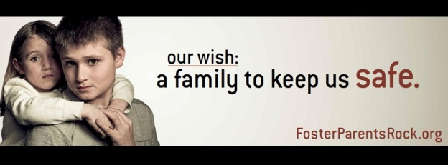

Slide 93
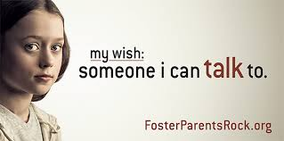

Slide 94
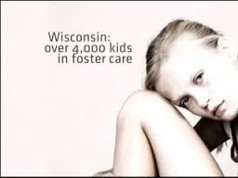

Slide 95


Slide 96


Slide 97


Slide 98
My Wish Campaign Resources:
www.fosterparentsrock.org
www.wifostercareandadoption.org
www.nrcdr.org

Slide 99
County Conversations:
What Would Success Look Like?
What Are You Doing Now?
What Are the Barriers to Implementing CCR
What Are Other Strategies/Needs to Address?

Slide 100
Room Assignments
Central Valley Auditorium
Southern Room 202
Bay Area Room 203
Northern Room 204

Slide 101
Next Steps
Regional Report Outs
Action Steps
    Local
    Regional
    Statewide

