Slide 1
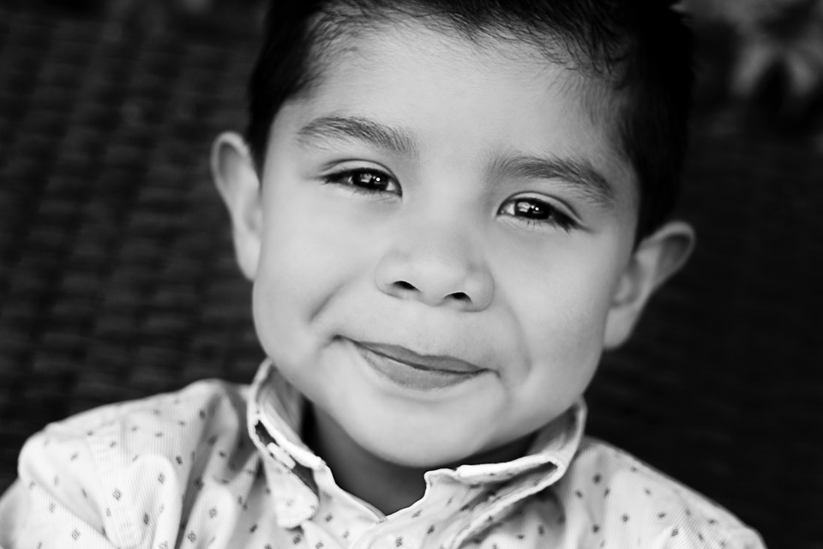
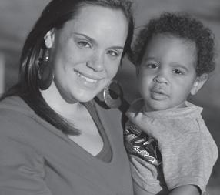
CFT TRAINING PART 1
FOUNDATIONS: CHILD AND FAMILY TEAMS (CFTs)

Slide 2
PURPOSE OF TRAINING
Develop standardized knowledge and implementation of Child and Family Team (CFT) practice to achieve and maintain fidelity to the CFT model, Integrated Core Practice Model (ICPM), and Continuum of Care Reform (CCR) requirements.

Slide 3
TRAINING AGENDA
The Historical Context of Team-Based Practices
What is a CFT?
Regulations and Requirements

Slide 4
Historical Context of Child and Family Teams (CFTs)

Slide 5
Reform Prior to Continuum of Care (AB 403)
Systems of Care (1985)
Wraparound (1997)
Mental Health Services Act (2005)
Child Welfare Redesign (TDM/FGDM) (2006)
Katie A. Class Action and Settlement (2011)
Local Control Accountabilty Planning (2012)

Slide 6
HISTORICAL CONTEXT: PROMISING TEAM-BASED EFFORTS IN CALIFORNIA
System of Care
California Partners for Permanency (CAPP)
Wraparound
Family to Family
Pathways to Well-Being (ICPM)
Team Decision Making (TDM)
Family Group Decision Making (FGDM)
Safety Organized Practice (SOP)
Residentially Based Services (RBS)

Slide 7
Pathways to Well-Being: Integrated Core Practice Model (ICPM) Overview
The ICPM requires a trauma-informed focus on engagement, assessment, service planning, delivery, coordination, care management, monitoring, adapting services, and transitioning when care is completed for all those serving children, youth, nonminor dependents, and families in California.
CHILDREN, YOUTH, NMDs, PARENTS, FAMILIES
Core
Components
Shared Values
Standards of Practice

Slide 8
HISTORICAL CONTEXT: THE NEED FOR SYSTEM REFORM
The Continuum of Care Reform (CCR) draws together a series of existing and new reforms to our child welfare services program.
CCR is designed out of an understanding that children who must live apart from their biological parents do best when they are cared for in committed, nurturing family homes.
CCR, also known as AB 403, provides the statutory and policy framework to ensure services and supports provided to the child, youth, or NMD, and his or her family are focused on improving safety, permanency, and well-being.
Reliance on congregate care should be limited to short-term, therapeutic interventions, which is just one part of a continuum of care available for children, youth, and young adults.

Slide 9
HISTORICAL CONTEXT: THE NEED FOR SYSTEM REFORM
CCR builds on California’s current reform efforts:
Approved Relative Caregivers (ARC) Program
Resource Family Approval (RFA) Program
Quality Parenting Initiative (QPI)
Pathways to Well-Being (previously known as Katie A.)

Slide 10
Child and Family Team (CFT) Foundations

Slide 11
What is a Child and Family Team?
Child and Family Teams (CFTs)
A CFT is a team comprised of the child, youth, NMD, family members, friends, foster parents, legal custodians, community specialists, and other interested people identified by the family and agency.
The CFT joins together to assess, understand, and assist trauma-exposed children, youth, NMDs, and families in trauma-informed ways.

Slide 12
WHO NEEDS A CFT?
Effective 1/1/2017, implementation of the Continuum of Care Reform requires that Child Welfare and/or Juvenile Probation Departments provide a CFT to all children, youth, and NMDs in foster care.
See All County Letter 16-84 and All County Letter 18-23

Slide 13
CFT VALUES
TRAUMA-INFORMED CARE
COMPREHENSIVE
SHARED
PLANNING
YOUTH & FAMILY
CENTERED AND DRIVEN
UNIQUE
AND
INDIVIDUALIZED
TRAUMA IS TREATABLE
needs driven
CULTURALLY
REFLECTIVE, RESPECTFUL,
AND RESPONSIVE
COLLABORATION
& INTEGRATION
STRENGTHS-BASED
OUTCOMES-FOCUSED

Slide 14
COMING TOGETHER AS A CHILD AND FAMILY TEAM
Example

Slide 15
CFT PROCESS AND MEETINGS
Trauma-Informed CFT Process:
Engagement
Communication/Collaboration
Assessment
Implementation of Plan
Coordination and Care Management
Monitoring and Adapting Services
Trauma-Informed CFT Meetings
A CFT meeting is distinct from the team itself
Provides meaningful opportunities for children, youth, NMDs, and families to participate in case planning
An opportunity for engaging the family and their service teams in thoughtful and effective goal setting while monitoring progress toward achieving goals
Can be requested by the child, youth, NMD, and/or family as needed
Timeline of meeting requirements outlined in ACL 16-84 and ACL 18-23

Slide 16
CFT TIMELINES
CFT meetings should occur at intervals according to the needs of the child/youth/NMD and/or family, along with timelines outlined in the All County Letter (ACL) 16-84 and ACL 18-23.
For children or youth in placement who are receiving Intensive Care Coordination (ICC), Intensive Home Based Services (IHBS), or Therapeutic Foster Care (TFC), a CFT meeting must occur at least once every 90 days. For children and youth who are not receiving SMHS, the placing agency will convene a CFT meeting no less than once every 6 months.
Best practice dictates that meetings should occur as soon as possible for, but not limited to, case planning purposes, placement determination, emancipation planning, and/or safety planning; therefore, frequency of meetings and timeframes varies.

Slide 17
CFT MEETINGS AND TIMELINES

Slide 18
CFT MEETING STRUCTURE
Greetings and Agenda
Confidentiality and Team Agreements
CFT Vision and CFT Meeting Purpose
Identification of Strengths and Needs (including, but not limited to, the Child and Adolescent Needs and Strengths Tool)
Goals
Brainstorming Ideas
Action Plan
Evaluation

Slide 19
CFT MEETING STRUCTURE
Greetings and Agenda
Start of Meeting
This meeting should not be the first time the child, youth, or NMD meets team members; team members should meet child, youth, or NMD prior to the CFT meeting
Leveling of Power:
Importance is placed on partnering
CFT recognizes that everyone has a role to play in a trauma-informed approach
Skeleton Agenda prior to CFT meeting
Agenda reviewed and adjusted within CFT meeting
Integrated Agenda
Inclusion of the Child and Adolescent Needs and Strengths (CANS) tool (In some cases, the Life and Strengths Domains)

Slide 20
CFT MEETING STRUCTURE
Confidentiality and Team Agreements
WIC code, Section 832(a)
Memorandum of Understanding (MOU)
Defining the collaboratively shared design, delivery, and management of services to children, youth, NMDs, and families in care
Team Rules/Agreements for CFT members’ relationship
Team Ground Rules/Comfort Agreements for CFT meetings
Release of Information form(s) (ACL 18-09)

Slide 21
CFT MEETING STRUCTURE
CFT Vision
CFT Vision: The team defines its purpose, goals, and objectives. The team shares responsibility to assess, plan, intervene, monitor, and refine services over time.
Example: Dino and his family will feel safe, supported, and will understand the CFT process and identified, flexible plan.

Slide 22
CFT MEETING STRUCTURE
Strengths
Use of CANS tool to identify strengths
Functional Strengths
Layers of a strengths-based approach
Belief in the resilience and ability of individuals to heal from trauma
Strengths to overcome circumstances
Strengths to use in CFT process
Strengths to be used to complete action items
Strengths of all team members are used in action planning

Slide 23
CFT MEETING STRUCTURE
Needs
People’s experiences and behaviors are understood in the context of coping strategies designed to survive adversity and overwhelming circumstances
Use of CANS tool to identify needs
Needs can be underlying conditions or causes for behaviors
Examples of needs:
Safety, respect, connection, being heard
Integrated concerns (include all team members)
Concerns across life domains
Focus on child, youth, NMD, parent, family voice

Slide 24
CFT MEETING STRUCTURE
Brainstorm Ideas
The CFT strives to understand and assist trauma-exposed children, youth, NMDs, and families in a trauma-informed manner
Exploring ideas to complete tasks and/or meet needs
Child/Youth/NMD/Family Voice is explored and prioritized
Ideas should be:
Trauma-sensitive
Strengths-Based
Child/Parent/Family Driven
Culturally Aware, Competent, and Respectful
Needs-Driven
Team-Focused
Developmentally Informed

Slide 25
CFT MEETING STRUCTURE
Developing Action Plans
Plans should be:
Strengths-Based
Child/Parent/Family Driven
Culturally Aware and Competent
Needs-Driven
Team-Focused
Integrated Across Systems of Care
Developmentally Appropriate
Detailed (who, when, what, where, and how)

Slide 26
CFT MEETING STRUCTURE
Evaluation
Authentic Voice and Choice
Leveling of Power within the CFT
Check in on:
Strengths and Areas of Growth of CFT meeting
Strengths and Areas of Growth of CFT processes

Slide 27
Share Example Plan(s)
ONE CFT INTEGRATED PLAN
The CFT works together through a trauma-informed approach to identify the child, youth, NMD’s, and family’s needs and strengths. This information is comprised of team members’ input, mandates and requirements, and safety recommendations. Information should also be included from any formal assessments.
In keeping with the Integrated Core Practice Model, all case plans should be trauma-informed, outcomes-focused, culturally sensitive, respectful, and responsive to each family’s needs. It is important to integrate the CFT case plan across systems, perspectives, and individual needs based on information shared by:
CANS tool
Child, youth, or NMD’s, family’s, and agency’s perspectives
Service providers’ perspectives
Family members’, community’s and natural supports’ perspectives

Slide 28
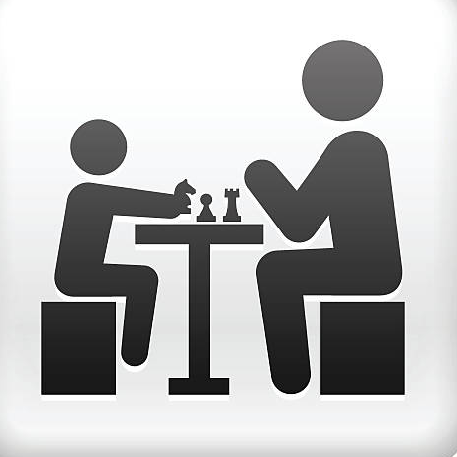
CFT ROLES AND EXPECTATIONS
Parent and/or Caregiver
Key team member with strengths, knowledge of needs, concerns, and ideas that work and might not work.
Mental Health Worker
Team member responsible for focus on psychosocial and behavioral needs. Responsible for representing the agencies with the child and team members.
Community Members
(CASA, Education, Ph.D. Health, AOD Expert, etc.)
Key team members who play a role in the child's life and bring subject matter expertise, resources, and strengths to the team.
Informal Supports
(coaches, pastors, best friends, uncles, others)
People who are part of the family's personal social network who want to aid in the child, youth, NMD’s, and family’s success. They bring strengths, resources, and knowledge to the team.
Child, Youth, Nonminor Dependent
Key team member with strengths, knowledge of needs, concerns, and ideas that work and might not work.
Facilitator
A trained and skilled team member who is responsible for team and meeting facilitation, including CFT process and CFT meetings.
Agency Worker
(Juvenile Probation and/or Child Welfare)
Team member responsible for convening the CFT and working with team members to develop the case plan. Responsible for representing the agency with the team.

Slide 29
CFT MEMBERS AND THEIR CONTRIBUTIONS
Team Members:
Understand how trauma can affect families, groups, and communities, as well as individuals
Bring their strengths, resources, needs, and ideas to the team
Build appreciation of input from all team members and balance the importance of the child and family voice and choice as a priority.
Build respect for the family’s culture, leveraging the healing value of traditional cultural connections

Slide 30
CFT MEMBERS AND THEIR CONTRIBUTIONS
Team Members:
Respect the trauma-sensitive CFT process and team agreements
Balance child, youth, NMD, and family voice and choice along with agency mandates and safety parameters
Public agency staff can meet their court or legally required duties while also practicing the trauma-informed values, activities, and principles of CFT

Slide 31
CFT MEETING AND OTHER TEAM MEETINGS
The CFT process is intended for collaboration in case planning related to the child, youth, NMD, and family while in care
CFT meetings are intended to integrate all team-based practices and behaviors to serve children, youth, NMDs, and families
The following are some of the team-based processes that can be integrated:
Team Decision Making
Safety Organized Planning
Wraparound Family Team Meeting
Multidisciplinary Team Meetings
Individualized Education Plan

Slide 32
CFT MEETING AND LOCAL INITIATIVES
EXAMPLES OF INTEGRATING PRACTICE MODELS AND INITIATIVES
SOP
FGDM
?
?
Wraparound
TDM
?
?

Slide 33
CFT MEETING
Observe a CFT Meeting

Slide 34
Practice Activity:
Part 1: Each group designs a vignette involving a CFT meeting.
Identify 5 team members that must be present at the CFT meeting. List their roles, strengths, and needs.
Part 2: Trade vignettes with different groups in the class; based on the vignette you have been assigned, assign team members and role play a CFT meeting.
Your goal for this practice CFT meeting is to:
-create a trauma-sensitive environment
-identify the team’s purpose
-identify 3 team agreements
-identify 1 priority-integrated need
-develop a strengths-based, culturally relevant, team-based action plan to address the need
Part 3. As a larger class, discuss the CFT practice meeting. Identify any concerns and what worked in your meetings.
Role Play a CFT Meeting

Slide 35
Each individual will write down 1 question based on the material presented in class
Each individual will write the answer to the question
Pass your questions and answers to the class presenter
As a larger group, and as time allows, answer the post test questions
Complete Post Test 1.0
Class Post Test

Slide 36
QUESTIONS OR ADDITIONAL NEEDS
CLASS EVALUATION
CLEAN UP
CFT TRAINING PART 1
FOUNDATIONS: CHILD AND FAMILY TEAMS (CFTs)

Slide 38
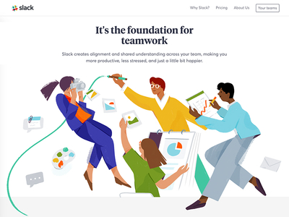
CFT TRAINING PART 2
SKILLS BUILDING AND PRACTICE:
CHILD AND FAMILY TEAMS (CFTs)

Slide 39
PURPOSE OF TRAINING
This course will focus on skills development for Child and Family Teams. The audience represents all persons who may be part of a CFT and/or a CFT meeting.
This course will provide opportunities for participants to practice and develop their team-based skills.

Slide 40
TRAINING AGENDA
Practice Engagement
Practice Fidelity to CANS
Practice Building Teams
Practice Shared Development
Practice Communication

Slide 41
Skills Practice Prep
In your group, construct a 3-5 sentence vignette in which a CFT meeting has team member(s) feeling disengaged.
Skills Practice Action
Trade vignettes with a different group. Now identify 5 skills for engaging the person(s) who are disengaged.
Skills Practice Discussion
As one large group, review each scenario and share trauma-informed engagement strategies.
Skills Practice Reflection
On your CFT Journal page, identify 3 skills you discussed today that you would like to add to your trauma awareness and engagement tool belt.
Practice Engagement
Trauma-Informed, authentic engagement skills, demonstrate strengths-based, needs-driven, and child, youth, NMD, and family-centered activities.

Slide 42
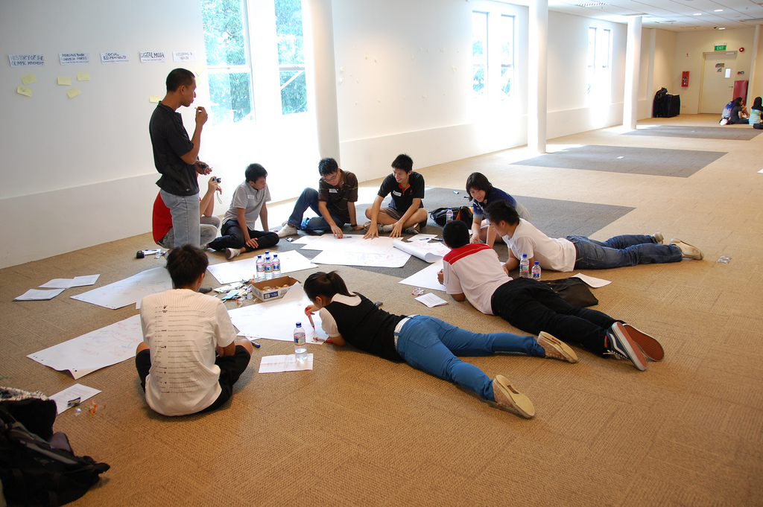
Skills Practice Prep:
As a class, discuss the use of CANS in a CFT process; discuss challenges and fidelity to the appropriate/accurate application of CANS.
Skills Practice Action:
Based on the vignette you created in the Engagement section, role play:
Introduce the CANS tool and its purpose
Practice using team members’ input to inform the CANS tool
Identify priority action ratings
Develop a case plan informed by the CANS
Skills Practice Discussion
In small groups, identify one way you see the CANS tool supporting CFT goals and identify one question you have related to the CANS.
In the larger group, review ways the CANS supports the CFT and answer questions together.
Skills Practice Reflection
On your CFT Journal page, answer the 3 true or false questions about use of the CANS in the CFT process.
Practice Fidelity to CANS
*Child and Adolescent Needs and Strengths

Slide 43
Skills Practice Prep:
In your groups, discuss the types of team members we could have on a team. Choose a person from pop culture that all team members know.
Skills Practice Action:
Brainstorm as many team members for the pop culture person. List as many as possible; try to get at least 13 people.
List reasons why people might not choose to participate in a CFT; choose the top 3. Find a partner and discuss how you could increase engagement of team members (team members include the child, youth, NMD, family, and others).
Skills Practice Discussion
As a large group, share your team member list and see who has the most.
Skills Practice Reflection
On your CFT Journal page, identify 3 types of team members that would be important to have on a CFT.
Practice Building Teams
Using a trauma-informed approach to engage and recruit team members to participate in the CFT process.

Slide 44
Skills Practice Prep:
In table groups, discuss the importance of the child and family voice and choice in the context of trauma-informed care. Identify 5 agency mandates that appear to conflict with FPY voice and choice
Skills Practice Action:
As a group, go through the 5 conflicts and brainstorm potential common ground. Partner with a classmate and choose the conflict that you see happening the most; with your partner, practice talking through the conflict as a parent or youth and an agency worker. Practice recognizing this situation as the result of varying impacts of traumatic stress on children, youth, NMDs, and families.
Skills Practice Discussion
In groups, discuss the impact of missed opportunities for common ground and instead moving into judgement or blame. Discuss how CFTs strive to build a climate and culture that supports trauma-informed approaches.
Skills Practice Reflection
On your CFT Journal page, write an entry describing a challenging situation in which you were unable to find common ground. Describe how you felt and then tried to remedy the situation.
Practice Shared Development
*Balance child, youth, nonminor dependent, and family voice and choice along with agency mandates and safety parameters.

Slide 45
Skills Practice Prep:
Review WIC code, Section 832(a), and review the Memorandum of Understanding (MOU), defining the collaboratively shared design, delivery and management of services to children, youth, NMDs, and families in care.
Skills Practice Action:
As a group, identify barriers to effective communication in a CFT meeting.
Discuss and brainstorm ways to overcoming CFT communication conflicts.
Choose partners and have 1 person express their concerns about a life situation. The other person listens to the conflict using a strengths-based, trauma-informed lens and reflects back what they are hearing. Partners switch sides and repeat.
Skills Practice Discussion
As a large group, discuss how you have seen confidentiality and record keeping managed successfully in a CFT.
Skills Practice Reflection
List any questions you have about sharing information/confidentiality in a CFT to discuss with your supervisor at a later date.
Practice Communication
*Effective trauma-focused team-based practices, including the participation of trained CFT Facilitators, the use of the CANS, CFT record keeping, sharing of plans, managing confidentiality and privacy, and other information.
According to WIC, Section 832(a) (1): “To promote more effective communication needed for the development of a plan to address the needs of the child or youth and family, a person designated as a member of a child and family team as defined in paragraph (4) of subdivision (a) of Section 16501 may receive and disclose relevant information and records, subject to the confidentiality provisions of state and federal law.”
THIS MEANS: The laws protecting privacy or information sharing should never create a barrier to treatment.

Slide 46
QUESTIONS OR ADDITIONAL NEEDS
CLASS EVALUATION
CLEAN UP
CFT TRAINING PART 2
SKILLS BUILDING AND PRACTICE:
CHILD AND FAMILY TEAMS (CFTs)

Slide 48
CFT TRAINING PART 3
SKILLS BUILDING AND PRACTICE:
CHILD AND FAMILY TEAMS (CFTs)

Slide 49
PURPOSE OF TRAINING
This course will focus on trauma-informed case plan development skills. The audience represents all persons who may be part of a CFT and/or a CFT meeting.
This course will provide opportunities for participants to practice and develop their team-based skills.

Slide 50
TRAINING AGENDA
Practice Developing Culturally Relevant, Trauma-Informed, and Developmentally Appropriate Case Plans
Role Play a CFT Meeting
CFT Pictionary
CFT Post Test, Evaluation, and Closing

Slide 51
Skills Practice Prep:
As a larger group, review your community’s local case plan, which includes input from the CFT. Identify the areas in the plan for strengths, needs, goals, services and action items. Using your pop culture person from the potential team member section earlier, choose 1 major area for which to develop a trauma-informed case plan.
Skills Practice Action:
As a group, practice building a trauma-informed case plan for this person. Be sure to identify initial strengths, needs, and then assign identified strength-based action items to team members.
Skills Practice Discussion
As a larger group, choose one pop icon from the class, identify one major need and then have each group write down the 3 most culturally relevant strategies to help the pop icon. Share your top three with the larger group.
Skills Practice Reflection
On your CFT Journal page, describe the difference between a need and a service or strategy.
Practice Developing Case Plans
Using a trauma-informed lens, build case plans that include input from formal and informal team members, assess needs, build on strengths, respond to families in an individualized manner, and utilize culturally respectful, responsive, and reflective interventions.

Slide 52
CFT STRUCTURE
Greetings and Agenda
Confidentiality and Team Agreements/Release of Information Form(s)
CFT Purpose (Initial and Ongoing Vision/Mission)
Identification of Strengths and Needs (including, but not limited to, the Child and Adolescent Needs and Strengths Tool)
Trauma-Informed Goals
Brainstorming Ideas
Action Plan
Evaluation
CFT Simulation Meeting

Slide 53
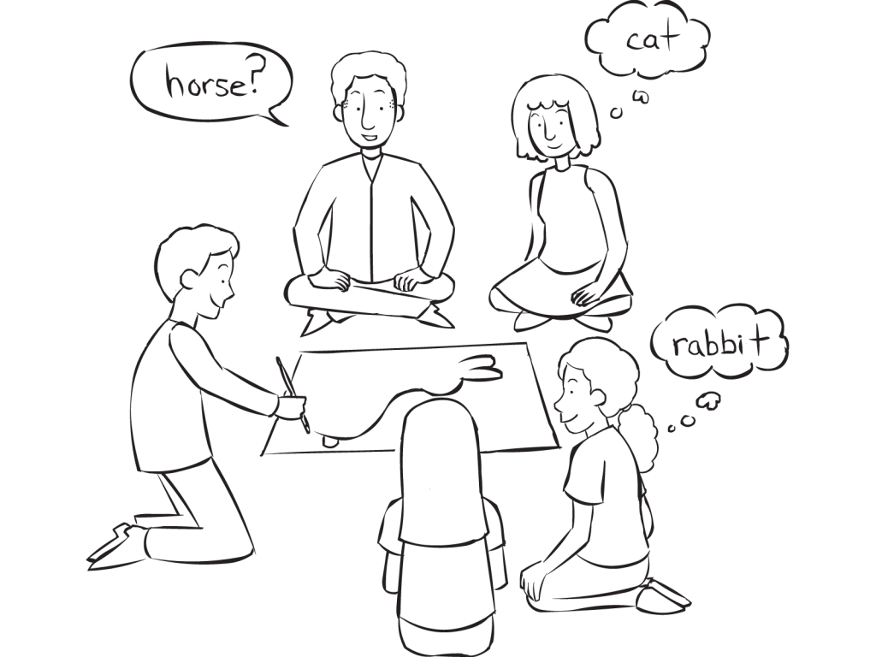
Practice Activity:
Part 1: On post-it notes, write down one CFT skill learned today. Reflect on what was taught, including the importance of maintaining a trauma-informed approach.
Part 2: Pass all the post-it notes in; the class facilitator will choose participants randomly to draw the skill. Team members will shout out their guess until the correct skill is identified.
This is our post test prep
CFT Gone Right or Wrong Pictionary

Slide 54
Complete Post Test

Slide 55
QUESTIONS OR ADDITIONAL NEEDS
CLASS EVALUATION
CLEAN UP
CFT TRAINING PART 3
SKILLS BUILDING AND PRACTICE:
CHILD AND FAMILY TEAMS (CFTs)

