Slide 2
WIDENING THE CIRCLE: BROADENING CPM AGENCY OWNERSHIP AND IMPLEMENTATION EFFECTIVENESS FOR BETTER ORGANIZATIONAL, YOUTH AND FAMILY OUTCOMES
Robin Jenkins, PhD
Notes:
Robin

Slide 3
Revisiting: The Core Practice Model Integration Definition
Integration means leaders adopting and using the CPM’s leadership and practice behaviors in the agency’s administrative/executive, day-to-day, and integrative (within and across the agency) functions to fully implement the CPM in alignment with other required or desired initiatives.
Notes:
Parallels to M-W: blending CPM into the administrative/executive, day-to-day and integrative functions to align/unite agency business practices, and incorporate into a larger “whole” that suggests the potential for better client/family, staff, agency and system outcomes. CPM is BOTH an agency and system intervention.

Slide 4
What CPM Integration Looks Like
SOP
CCR
Wraparound
California CANS
Begins here @ adoption
Notes:
Integrating CPM begins with intentional adoption and advocacy for the CPM as the foundation for all agency leadership and practitioner behaviors. Adaptive leaders then use their “smart people” – their leadership and management teams as well as others (at each agency level and including external stakeholders) to help design an implementation process that fits the agency’s environment. Note that all of this depends on COMMUNICATION and DATA feedback up and down system levels --- reinforcing the integrative functions along the way. During this exploration phase, the agency might engage in the Snapshot and Planning template activities, and select key priorities for initial implementation. Implementation teams are then constructed (repurposing 3-5 staff from existing teams where feasible), and ensuring folks with CPM competencies are on the team, to begin the work of initial installation and active CPM implementation and support. Implementation teams will attend to the “drivers” for successful implementation: organizational, leadership and competency drivers, implementing in stages, using PDSA or other techniques to evaluate implementation progress, linking implementation/management/practice teams for feed forward and feedback loops, begin to assess fidelity and several other key activities.

Slide 5
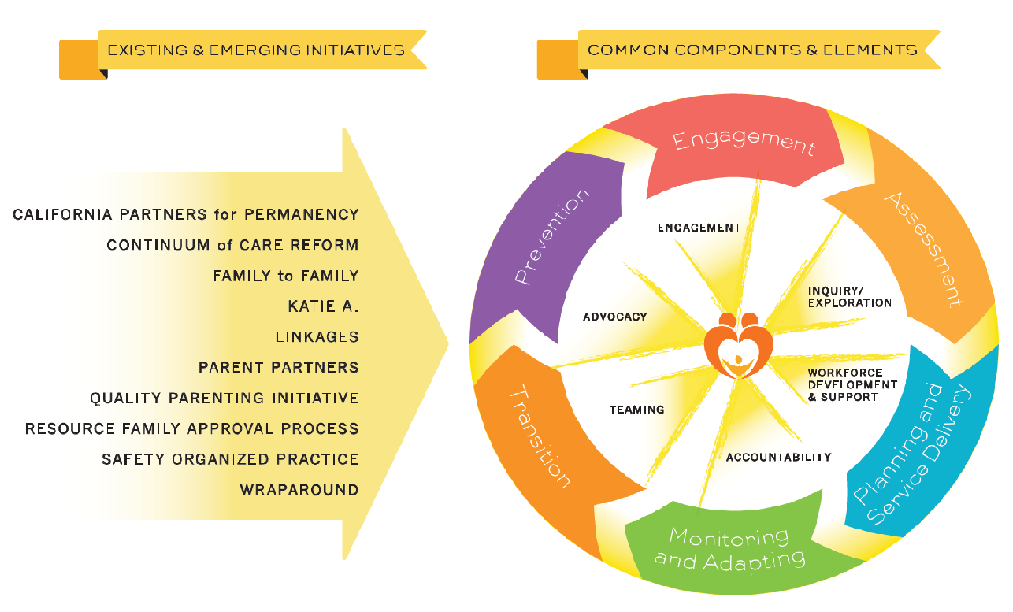
Widening Your Agency Circle with
CPM as the Foundation:
Casework components
Practice Behaviors
CANS
Notes:
Note that CPM provides the leadership, casework elements and practice fundamentals for each initiative “on the map”. All schools of social work and interpersonal counseling teach strengths-focused, solution-focused interventions to students. CPM wraps them into a nice, theoretically sound set of components and behaviors that enable better child/family, practitioner, agency and system outcomes when done well.

Slide 6
Remember the 4 Categories or “Buckets” Of CPM Implementation?
Organizational Readiness Building
Engagement, Relationships and Partnerships
Workforce Development
Quality, Outcomes and System Improvement
Notes:
To ensure that participants remember and refer to these buckets of work as integration and diffusion of the CPM throughout their agencies occurs.

Slide 7
CPM Integration Math (Roles, Activities, Actions)
CPM Implementation Process Owners (Agency Directors)
Process Champions (Senior and Middle Managers and Supervisors, Implementation Teams)
CPM Integration
Process Managers and “Do-ers” (Implementation teams, other staff and key stakeholders)
Notes:
Critical to note where the roles, key activities and ongoing actions of CPM integration are nested within organization levels.

Slide 8
Managing Circle Widening Processes Through CPM Integration
Ensure integration of CPM team structures, CQI, feedback, ongoing delivery/ performance (full system activation and integration)
Engage process managers/do-ers;
attend to day-to-day functions
Engage process champions; design implementation; attend to integrative functions (cross-agency)
CPM process owners adopt, develop and communicate agency vision for CPM; attend to executive functions
Notes:
Strategic integration: from Executive leaders adopting and framing CPM vision as the foundation for leadership and practice behavioral expectations, to designing and creating implementation teams, policies and procedures, CQI, workforce development, forging within and across agency partnerships, and developing/utilizing communications and messaging in proactive support of the CPM.

Slide 9
Widening the Circle is Change Management for CPM
DeAnne Aguirre, with Strategy & Business
Retrieved from: https://www.strategy-business.com/article/00255?gko=9d35b

Slide 10
Discovering and Engaging Your “Special Forces” for CPM
Don’t confuse communication for engagement – seeking grassroots up, and top-down input creates awareness of potential champions and informal leaders
Don’t confuse delegation for leadership – while leaders must delegate, they often lose track of important aspects of change causing disengagement, morale challenges, and implementation breakdowns
Create coherence – link communications, messaging, partner engagement to clear roles, responsibilities, and feedback loops
Look for incentives (non-financial, financial, social) to reward early adopters, champions, and motivated leaders/champions/do-ers

Slide 11
Revisiting “Strategic Coherence” (http://learningforaction.com/lfa-blogpost/strategic-coherence)
A master CPM integration plan mapping how CPM will serve as the foundation for RFA, CANS, CFT’s, SOP, etc. can drive clarification of roles, responsibilities, accountability structures and required resources

Slide 12
CPM Implementation and Circle Widening Process Owners 🡪 Leadership Behaviors
CPM Leadership Behaviors In Service to Broad Activation of CPM Implementation:
Model inclusive decision-making with staff at all levels across agencies and with partners using teaming structures and approaches to implement and support the CPM. (Teaming Behaviors for Leadership)
Seek input and perspective to develop solutions at all staff levels and with stakeholders. (Inquiry/Exploration Beh.)
Advocate for the resources needed to support and develop staff, and to provide effective, relevant, culturally responsive services for families. (Advocacy Behaviors for Leadership)
Support staff and hold each other accountable for sustaining the CPM by utilizing a practice to policy feedback loop that engages staff and stakeholders in data collection and evaluation. (Accountability Behaviors for Leadership)
Agency Executive Leaders

Slide 13
CPM Implementation and Circle Widening Process Champions 🡪 Leadership Behaviors
Agency Process Champions
Senior/Middle Managers
HR
Staff Development
IT
CQI
Policy
Communications & Networking
CPM Leadership Behaviors: Institutionalizing the Work:
Create regular opportunities to explore and affirm the efforts and strengths of staff and agency partners, fostering leadership through gains in skill and abilities, confidence, and opportunities to mentor others. (Engagement Behaviors for Leadership)
Advance mutually reflective, supportive supervision at all levels. (Inquiry/Exploration Behaviors for Leadership)
Work with families, youth, communities, and other stakeholders and peers as active partners in implementation of best practices, policy development, and problem-solving to support the CPM. (Teaming Behaviors for Leadership)

Slide 14
CPM Implementation and Circle Widening Process Managers and “Do-ers” 🡪 Leadership/Practice Behaviors
Agency Process Managers/Do-ers
Program Managers and Day-to Day Supervisors
Practice staff (front-line doing the work)
Support staff
Administrative and technical
Volunteers / advocates
Youth and families
CPM Leadership/Practice Behaviors – Making it Happen:
Model inclusive decision-making with staff at all levels across agencies and with partners using teaming structures and approaches to implement and support the CPM. (Teaming Behaviors for Leadership)
Identify and implement a transparent process at all levels to monitor for practice fidelity and effectiveness. (Accountability Behaviors for Leadership)
Promote advocacy by providing frequent and regular opportunities for Tribes, agency partners, staff, youth, families, and caregivers to share their voice. (Advocacy Behaviors for Leadership)
Work with the family to build a supportive team that engages family, cultural, community and Tribal connections as early as possible. (Teaming: Practice)
Demonstrate an interest in connecting with the child, youth, young adult, and family and helping them identify and meet their goals. (Engagement: Practice)

Slide 15
A Few Final Thoughts on Key Principles of Circle Widening through Managing Change
Involve every layer of your organization – change resistance is most prevalent in front line and 1st line supervisory staff. They deal with all of the pressures of clients, policies, systems and other requirements. Involve them early, often, consistently and in ways that lift their voices as well, rewarding participation
Role model, role model, role model: “acting your way into new ways of thinking and doing” (delegating is a necessary but insufficient leadership tool for ensuring active agency engagement and implementation)
Attend to culture: what you think (believe) is happening may or may not be your truth. Engagement affords “deep” agency diving into what is believed and and what gets done, despite management or policy. Use internal champions for change to evolve CPM culture
Notes:
Prompt audience – using the RTA questions as well as seeking examples of multi-layer involvement and why it is critical. How being a role model makes such an important difference.

