Slide 1
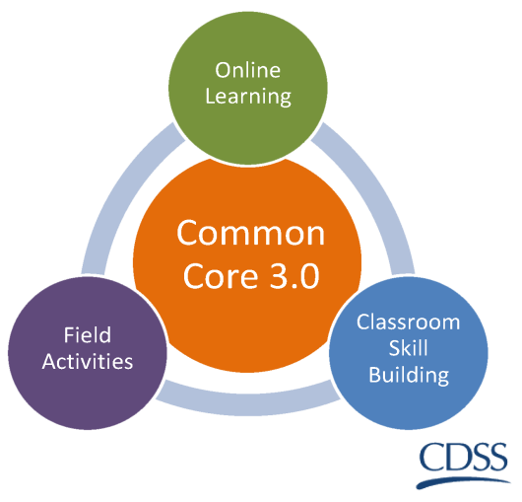
Common Core 3.0 Subcommittee Meeting
February 10, 20217
9:00-3:30

Slide 2
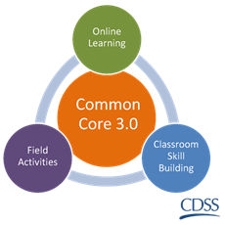
Welcome
Introductions
Group Agreements
Review Agenda
Agenda Additions
Notes:
Melissa

Slide 3
Previous Meeting Action Items
Completed update:
By C.O.B. Tuesday, November 29, RTAs will let CalSWEC know if they can partner to produce overview webinars
CDOG will discuss version numbering concerns to develop protocol
CDOG will explore/develop trainer consult/feedback process
CalSWEC will send a document outlining dates that e-learning courses will be released and synch dates and curriculum packaging dates
CalSWEC will try to prioritize Foundation Block posting to meet sequence recommendations
CalSWEC and item writers will seek to review text plans with curriculum developers on a voluntary basis
Macro eval will further refine the 8 standard level 1 questions

Slide 4
Previous Meeting Action Items
Need Status update:
TT will explore storyboards/transcripts for each on-line course to be available as a resource
RTAs will consult with trainers to decide if their info can be shared to a centralized trainer directory
Regions will share calendars to facilitate trainer peer observation to help with trainer prep
RTAs will encourage county participation in field activity pilots
CDSS will consider sequence concerns and develop clarified expectations
CalSWEC will provide a Qualtrics links with the level 1 questions to the regions

Slide 5
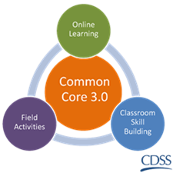
Common Core 3.0 update
Website Tutorial
On-line Trainer Discussion Forum
Revision Plan and Process

Slide 6
Implementation Updates from the regions
What do we need to prepare for February 2017 Implementation?

Slide 7
Online Learning
Updates on work from the Tech Team
Notes:
Mauricio

Slide 8
Field Training
Updates on work from the Field Committee
Development of Cultural Responsiveness field activity
Notes:
Joanne

Slide 9
Curricula
SDM and CMI
Notes:
Jennifer

Slide 10
Evaluation
Notes:
Sandhya

Slide 11
Closing and Next Steps
Next meeting:
May 12, 2017
9:00-3:30

