Slide 1
CPM LOGIC MODELING Navigating the Road to Implementation and Change
CA Child Welfare Core Practice Model (CPM) Directors Institute Webinar
Wednesday, April 18 | 10-11:30 AM
Notes:
Stuart or Danna hand off to Nancy Satterwhite (Slides 1-5; 10:02-10:08)

Slide 2
When those involved in using or supporting a new practice understand the theory behind it and contribute to the plan for change, they are more invested in the work and achieve better outcomes.
CPM logic modeling provides tools for engaging staff and partners in CPM change strategies, using data for improvement, and ultimately telling the story of CPM and its impact in the county.
Notes:
Nancy Satterwhite (Slides 1-5; 10:02-10:08)

Slide 3
Learning Objectives
3
Learn how the Snapshot and CPM Implementation Tools lead to a practical Logic Model process for your agency
Explore working examples of Logic Models based on simple implementation plan data
Engage teams of participants in active Logic Model planning based on Director’s Institute tools, resources, and sample templates
Notes:
Nancy Satterwhite (Slides 1-5; 10:02-10:08)

Slide 4
CPM Implementation Logic Modeling
4
CPM Director’s Institute
Sep 2017
Mapping Webinar
Nov 2018
Snapshot Webinar
Jan 2018
Messaging Webinar
Apr 2018 Logic Modeling Webinar
Mar 2018
Org Read Building Webinar
Feb 2018
Impl Planning Webinar
Today’s webinar builds on content from past webinars
Notes:
Nancy Satterwhite (Slides 1-5; 10:02-10:08)
**Mia – 6 clicks – one for each hexagon as Nancy briefly covers each webinar topic and a relevant takeaway.
Sep MAPPING WEBINAR – A process for aligning various local initiatives under the umbrella of CPM
Nov SNAPSHOT WEBINAR – Engage with others from the start - inclusive leadership and teaming (carries forward/deepens with LM work)
Jan 2018 MESSAGING WEBINAR - Understand strategies for targeting messages to specific audiences; apply communication and feedback loops
Feb IMPL PLANNING WEBINAR - Focus on your priorities and plan of action, build momentum toward the changes you want to see
Mar ORG READINESS WEBINAR - Keep a focus on using what you learn and bringing people along
SNAPSHOT & IMPLEM PLANNING WORK are designed to empower a planning team to help you steer the process. Overall - focus is not content, per se, but bringing people together across the agency and community to stimulate local thinking and action. CPM logic modeling builds on that process of teaming and collaboration to support quality implementation.

Slide 5
examines current reality, interprets results, identifies planning priorities
5
BUILDING BLOCKS
Supporting Quality Implementation and Outcomes
SNAPSHOT
IMPL PLANNING
LOGIC MODELING
strengthens focus on data & outcomes; creates a concise picture of local implementation efforts to share and encourage others’ interest, investment and support
develops implementation objectives and action steps in priority areas; identifies support resources for success
Notes:
Last Nancy slide, then hand off to Deanna (approximately 10:08)
**Mia clicks once to bring in logic modeling description after Nancy summarizes Snapshot/Impl Plan Processes
The snapshot and implementation planning processes are two primary building blocks to help counties set their CPM implementation course based on local strengths, context and needs.
CPM logic modeling can be an additional building block to help counties strengthen focus on CPM data and outcomes and move CPM forward locally. Today’s webinar will walk us through a practical approach for CPM logic modeling building on a county’s snapshot priorities and the local CPM implementation plan

Slide 6
CPM Logic Modeling
Navigating the road to implementation and change
Notes:
Deanna (hope to be here by 10:08)

Slide 7
Logic Model Insights . . .
7
If there was a time when you
or your agency were involved in
developing or using a logic model…
Share what worked about that process.
How was the logic model used/helpful?
Notes:
Deanna (10:09-10:15)
Ask participants to share their thoughts in chat – or can raise their hand to add verbally! ☺ Barry SF and Kristine Frerer SC will raise hands.

Slide 8
The Many Uses of Logic Models
8
For evaluation purposes
Communication tool with diverse audiences
Guide project planning and development
Manage a program or project
Guide local implementation effort
And more…
Notes:
Deanna (Slides 8-10; 10:15-10:20)
Deanna ties insights shared in previous slide to some of the things on this list. Helps audience move from this broad view of logic model uses to the focus of CPM logic modeling on implementation that we’ll focus on today.
Used for both new and existing programs and initiatives, for many years logic models have helped organizations conceptualize their change efforts and promote program success.
There are many ways to use logic model - from program design to implementation to evaluation.
It’s also been used as a communication tool with diverse audiences to build a shared understanding of what is to take place
When used for program evaluation purposes, they help ensure clarity about the outcomes you want to achieve, the evaluation questions you want to answer, and the data protocols and capacity to measure progress and understand results.
Today we’ll focus on CPM logic modeling as part of guiding local implementation efforts – it’s a tool to help counties keep a balanced focus on the big picture of quality implementation and its component parts.

Slide 9
CPM Implementation Logic Models…
9
Build on priorities in local implementation plan
Show how the agency is making changes to support and reinforce CPM
Point everyone toward the implementation outcomes they are collectively working to achieve
Suggest data and feedback loops that will
be helpful in navigating implementation
and change
Notes:
Deanna (Slides 8-10; 10:15-10:20)

Slide 10
Relies on CPM Leadership Behaviors
10
Accountability
Support staff & hold each other accountable for sustaining the CPM by utilizing feedback loops that engage staff & stakeholders in data collection & evaluation.
Identify & implement a transparent process at all levels to monitor for practice fidelity & effectiveness.
Engagement
Establish regular & frequent communication to encourage an active partnership that engages staff at all levels in implementation & system improvement.
Notes:
Final Deanna slide - Hand off to Leslie Ann (will probably be about 10:20)
**Mia clicks to bring in each subheading and leadership behavior as Deanna gets to each.
There are 3 particular Leadership Behaviors that are important for creating an organizational environment that supports using data for understanding, learning and system improvement. The first 2 are related to Accountability…..
The 3rd leadership behavior is related to Engagement….

Slide 11
Helps Answer Key Questions About CPM Implementation
11
Why are we implementing CPM?
Implementation Outcomes
What are we doing to get there?
Implementation Activities
How will we know it happened?
Implementation Outputs
Did we get there? Implementation Data
Notes:
Leslie Ann (10:20-10:35; Slides 11-23)
**Mia clicks to bring in each line as Leslie Ann focuses on Why, What, How, and Did we get there?

Slide 12
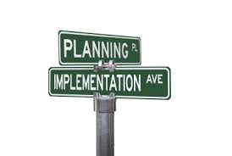
Planning for Results Monitoring for Change
12
Do we have a CPM Implementation Plan?
Did we do what we set forth in our Plan?
Did we do it with fidelity?
Did we achieve what we intended?
Notes:
Leslie Ann (10:20-10:35; Slides 11-23)
**Mia clicks to bring in each bullet as Leslie is about to cover it.

Slide 13
Three Keys to CPM Implementation Logic
13
Implementation
Activities
Outputs
Outcomes
WHAT YOU DO TO SUPPORT CPM
Changes IN
KNOWLEDGE,
SKILLS,
ATTITUDES OR
BEHAVIORS
TANGIBLE PRODUCTS
LEADS TO
LEADS TO
Notes:
Leslie Ann (10:20-10:35; Slides 11-23)
**Mia 4 clicks - first to bring in the 3 blue cells, then clicks to bring in the wording below each cell as Leslie Ann gets to each.

Slide 14
Three Keys to CPM Implementation Logic
14
Implementation
Activities
Outputs
Outcomes
Develop and Deliver
CPM 101 Curriculum to
All Staff
Completed Curriculum; Training Delivery Dates; Sign-in Lists show #/% of Staff Trained
Staff Knowledgeable
about CPM Values
and Behaviors
LEADS TO
LEADS TO
Notes:
Leslie Ann (10:20-10:35; Slides 11-23)
**Mia clicks 3 times – each click when Leslie Ann begins to give example under each blue cell.
Let’s look at the logical sequence of training as an example. From the training activities, to the products of curriculum development and delivery (completed curriculum and staff trained) to the outcome that the training is expected to lead to staff knowledge of CPM. Note that the 2nd and 3rd keys in the example have implications for data and feedback loops to understand if they are happening.

Slide 15
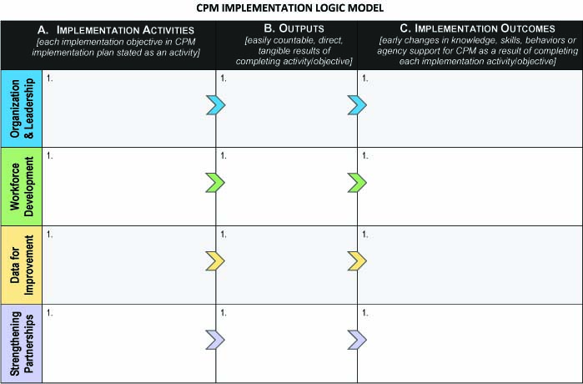
15
TEMPLATE
IMPLEMENTATION ACTIVITIES OUTPUTS IMPLEMENTATION OUTCOMES
Notes:
Leslie Ann (10:20-10:35; Slides 11-23)
Here’s an Implementation Logic Model template for CPM. We wanted you to see how the 3 columns: Activities – Outputs – Outcomes come together in the template, organized by 4 key areas of implementation that correspond to key elements of quality implementation (Organization & Leadership, Workforce Development, Data for Understanding & Improvement and Strengthening Partnerships for System Change).
Now let’s use a concrete example to walk through how a county might use this template to customize a CPM logic model that fits their needs.

Slide 16
“Any County”, California
16
We’ll refer to the fictional California county and CPM Implementation Plan that was used for illustration purposes during the CPM Implementation Planning Webinar (Feb 2018).
Helps you see how to bring the pieces of a CPM Logic Model together and logically tie the activities in your CPM Implementation Plan to outcomes and data for decision-making and improvement.
Notes:
Leslie Ann (10:20-10:35; Slides 11-23)
Emphasize we’ll use a hypothetical county for illustration purposes
Help everyone understand we’re really making it up in terms of assumptions used for this county.
Everyone’s snapshot, implementation plan, organizational readiness-building, etc. will look different, as will their logic models if they decide to create one.

Slide 17
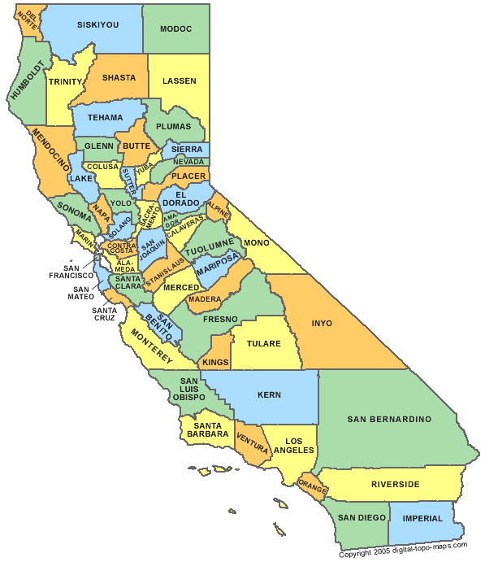
“Any County” Followed Building Blocks
(Fictional California county example)
SNAPSHOT
IMPL PLANNING
LOGIC MODELING
Notes:
Leslie Ann (10:20-10:35; Slides 11-23)
**Mia clicks once to bring in building blocks

Slide 18
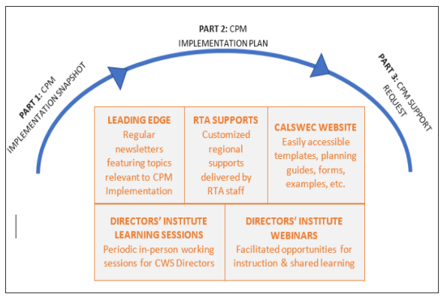
“Any County” Learned About CPM Implementation Planning
Notes:
Leslie Ann (10:20-10:35; Slides 11-23)
**Mia clicks once to bring in yellow arrow as Leslie Ann focuses on CalSWEC Website cell

Slide 19
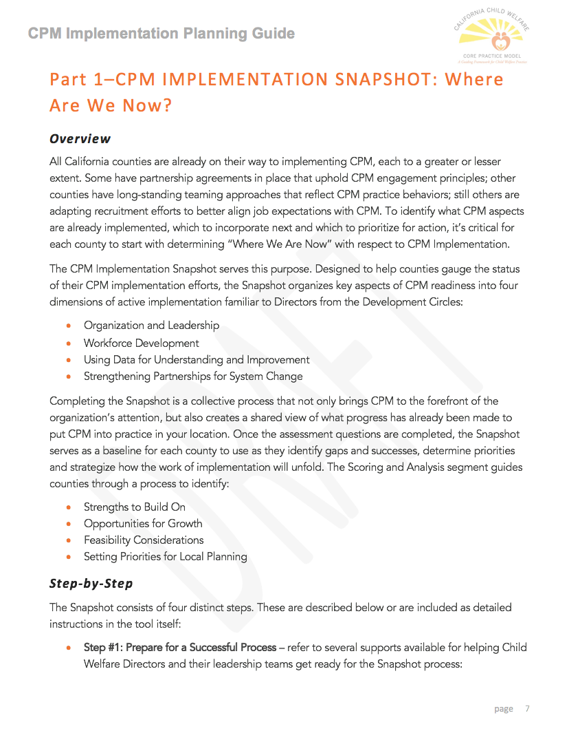
CPM Implementation Snapshot: Where Are We Now?
Notes:
Leslie Ann (10:20-10:35; Slides 11-23)
**Mia clicks once to bring in picture of Snapshot doc as Leslie Ann reminds of this document/process

Slide 20
CPM Implementation Snapshot: Where Are We Now?
Core Elements of Quality Implementation | Areas of Inquiry
Organization & Leadership | Strategic Direction ♦ Leadership ♦ Resources ♦ Teaming for Implementation ♦ Communication
Workforce Development | Recruitment/Selection ♦ Training ♦ Coaching ♦ Supervision
Using Data to Understand & Improve | Data Availability ♦ Data Utilization ♦ Logic Model ♦ Evaluation
Strengthening Partnerships for System Change | Engagement ♦ Relationships ♦ Partnership
Notes:
Leslie Ann (10:20-10:35; Slides 11-23)

Slide 21
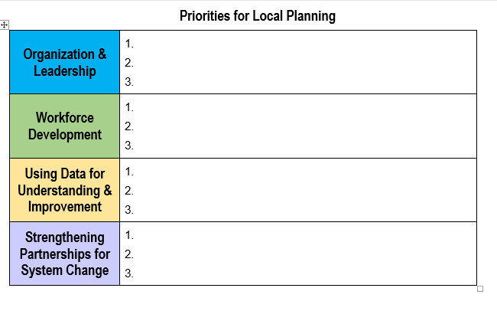
“Any County” Set Planning Priorities based on their Snapshot Findings…
Create teaming structure to guide CPM implementation
Train all CWS staff on CPM practice behaviors
Create a CPM logic model
Orient resource families, behavioral health partners & out-stationed public health nurses to CPM
Notes:
Leslie Ann (10:20-10:35; Slides 11-23)
**Mia clicks 5 times (4 clicks bring in each priority as Leslie Ann focuses on each cell, then final click to bring in orange circle to highlight workforce development priority
With these priorities, let’s see how Any County creates a logic model from their CPM Implementation Plan. We’ll use the Workforce Development strand to walk through the process.

Slide 22
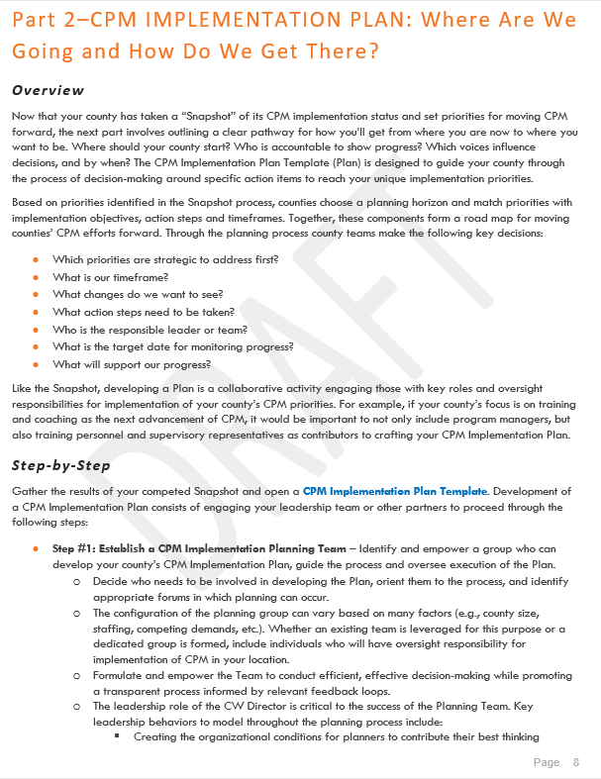
CPM Implementation Plan:
Where Are We Going & How Do We Get There?
Notes:
Leslie Ann (10:20-10:35; Slides 11-23)
**Mia clicks once to bring in picture of Implementation Plan doc as Leslie Ann reminds group of this resource/process.

Slide 23
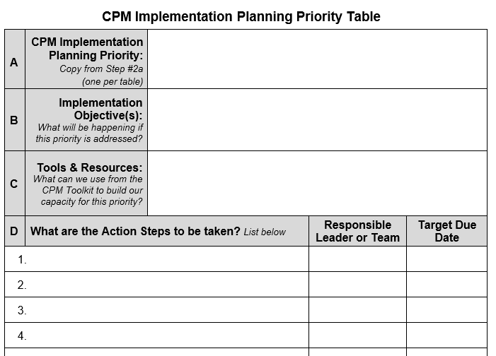
“Any County” Selected Implementation Objectives for Each Planning Priority…
23
- WD Excerpt
Train all CWS staff on CPM practice behaviors
Workforce Dev
Exec leaders, mgrs and sups have received training in the specific
knowledge/skills required for applying CPM Leadership Behaviors
SW’s and Sups have received training in knowledge/skills required for
applying CPM Practice Behaviors as part of integrated local practice
Sups and mgrs have received training and /skill-building opportunities
in supervision coaching of their staff
CPM Logic Modeling
Starts with your Impl Objectives
Orient resource families, behavioral health partners & out-stationed public health nurses to CPM
Notes:
Final Leslie Ann slide, then hand off to Robin (approximately 10:35)
**Mia 2 clicks –first click as Leslie Ann connects these objectives to logic modeling, then 2nd click follows pretty quickly to bring in dotted circle highlight for further emphasis
For their priority to train all CWS staff on CPM practice behaviors, here are the 3 Implementation Objectives that Any County included in their Implementation Plan. As you complete your Snapshots and create an Implementation Plan, the objectives in that plan provide the foundation for the implementation activities in a CPM logic model.

Slide 24
CPM Logic Modeling: Getting Started
24
Implementation
Activities
The Objectives in your CPM Implementation Plan become the Implementation Activities in your CPM Logic Model.
Restate each objective with an active verb at the beginning.
For example: Hold meetings for staff…
Develop leadership team…
Provide training to staff….
Notes:
Robin (Slides 24-31, 10:35-10:55)

Slide 25
“Any County” Translated their Implementation Objectives into Action
25
CPM Impl Plan
Impl Objectives
Workforce Dev
Exec leaders, Mgrs and Sups have received training in the specific
knowledge/skills required for applying CPM Leadership Behaviors
SW’s and Sups have received training in knowledge/skills required for
applying CPM Practice Behaviors as part of integrated local practice
Sups and Mgrs have received training and skill-building opportunities
in supervision coaching of their staff
Provide knowledge and skill-based training to Exec leaders, Mgrs and Sups in applying CPM Leadership Behaviors
Provide knowledge and skill-based training to SW’s and Sups in applying CPM Practice Behaviors as part of integrated local practice
Provide knowledge and skill-based training to Sups/Mgrs.in supervision coaching of their staff
Notes:
Robin (Slides 24-31, 10:35-10:55)
**Mia – first click animates in Objective #1 for Robin to cover, then 2nd click as Robin begins focusing on the Action #1. Repeat clicks for 2nd and 3rd Objectives/Actions as Robin moves through each.
With these priorities, let’s see how Any County creates a logic model from their CPM Implementation Plan. We’ll use the Workforce Development strand to walk through the process.

Slide 26
CPM Implementation Logic Model – Any County, CA
26
Implem. Activities |  | Outputs | Outcomes
Org/Lead
Workforce Development
Data
Partner-ship
Provide knowledge and skill-
based training to Exec Leaders/
Mgrs/Sups in applying CPM
Leadership Behaviors
2. Provide knowledge and skill-
based training to SW’s/Sups in
applying CPM Practice
Behaviors
3. Provide knowledge and skill-
based training to Sups/Mgrs in
supervision coaching of staff
Notes:
Robin (Slides 24-31, 10:35-10:55)
** Mia clicks once to bring the Implementation Activities into the template

Slide 27
Activities Lead to Outputs
27
Outputs
Easily countable events or products of an activity
For each activity in a logic model, identify the events or products that will demonstrate it’s been completed
For example: If an Activity is “train CWS staff,” two Outputs will provide usable information about activity completion:
dates/# trainings delivered
#/% of staff trained
Notes:
Robin (Slides 24-31, 10:35:-10:55)
Encourage identification of outputs that have an existing data source whenever possible (for instance, training sign-in lists or database, team charters, meeting notes, and other business flow documentation and process data)
When no data source exists, consider the feasibility of developing a data source (for instance, if you are starting up coaching, establishing a simple coaching or tracking log will provide important output data)

Slide 28
CPM Implementation Logic Model – Any County, CA
28
Activities Outputs
Implem. Activities |  | Outputs | Outcomes
Org/Lead
Workforce Development
Data
Partner
Provide knowledge and skill-
based training to Exec Leaders/
Mgrs/Sups in applying CPM
Leadership Behaviors
1. # CPM leadership
trainings provided/
% trained by level
2. Provide knowledge and skill-
based training to SW’s/Sups in
applying CPM Practice
Behaviors
2.. # CPM practice
trainings/% SW’s
and Sup’s trained
3. Provide knowledge and skill-
based training to Sups/Mgrs in
supervision coaching of staff
3.. # coaching trainings/
% Sups and Mgrs
trained
Notes:
Robin (Slides 24-31, 10:35-10:55)
**Mia clicks 3 times as Robin gets to each implementation activity to show the corresponding output.
Robin explains that the implementation activities Any County developed from their objectives are then added into the first column in the template.

Slide 29
Setting Sights on Outcomes
29
Outcomes
Expected changes in knowledge, skills, attitudes, or behaviors as a result of implementation activities
If-Then logic will help your team identify outcomes for each activity
Think about who/what is targeted by the activity (staff, teaming structure) and describe the type of change expected for that group, stating it in the present tense
Notes:
Robin (Slides 24-31, 10:35-10:55)
It may help to think about who or what is targeted by the implementation activity (staff, agency teaming structure, partnerships, etc.) and then describe the type of change for that targeted group, stating it in the present tense.

Slide 30
“If – Then” Example
30
Outcomes
If the agency completes this implementation activity/objective…
IF … We hold meetings and forums in which staff develop clarity about and participate in local CPM implementation and practice,
Then we will see this early change in knowledge, skills, attitudes, behaviors (stated in present tense)…
THEN …There is awareness, buy-in and support for CPM and its implementation by staff throughout the agency
Notes:
Robin (Slides 24-31, 10:35-10:55)
Let’s try an ORB example for developing outcomes. We’ll focus on outcomes for the Any County workforce development strand in the next slide.

Slide 31
Activities Outputs Outcomes
31
CPM Implementation Logic Model – Any County, CA
Implem. Activities |  | Outputs | Outcomes
Org/Lead
Workforce Development | 1. Provide knowledge and skill-based training to Exec Leaders/ Mgrs/Sups in applying CPM Leadership Behaviors 2. Provide knowledge and skill-based training to SW’s/Sups in applying CPM Practice Behaviors 3. Provide knowledge and skill-based training to Sups/Mgrs in supervision coaching of staff | # CPM leadership trainings provided/ % trained by level # CPM practice trainings/ % SW’s and Sup’s trained # coaching trainings/ % Sups and Mgrs trained
Data
Partner
If…
Then…
Exec Leaders/Mgrs/Sups are knowledgeable about & building skill in applying Leader Behaviors
2.SW’s/Sups are knowledgeable about & building skill in applying the CPM Practice Behaviors in their work/roles
Sups/Mgrs are building the confidence and competence of their staff in applying CPM behaviors in their work/roles
Notes:
Last Robin slide, then hand off to Crystal (will probably be about 10:55)
**Mia 5 clicks – 2 clicks to bring in IF/THEN at top, then click to bring in each outcome as Robin highlights each activity and the corresponding outcome that Any County developed.

Slide 32
Come to the Polls!
32
Use the polling feature you’ll see on your screen. If you’re sitting with a number of people, answer as a collective.
Thinking about your county’s overall context and needs, how could a CPM logic model be most helpful in local implementation and system improvement efforts? (pick one)
Communication/engagement tool (share concise picture of local implementation and strategic thinking)
Framework for identifying/using CPM data for improvement
Strengthen outcomes-focus of our implementation & teamwork
Integrate CPM with other system improvements (CSA, SIP, CQI, etc)
Other (there is another more important way it could help our county)
Notes:
Crystal (5 minutes), then hand off to Kim G. for a focus on the interplay between logic models, teaming, and data (will probably be about 11 AM)
**Mia – choices to use for poll are on slide and pasted in below:
Communication/engagement tool (share concise picture of local implementation and strategic thinking)
Framework for identifying/using CPM data for improvement
Strengthen outcomes-focus of our implementation & teamwork
Integrate CPM with other system improvements (CSA, SIP, CQI, etc)
Other (there is another more important way it could help our county)

Slide 33
Teaming, Logic Models, and Data
Navigating the road to implementation and change
Notes:
Kim (slides 33-38; 11-11:15 AM)

Slide 34
Pairing Quality Implementation with Data
34
Teaming strengthens implementation planning and extends your leadership reach
CPM teams establish feedback loops to understand how people, teams, and practices in the organization are helping or getting in the way of implementation
Logic modeling focuses CPM teams on the most meaningful data and feedback loops for implementation, problem-solving, and working to achieve desired outcomes
.
Notes:
Kim (slides 33-38; 11-11:15 AM)
For quality implementation, teams are helpful in logic modeling and using data to understand what’s working, what’s not, and what to do next.

Slide 35
Data for Learning and Improvement
35
LEADERSHIP BEHAVIORS
Create a learning environment and try new approaches
Seek out and invite input from staff and stakeholders (focus groups, surveys, community meetings, etc.)
Use feedback loops to keep others aware of and contributing to the path forward
Listen to staff at all levels to hear their successes, worries/concerns, and ideas for implementing, supporting and sustaining CPM
Work with others to develop solution-focused strategies for managing adaptive challenges and barriers
Notes:
Kim (slides 33-38; 11-11:15)
**Mia 4 clicks – See Kim’s talking points below and bring in first 2 clicks during first paragraph, and 3rd/4th click during 2nd paragraph.
These are specific leadership behaviors that invite the use of ongoing data and feedback loops for learning and improvement. Leadership behaviors should help create a learning environment and support the utilization of data and feedback loops to monitor the progress toward implementing CPM. The use of data by leaders will help us build adaptive leadership skills to tackle the problems and challenges of implementation.
Leaders can communicate hope and understanding by listening to staff challenges and engaging in solution-focused strategies to work together to solve problems. Leaders can show compassion and provide support and encouragement by listening to staff at all levels in the organization to hear their successes, concerns/worries and ideas about implementing, supporting and sustaining the model. Supervisors are in a unique position to provide a mechanism for unit staff to voice their challenges and successes with CPM and share those challenges and success with managers and directors.

Slide 36
Logic Model Data
36
Keep it Simple. Listen. Leverage.
Outputs
Easily countable
Reflect progress on activities
Often found in documents created as part of normal business flow
[training sign-in lists, team roles/responsibilities document, meeting notes, coaching log or tracking sheet, etc.]
Outcomes
Often no existing data source
Build in feedback loops, short surveys, focus groups, etc. as ongoing ways to periodically gather info about outcomes
[ask sups about staff’s working knowledge of CPM, ask SW in each unit 1-2 questions re sup coaching, hold focus group to assess CPM buy-in/support, etc.]
Notes:
Kim (slides 33-38; 11-11:15 AM)
Output and outcome data can be simple to identify. It should be built into ongoing communication and feedback loops that are important to support CPM implementation. Output and outcome data can be found in existing agency documentation and processes that can often be leveraged to gather the data and information you need to monitor your CPM implementation.

Slide 37
Logic Model Data Reflections
37
Activities → Outputs
Regularly check in on the activities and
outputs in your logic model to explore:
What’s working? (strengths, successes, progress)
What’s not working? For whom? Why? (barriers, challenges, areas where more input or exploration is needed)
Next steps to problem-solve, gather more input, address barriers, improve supports, etc.
Notes:
Kim (slides 33-38; 11-11:15 AM)
Implementation teams regularly review the logic model, first checking on the progress of completing implementation activities. By monitoring the outputs we can see if we are on track with our implementation activities. By regularly reviewing the logic model, we can see quickly what’s working, what’s not, for whom, and why, and what next steps we need to take.

Slide 38
Logic Model Data Reflections
38
Outcomes
When activities have been completed or significant
progress made, begin to regularly reflect on the outcomes in the logic model:
Are implementation activities leading to the outcomes expected?
If not, why not? What needs to be addressed/changed?
Notes:
Last Kim slide, then hand off to Crystal (will probably be about11:15)
Once you have made progress with implementation activities, it is time to start checking the outcomes that are being achieved. Are implementation activities leading to the outcomes expected? If so, what has led to the success? What behaviors do we want to continue to support to see further improvements in outcomes? If not, why not? What needs to be addressed/changed? The logic model can be a useful framework for thinking through Core Practice Model implementation and monitoring implementation progress. It is important that leaders and implementation teams regularly review the logic model as a means for monitoring the success of implementation.

Slide 39
Back to the Polls!
39
Use the polling feature you’ll see on your screen. If you’re
sitting with a number of people, answer as a collective.
At this point . . . To what extent are you taking away more than when you started this webinar about CPM logic modeling and how it might be helpful in local CPM implementation?
To what extent has the webinar helped you think about how local teams can use simple and accessible data, feedback loops, and ongoing reflection to support CPM implementation?
Notes:
Crystal (5 minutes) then hand off to Nancy for some final thoughts (approximately 11:20)
**Mia – Responses to build into the poll are below. After the first poll and results, you’ll need to click on the slide to bring in the 2nd poll question (note: we may decide not to do question 2 if time is short!).
Question 1 & 2 Scaling Responses:
Yes, extremely
Yes, a lot
Somewhat
Very little
Not at all

Slide 40
RTAs want to help!
40
They can assist in building your resources and
capacity to:
Develop and use CPM logic models
Gather meaningful, low-burden implementation and outcome data
Regularly review CPM data for understanding and improvement
Integrate CPM into local system improvement processes
And more…
Notes:
Nancy slides 40-43 (11:20-wrap up before 11:30)

Slide 41
Finding What You Need
Quality Outcomes and System Improvement (QOSI) Overview
CPM Implementation Logic Modeling – Tips and Template
Keep an Eye Out - Additional QOSI Resources may be refined and posted in the future
http://calswec.berkeley.edu/california-child-welfare-core-practice-model-0
Notes:
Nancy slides 40-43 (11:20-wrap up before 11;30)
We hope you received the CPM documents (QOSI overview and Tips/Template for CPM Logic Modeling) – these were forwarded on Monday to everyone registered for this webinar as they are not yet available on the CalSWEC website. In the coming week or two, though, these logic modeling resources will be posted on that site, along with a recording of this webinar.

Slide 42
Logic Modeling Webinar Take-Aways
42
Use a logic model to map your implementation objectives to the outcomes they are meant to achieve. Share this concise picture w/others to build teamwork in CPM implementation and change.
Logic models and data go hand-in-hand. Use a CPM logic model as a framework for gathering and using data and feedback loops for CPM learning and improvement.
Reflect….reflect.…and continue to reflect….
Did we do what we set forth in our Implementation Plan?
Did we do it with fidelity?
Did we achieve what we intended?
Notes:
Nancy slides 40-43 (11:20-wrap up before 11:30)

Slide 43
Next Webinar
43
A Closer Look at CPM Toolkit:
Using Workforce Development Tools & Resources
Wednesday, May 16 | 10am – 11:30am
Notes:
Nancy slides 40-43 (11:20-wrap up before 11:30)

