Slide 1

Learning Session #3
December 7-8, 2017
Berkeley, CA
Notes:
Stuart opens

Slide 2
welcome
Stuart Oppenheim, CFPIC
Renee Boothroyd, UNC
Notes:
Stuart

Slide 3
CPM: Stronger Together
Since 2012 , the California Child Welfare community has:
  Committed to developing a Core Practice Model intended to improve the lives of the children and families we serve
  Engaged in a consensus process based in a theoretical framework to develop a Core Practice Model that we can all embrace
  Devoted time and energy to advancing the process from a vague idea to tangible processes and products that will make the Core Practice Model a reality throughout the state
  Embodied the fundamental principles of the Core Practice Model: Inquiry and Exploration, Teaming, Engagement, Advocacy, Accountability and Workforce Development
Notes:
Stuart

Slide 4
That Was the Year that Was: 2017
This year’s Directors Institute has been a culmination of our work to date and a bold step into the future
A year ago we set ambitious goals and objectives
  To engage every Child Welfare Director in the Learning Sessions
  To engage staff from all counties in developing implementation tools and resources through the Development Circle
Hundreds of people in countless meetings and conference calls throughout the year have exceeded our fondest expectations
You and your staff have worked extremely hard to get us to the threshold of another exciting year of co-creation at the statewide and local levels
Notes:
End by turning the mic to renee

Slide 5
Directors’ Institute
OVERALL GOALS
To develop a cohort of strong, effective Child Welfare Directors and other leadership supporting implementation of the California Child Welfare Core Practice Model (CPM)
By January 2018, have the skills, ongoing support, and organizational resources to begin systematically implementing the CPM
Notes:
CFPIC, CWDA, CalSWEC, RTAs, CDSS

Slide 6

Directors’ Institute
Objectives
To strengthen local leadership and management resources and abilities to support implementation
To develop then test, refine, and apply implementation and evaluation tools and resources
To stimulate and organize shared learning that guide improvement in implementation
To strengthen state and regional capacities for ongoing implementation support with counties
Notes:
Change format with a visual

Slide 7

Shared Vision Across Counties:
CPM is implemented with fidelity and intended outcomes for children and families.
County Child Welfare Agency & Leadership
In and With Community
10-15% can do this on their own . . . .
Supervisors & Workers
Children & Families
Notes:
WHY?

Slide 8
Shared Vision:
CPM is implemented with fidelity and intended outcomes for children and families.
Shared Vision/Mission:
A multi-level system of implementation support - transferrable across multiple programs - builds, sustains, and improves local capacities for implementing the CPM and getting to outcomes
Statewide & State-Level
Feedback
One Strong Example:
Regional Level
SUPPORT
Feedback
County-Level
SUPPORT
Notes:
The need for . . . .
Directors Institute - CFPIC, CWDA, CalSWEC, RTAs, CDSS – is one strong example .
Collaboration and strategic thinking is ongoing to address a key issue related to sustainability – how to To strengthen state and regional capacities for ongoing implementation support with counties

Slide 9
Paying Attention to “What It Takes”
The Big Idea: Implementation is a process of collective action by people and organizations. Lack of attention to organizational behavior is often the major gap in the process of implementation.
Leadership ensures structures, processes,
policies, and resources in the organization
to support use of the practice model
How introduce CPM, create buy-in
How adjust or incorporate CPM
into work and case flow
How listen, provide feedback,
respond to needs
How monitor change, problem solve,
use information for improvement
How partner with community and
connect with other systems
ORGANIATIONAL CLIMATE FOR CHANGE
Role clarity, positive recognition, opportunities to learn, and grow
Workers &
Supervisors
Children and Families
Notes:
Paying attention to what science and practice tell us about “what it takes” to support effective implementation
Not just training and coaching . . . . Attention to the organization as HOST

Slide 10
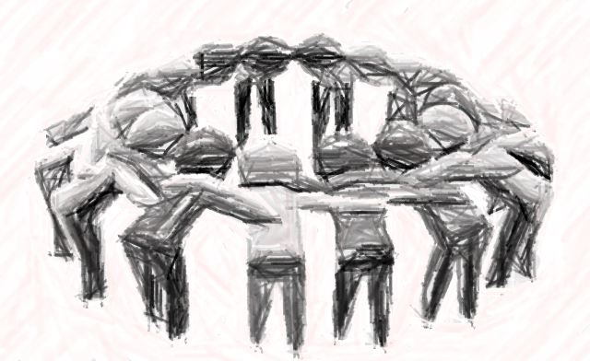

An Applied Focus on “What it Takes” for Implementation
A focus on people matters.
  Workforce Development (Training, Ongoing Coaching for all staff)
A focus on the organization matters just as much if not more AND
Leadership for change lives at multiple levels.
  Organizational Readiness Building
  (Linked Leadership and Implementation Teams,
  practices to strengthen organizational climate)
  Engagement, Relationships, and Partnership
Supporting use of the practice model is a deliberate, ongoing process.
  Quality, Outcome, and System Improvement
HOST
Notes:
In particular

Slide 11
Why Is this Important? Critical Role of Implementation Capacities
(from NC Triple P implementation project)
Organizational Readiness Building
Partnership & Engagement
Workforce Development
Quality & Outcomes for System Improvement
Linked and Functional Leadership and Implementation Teams
Fidelity
Improved Outcomes
Agency Leadership & Implementation Team Capacities
Agency Implementation Infrastructure, Capacities & Performance
Fidelity
E.g., Practitioner Adherence to Triple P Session Protocols
These relationships are not only significant, but characterized by
moderate to large effect sizes!
Notes:
Why is this important?

Slide 12

DECEMBER
Notes:
Since March, the Directors Institute has been tackling these implementation capacity building goals at multiple levels
And here we are today

Slide 13
Directors Learning Session #3
Objectives
Understand and apply lessons from peers who are exploring readiness activities for CPM implementation
Familiar with an array of resources and tools and how they support counties’ own outcome-orientated CPM implementation
See yourselves and your own leadership roles in this work to prepare for local CPM implementation
More prepared to return to own counties and take next steps in implementation assessment, planning, and capacity activities
See how local implementation planning aligns with the Directors Institute and ongoing support activities in 2018
Notes:
Change format with a visual

Slide 14
Day 1: Thurs, Dec. 7, 9:00 am – 5:00 pm
Morning 1 | Welcome, Opening Remarks
 | View from the Balcony: Theory of Change
 | From Theory to Practice (Shorter Than You Think)
BREAK
Morning 2 | CPM Implementation Planning
 | Development Circles PART 1: QOSI & ORB
LUNCH
Afternoon 1 | Development Circles PART 2: WD & ERP
 | Introduction to Development Circle Trade Show
BREAK
Afternoon 2 | Development Circle Tradeshow
 | Fitting It All Together
 | Wrap-Up & Reception
Notes:
See agenda

Slide 15
Day 2: Friday, Dec 8, 8:30 am – 3:00 pm
Morning 1 | Revisiting the Big Picture: Implem Planning
 | Peer Panel: County Lessons Learned from County Snapshot Experiences
BREAK
Morning 2 | Scenario Based Practice: Snapshot Exercise
 | Implementation Planning: User’s Guide
LUNCH
Afternoon 1 | Connecting the Dots: From Snapshot to Outcome-Oriented Planning
BREAK
Afternoon 2 | Regional Dialogues: What Does Support Look Like?
 | What’s Next
Notes:
Change format with a visual

Slide 16
A view from the balcony
How Our Theory of Change Helps Address the Adaptive Challenges of CPM Implementation
Robin Jenkins, PhD
Notes:
Robin

Slide 17

Theories of Change, Logic Models, and Other Things That Make Us Go “Huh?”
Directors Institute Learning Session #3
December 7th, 2017
Notes:
Robin

Slide 18
Objectives for this session
Become familiar with a working definition of Theory of Change
Learn the rationale, structure and assumptions included in the Directors Institute’s TOC
Understand how Implementation Science has informed the Directors Institute’s Theory of Change as well as the pathway forward for CPM capacity building and implementation planning
Notes:
Robin

Slide 19
Translation (in other words…..)
Learn how and why things got put into the DI framework
Learn why it matters that things were put together that way
Learn why research says it’s better to do it that way
Learn how this stuff applies to building an implementation plan for your agency
See how this stuff may apply to you, through the experiences of Child Welfare System leaders (peers)
Notes:
Robin

Slide 20
Balcony View
(Why should you care about how things are implemented #1?)
Did you know? When folks doing the implementing actually understand the theory behind what they are doing, research teaches us that they (a) are more invested in the work, and (b) get better outcomes. Conclusion? Helping Directors, leaders and your team(s) understand theories of change, the logic and readiness building behind program implementation, and the quality management stuff DRAMATICALLY increases the chances of success!
Success means “quality implementation” ----
  Meyers et.al in 2012, “putting an innovation into practice in a way that meets the necessary standards to achieve the innovation’s desired outcomes” (e.g., CPM)
Notes:
Robin
Meyers, D.C., Katz, J.,Chien, V., Wandersman, A., Scaccia, J.P., & Wright, A. (2012). Practical Implementation Science: Developing and Piloting the Quality Implementation Tool. American Journal of Community Psychology (50). 481-496

Slide 21
Balcony View
(Why should you care about how things are implemented #2?)
Without active implementation support, 10-15% can implement on their own (and succeed). This means that 85-90% will only get part way there, or fail!
Without active implementation-informed practices, many innovations (like the CPM) can take as long as 15-17 years to become standard practice in the field, in a broad way. With active implementation support, research tells us that implementation at scale (reaching who needs to be reached, and doing business regularly, in the new way, with fidelity) as designed with accuracy, effectiveness and sustainment ---- in 3-5 years!
Notes:
Robin
This serves as a reminder of the importance of Implementation Science informed work in CPM.

Slide 22
Theories of Change and Logic Modeling –
Adaptive vs. Technical Challenges
“Adaptive challenges can only be addressed through changes in people’s priorities, beliefs, habits and loyalties. Making progress requires going beyond any authoritative expertise to mobilize discovery, shedding certain entrenched ways, tolerating losses and generating the new capacity to thrive anew.” The Practice of Adaptive Leadership (2009) by Ronald Heifetz, Alexander Grashow and Marty Linsky
Building your implementation and support plans, defining a LOCAL theory of change using the resources and tools from the Directors Institute Snapshot, prioritizing implementation support requests, creating readiness and capacity, integrating CPM/SOP and aligning with CSA/SIP/CFSR cycles = adaptive challenges.
Completing portions of the Logic Model, and doing things like assigning work teams, setting up project schedules, databases, re-configuring org charts and other technical processes = technical problems
Notes:
Robin
The Practice of Adaptive Leadership (2009) by Ronald Heifetz, Alexander Grashow and Marty Linsky. Directors face adaptive and technical problems daily. You’re already leading adaptively (if you don’t know it). Problems that have a defined solution and can be “fixed” using known remedies are technical in nature. Things like adapting a “system” such as a child welfare agency, aligning CPM with SOP and other initiatives = adaptive/complex challenges.

Slide 23
So, What the Heck is a Theory of Change?
A TOC basically lays out the systems change pathway for how you hope to get from point A, to point B.
In formal terms, it describes the causal relationship(s) between expected & desired outcomes. It begins with the end in mind, and maps backward.
TOC’s typically (but don’t have to) precede an intervention (in this case, the CPM). They illustrate the short/long term outcomes and impacts that ____________ desires to achieve, by EXPLICITLY stating the assumptions and values involved in the processes to be used.
Notes:
Robin
Main points here: illustrates why you believe that if you do X, you’ll get Y. You make the explicit theoretical case for how something should happened.

Slide 24


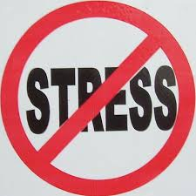

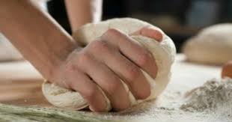
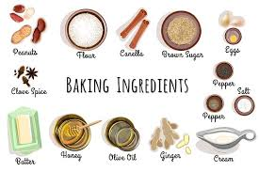
Let’s Try This Simplified Example
Presto -
Your TOC!
You want to make your home happier by baking/cooking your partner’s favorite dessert more often.
So --- your assumptions by making the favorite desserts:
  Happy partner = happier home
  Happier home = less stress
  Less stress = more time for positive activities and memories …… and so, your theory:
Long term impact (main intention): happier home
Long term goal: happier partner, more positive and stable relationships
Short term goal: baking / cooking favorite dessert (X number of times per year)
Outputs: favorite dessert(s), warm kitchen, pleasant atmosphere
Activities: planning, shopping, arranging time on the calendar for getting materials and doing the baking/cooking, etc.
Inputs: time, money, ingredients, equipment, person doing the baking/cooking, recipe
Happy Home ☺
Happier Partner ☺
Less Stress – More Positive Environment
Baking/cooking favorite desserts
Plan, shop, make time, ensure equipment, apply recipe accurately, etc.
Time, money, ingredients, equipment, person-power, recipe, etc.
Notes:
Robin

Slide 25
DI Theory of Change (In Real Words)
If…
Policymakers, key state & regional stakeholders, agency directors, managers, supervisors and practitioners agree that adoption and use of the evidence-informed CPM will measurably improve consumer, agency and child welfare system outcomes;
Policymakers and funders commit the required resources to co-create and sustain state, regional & local active implementation support infrastructures and processes;
Through the Directors Institute, Child Welfare Directors receive a strong learning foundation in the CPM, Implementation Science and Active Implementation Support/Practice, Partnership Engagement, Adaptive Leadership; as well as a clear understanding of the leadership and management roles (Executive, Cross-Agency, Day-to-Day) required for effective local CPM implementation;
9
Notes:
Robin

Slide 26
DI Theory of Change (cont.)
And If …
Through the Development Circles, Child Welfare Directors effectively engage their leadership and implementation teams/ participants in one or more of the 4 capacity/readiness groups (ORB; ERP; WD; QOSI), work (with teams) to identify readiness/capacity issues, tools, practices, processes, and instruments that can be locally evaluated (context!) and added to the Implementation Toolkit by the Directors Institute for peer-to-peer use in local county CPM implementation; and
CWDs begin to ready their local agency climates for CPM implementation; and
Sufficient implementation supports are planned, resourced and delivered (state, intermediary and local) ---
Notes:
Robin

Slide 27
DI Theory of Change (cont.)
THEN…The Directors Institute, Development Circles & supporting processes will produce:
(a) a cohort of CWDs with the leadership, management abilities & resources necessary to implement and sustain the California CW CPM; and
(b) a tool kit to assist each CA county in planning & implementing CPM with fidelity.
↓
AND… The DI process will generate:
an ongoing, cascading active implementation support structure (composed of a state leadership team, intermediary and regional organization infrastructure) and dedicated local leadership/implementation teams along with workforces having the skills/ knowledge and continuous learning processes needed to confidently and competently implement the CPM.
Notes:
Robin

Slide 28
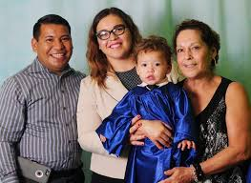
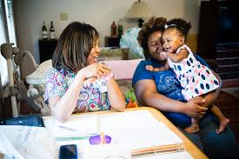

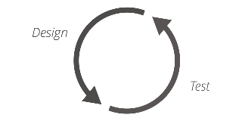


DI Basic Theory of Change – Easier, & Illustrated
Successful population effects (improved safety, permanency, child well-being, etc.)
Improved Partnership, Child/Family Practice, CW System short & long-term outcomes, ongoing implementation support structures
Local implementation capacity AND statewide Implementation support infrastructure: County Directors/Leadership, Management and Implementation Teams/Other Units (ORB, ERP, WFD, QOSI and statewide IS supports)
Development Circles: RTA’s, Local County Leadership and Implementation Teams
Directors Institute: CWDA, CDSS, CFPIC, Faculty, CalSWEC + the four RTA’s = State leadership, design team, (develops and ensures) implementation support
Notes:
Robin
Successful pop effects = Impacts
Improved partnership/etc. = short/long term goals
Local implementation = outputs
DC’s / etc.: =activities
DI / partners/leadership = inputs

Slide 29
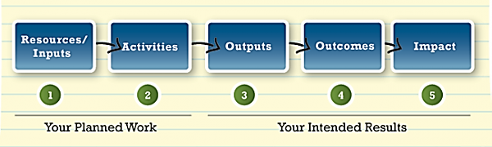

What’s This TOC Stuff Have to Do With
Logic Models, SIPs, CSAs CFSRs, etc.?
Theories of change lead to the next implementation planning steps – documenting your program-specific logic. They guide the “now what” thinking that goes into making the theory come to life. This is where the typical step-wise flow of specific things to do in order to achieve the expected short and long term outcomes comes into play.
So, theories of change, and logic models are not only planning tools – they grow readiness & capacity for implementation, MANAGEMENT and evaluation (accountability) tools/practices to inform and assess your SIPs, CSAs and CFSRs (don’t complicate – they complement and help articulate the work)
Basic Logic Model Structure
System changes
Agency changes
Program changes
Child / family changes
Workforce changes
Partnership changes
TOC
From W.A. Kellogg, Logic Model Development Guide, p. 1
Notes:
Robin
Be sure to refer (here) to the sample QOSI logic models and LM framework sheets on tabletops. Remind that logic models begin at the program level, and can be “added” or combined for an agency-wide logic model for CPM implementation.

Slide 30
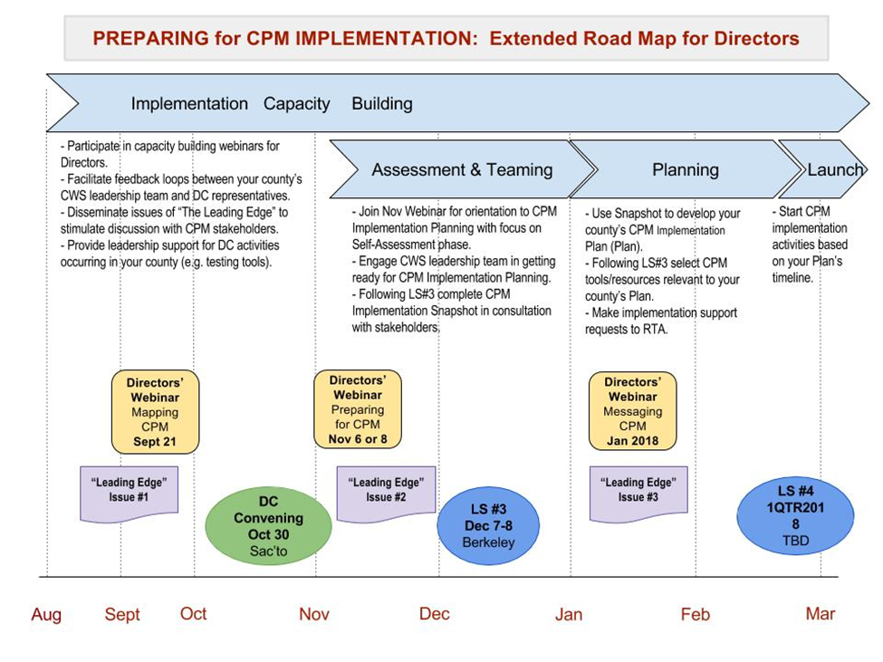
DI Theory of Change Has Guided and Informed the Entire Directors Extended Road Map
Next Steps
2017
2018
Notes:
Robin
Reminder: the DI theory of change has guided the creation of the entire readiness and capacity exploration process to date. The 3 phase LOCAL implementation planning process that follows (Snapshot, Prioritization, Action Planning, Requests for Support) is guided by this theory of change. Reminder: no one has all the 4 “buckets” of capacity ready, or seems likely to take on all 4 at once. Hence, the need to prioritize implementation support requests and to, in a planful way, begin working on CPM in a staged, deliberate way.

Slide 31
A Summary Illustration
CPM Implementation
Ongoing County/Agency Processes
Directors Institute
Development Circles
System Improvement Plans
(informed by CSAs, CFSRs, etc.)
Local Capacity Building & Readiness:
> CPM Impl. Snapshot
> Prioritized Action Plan
> Support Requests
Prioritizing, teaming structures, attention to climate & workforce
Mapping and alignment of initiatives and other requirements
Competent CWDs, Improved Org Readiness, Implementation Support Structures
Active implementation and support of innovations / practices
Improved Safety, Permanency, Well-Being; Staff Satisfaction;
+ Agency Outcomes
Continuous Improvement/Quality Assurance/Ongoing Org Learning
Notes:
Robin
Parallel processes in many ways, show up in the exploration, readiness and early installation phases of CPM implementation, and the ongoing work of county CW agencies. All agencies do environmental assessments and align resources to demands/requirements. Proactive implementation support can dramatically improve successes in various innovations and the integration of services or activities.

Slide 32
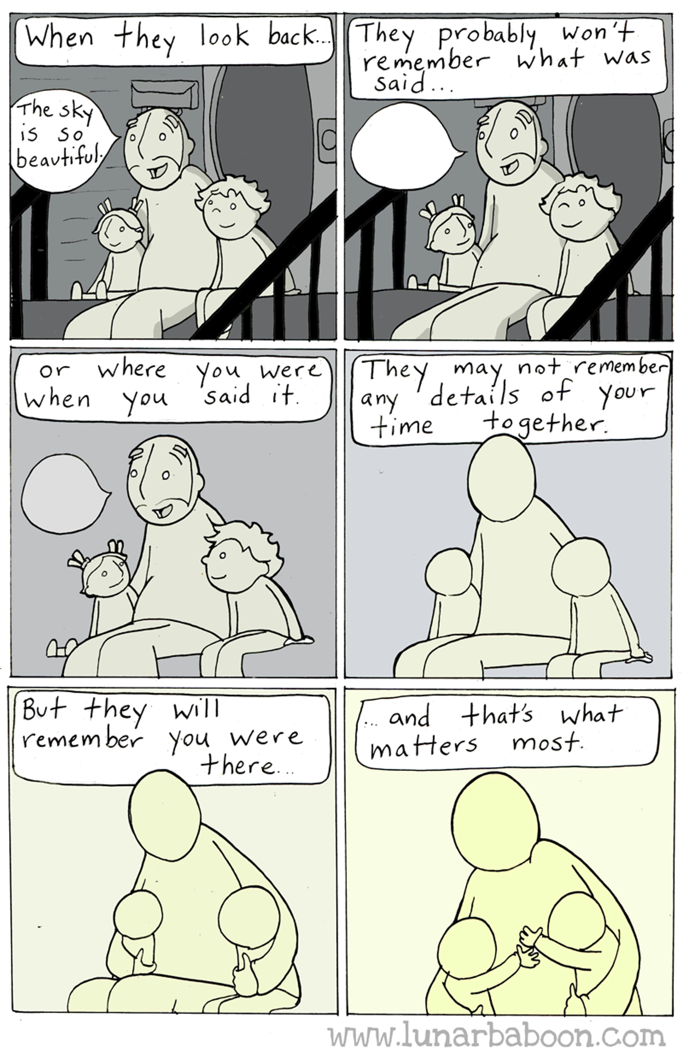
Thank You For Being There –
For Vulnerable Children
Christopher Grady
Notes:
Robin

Slide 33
BREAK
Please return by 10:30am

Slide 34
CPM Implementation planning
A Supported Process Informed by Local Readiness and Focused on Outcomes for Children & Families
Leslie Ann Hay, MSW
Notes:
Leslie Ann

Slide 35


Implementation is a Process:
Strengthening Systems for Social Impact
Implementation Capacity & Performance
(people, processes, using data, active and engaged partnerships)
Evidence-Based, Effective Strategies
Local Capacity & Practices for Active Implementation
Supportive and Efficient Child & Family Service Systems
Improved safety, permanency & wellbeing for children, families, communities
COMPLEX, SHIFTING CONTEXT
Notes:
Leslie Ann
Implementation Capacity is about people, processes, using data, partnering. Then that implementation capacity has to perform – it has to be active, so that the system (people and practices) are facilitating implementation.
All this occurs in complex, shifting contexts – staff transitions, new programs and policies, etc.
So think of all this “what it takes” as an intervention for the system over time.
Implementation Math adapted from: Fixsen, D., Blase, K., Metz, A., & Van Dyke, M. (2013) Statewide implementation of evidence-based programs. Exceptional Children, 79, 213-230.

Slide 36


Overall Approach to Implementation Planning
Builds from local realities & readiness
Focused on outcomes
Dynamic ongoing process
Offers support & guidance along the way
Notes:
Leslie Ann

Slide 37

CPM Implementation Planning: Setting Your Course
What Supports Do We Need?
How Do We Measure Progress?
How Can We Build Our Capacities?
How Do We Get There?
What Changes Do We Want To See?
Where Are We Now?
Notes:
Where Are We Now? (Snapshot)
What Changes Do We Want to See? (Short-Term Outcomes)
How Do We Get There? (Plan)
How Can We Build Our Capacities? (Tools)
How Will We Know We’re There? (Data/Measures)
What Will Support Our Progress? (Support Request)

Slide 38
CPM Implementation Planning: 3-Part Process
Part
Process
Tools for Planning
Self
Assessment
Examine current reality
Interpret the results
Where Are We Now Snapshot
Identify critical priorities to address
Define what success looks like
Plan the steps to get there
Implementation Planning
Implementation Plan Template
Identify support needs
Select tools & resources from CPM Impl. Toolkit generated by DCs
Submit support request to regional point of contact
Support Request
Supporting Success
CPM
Implementation Toolkit
Notes:
Leslie Ann
We’ve structured a 3-part process to help you step through CPM Implementation Planning over the next few months. Just like good social work, it starts with assessment, proceeds to outcome-oriented planning and concludes with identifying what it will take to support success.
The first part of the implementation planning process is to gain a better understanding on your county’s starting point. What capacities are in place to support quality implementation of CPM? Are there aspects of CPM that are already underway? What else is happening in your county environment that relates to launching or advancing the Core Practice Model? You’ll want to gather this view from a variety of perspectives to ensure it accurately reflects the current realities in your location. The findings of the “Snapshot” can then be interpreted to help determine where to focus your county’s CPM implementation planning energies. We’ll spend some time tomorrow practicing how to lead your county team through the Snapshot process.
The 2nd part involves the decisions to be made based on the results of your assessment: identifying critical priorities to address, defining what success looks like, and mapping out the work that needs to be done to get there. The tool involved is the Implementation Plan template—which you’ll learn more about tomorrow.
The 3rd part is considering what supports you may need along the way. This includes selecting various tools & resources generated by the Development Circles that are relevant for the kinds of efforts your county is pursuing to get CPM going in your location. For example, your county’s focus for 2018 may be on training and coaching, so many of the tools from the Workforce Development DC will be a fit. In addition, technical assistance on using some of these tools or completing any of the stages of implementation planning itself can be requested through a single point of contact for each Region. We’ll also have a session tomorrow to engage all of you in helping us shape what those supports should look like.

Slide 39
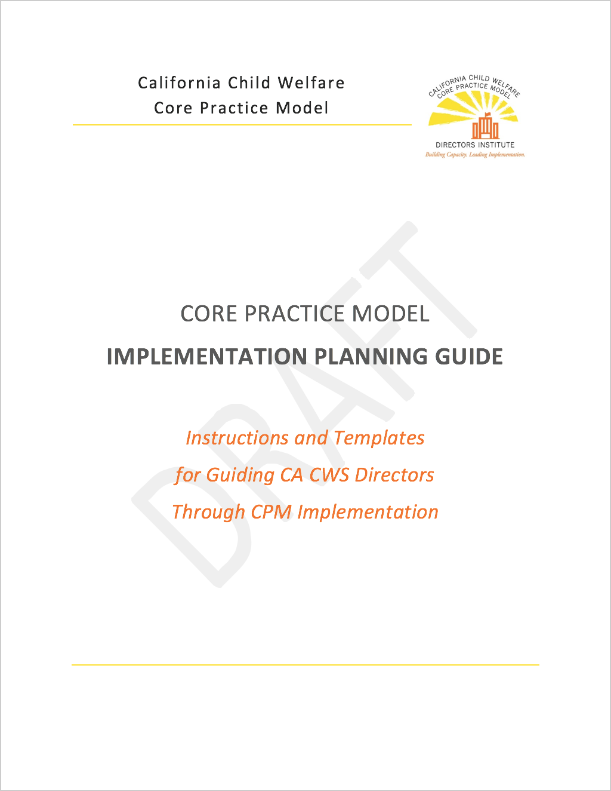
CPM Implementation Planning Guide
Instructions and Templates
for Guiding CA CWS Directors
Through CPM Implementation
MORE ON THIS TOMORROW
Notes:
Leslie Ann
In addition to what you’ll learn through our shared learning forums…we’re also developing a written guide to accompany this process that will be available on the CalSWEC website as a reference for guiding you and your county teams through the planning process.
We’ll share some highlights of the Planning Guide with you tomorrow…

Slide 40

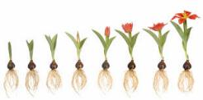
“What it Takes” for Implementation
A focus on People matters.
A focus on the Organization matters just as much if not more.
Leadership for change lives at multiple levels.
Supporting use of the practice model is a deliberate, ongoing Process.
Notes:
First, let’s remind ourselves of ‘What It Takes” for effective implementation…
We know that getting to outcomes is not as simple as designing the CPM (“the WHAT”). The process of supporting use of the CPM (“HOW”) is just as, if not more important, for creating supportive systems and improving outcomes.
The DI Development Circles are based on what we know from implementation science and practice about “what it takes” for effective implementation.
READ

Slide 41
How DCs Support “What It Takes” for Implementation
A focus on people matters.
  Workforce Development (Training, Ongoing Coaching for all staff)
A focus on the organization matters just as much if not more AND
Leadership for change lives at multiple levels.
  Organizational Readiness Building
  (Linked Leadership and Implementation Teams,
  practices to strengthen organizational climate)
  Engagement, Relationships, and Partnership
Supporting use of the practice model is a deliberate, ongoing process.
  Quality, Outcome, and System Improvement
HOST
Notes:
What does this mean for what we’re doing with the DCs? Purposefully integrated this notion (from previous slide) into the selection of DC topics.
Building competence to implement the CPM in the people who deliver the work.
Both organization & leadership are also essential for CPM to get on the ground; includes strengthening linked leadership & implementation teams.
We also don’t do any of our interventions in isolation from the community and other partners to help children & families thrive; implementation of CPM relies on alignment of those same values, behaviors and principles with those who collaborate with child welfare services.
QOSI focuses on building capacities for gathering & understanding and using data to know what’s happening with implementation and how change may be impacting outcomes over time.

Slide 42
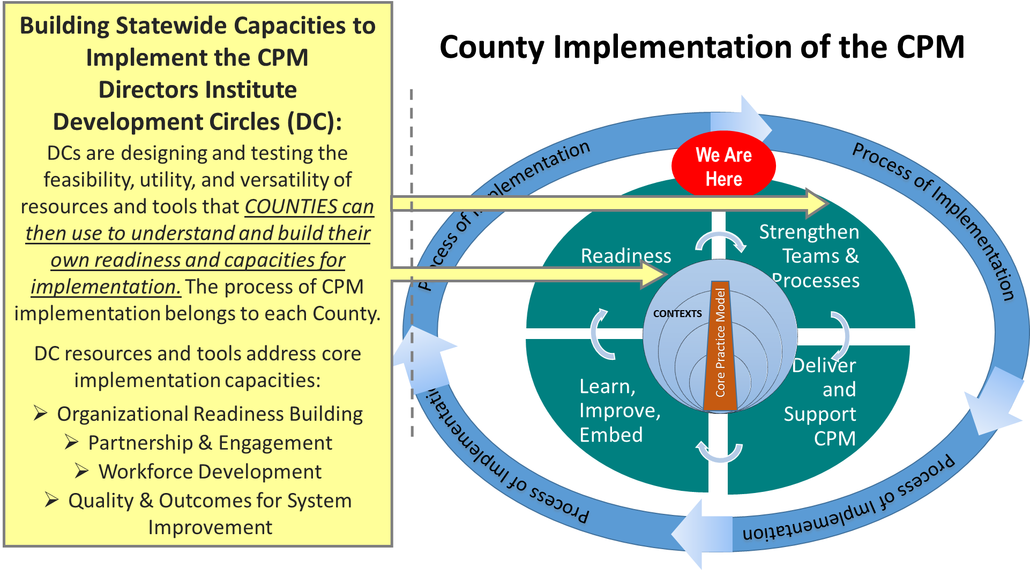
Notes:
We can zoom in on the role and contributions of the Development Circles (CLICK)
[read the yellow box]
Anticipating the work ahead for quality implementation (in a kind of pre-implementation way), DCs are exploring and building products that will assist counties to install structures and processes critical for implementation that are often skipped, rushed, and need more attention.
So the work of the DCs is not necessarily directly part of any County’s process of implementing the CPM – that is theirs.
Instead, the DCs are playing critical roles to assist counties in being able to effectively carry out this important, evidence-informed implementation work.

Slide 43
Development Circles: Tools & Resources
Learn about the work of the Development Circles:
  Tools & Resources Developed in Collaboration with County Staff
  Results of Testing at County Level
  Next Steps
Quality, Outcomes & System Improvement (QOSI)
Organizational Readiness Building (ORB)
Workforce Development (WD)
Engagement, Relationships & Partnership (ERP)
SEE MORE AT THE TRADE SHOW
Notes:
Leslie Ann
For the remainder of today, we’re going to give you an in depth look at what the Development Circles have been working hard to generate, test and refine over the last several months.

Slide 44
QOSI UPDATE
Name of Presenters or Subtitle

Slide 45
QOSI slides here

Slide 46
ORB UPDATE
Name of Presenters or Subtitle

Slide 47
Organizational Readiness Building
Development Circle (ORB DC):
Resources/Tools & Learning to Support
Local CPM Implementation
Directors Institute Faculty: Andrea Sobrado, Renée Boothroyd, Karen Gunderson, Virginia Rondero Hernandez, Mark Lapiz, Darlene Hill
County Child Welfare Director Champions: Sylvia Deporto, Wendy Osikafo, Nick Honey, Dianna Wagner
December 7, 2017
Notes:
On your table you should have a document that briefly reminds you of the ORB resources/ tools and then provides ORB County Testing Profiles. These resources will tell our story.

Slide 48
“What it Takes” for Implementation: Development Circles
A focus on people matters.
  Workforce Development (Training, Ongoing Coaching for all staff)
A focus on the organization matters just as much if not more AND
Leadership for change lives at multiple levels.
  Organizational Readiness Building
  (Linked Leadership and Implementation Teams,
  practices to strengthen organizational climate)
  Engagement, Relationships, and Partnership
Supporting use of the practice model is a deliberate, ongoing process.
  Quality, Outcome, and System Improvement
HOST
Notes:
Put ORB work in the context of “what it takes” for effective implementation AND the focus areas of the other DCs.

Slide 49
“Readiness” is a developmental point at which a person, organization, or system has the capacity and willingness to engage in a particular activity. It is not a pre-existing condition waiting to be found or an enduring aspect of a person. It needs active support to be developed, nurtured, and sustained.
“Organizational readiness” refers to ‘the extent to which organizational members are psychologically and behaviorally prepared and supported to implement organizational change.’
HIGH: More likely to initiate change, exert greater effort, exhibit greater persistence, and display more cooperative behavior.
LOW: More likely to view the change as undesirable, so avoid, or even resist, planning for the effort and participating in the change process.
Notes:
Let us start with definition to remind all of us of why we have been addressing ORB.
[refer to both boxes on the slide and their emphasis points underlined]

Slide 50

Directors Institute Development Circles
Organizational Readiness Building
VISION
People specifically resourced and tasked to come together, attend to day-to-day tasks of implementing the CPM
Teams of executive leaders, staff, and partners have functional roles and dedicated resources for implementation
Organizational practices create a climate that facilitates progress and problem-solves challenges to improve CPM implementation
Notes:
As we begin to share initial testing reflections, we want to remind everyone of the overall vision for ORB as a key feature of implementation capacity, and anchor where we have focused to support Counties strengthening these capacities in their CPM implementation work.

Slide 51
Organizational Readiness: Key Elements
Leadership (e.g., demonstrated commitment, ongoing support by people to remove barriers, foster pathways, streamline approaches)
Communications (defined feed-forward and feed-back loops among multiple groups for specific reasons)
Using Data for Understanding and Improvement
Functional Team Structures and Processes
Organizational Culture and Climate
  Values, assumptions, attitudes, perceptions (importance of innovation in practice, own skills to do so, leadership, organization’s support for change
  Policies, practices, procedures, behaviors, adequacy of resources
Staff Capacities (training, coaching) and Partnership
Notes:
The ORB DC started by defining key elements of ORB as drawn from implementation research and practice. As you can see, this is a multi-faceted and important aspect that influences the process of implementation. We organized these into five (5) key elements
[refer to bolded words on the slide]
As we started to link about these elements in real-world practice for implementing the CPM, we realized together that “ORB for the CPM” really needed to start with messaging about the CPM and the role of ORB in supporting CPM implementation.

Slide 52

Our ORB Dev. Circle Work
Communication for Engagement Strategies/Resources
  Key messages, messaging approaches, feedback loops for the CPM and how the organization is actively supporting it with implementation best practices
  Keeping people engaged and connected
Assessment Resources (hear from multiple voices)
to measure elements of organizational readiness to implement change
Planning Strategies/Resources (to use assessment findings)
  “What do we do now based on what we just learned? Where can we start?”
Teaming Resources (link with CPM Leadership behaviors)
  Designing functional, linked leadership & implementation teams, processes
Notes:
So, as we operationalized the ORB key elements in areas to guide our work together, we highlighted Assessment, Planning, and Teaming Resources (items B, C, and D), then added item A..
Since August, we have focused our initial testing efforts on these first two items [CLICK for red line to appear on slide]

Slide 53
A. Communication for Engagement Implementing CPM
Guiding Characteristics of Potential Tools:
(i) The would help me to explain the CPM to colleagues and partners.
(ii) The tool would help me to explain the roles of our organization and leadership in supporting the implementation of the CPM.
(iii) The tool would help me to prompt others to be actively involved in our organization's current and ongoing efforts to implement the CPM locally.
Generated Key Messages about CPM and ORB for implementing It. ORB County Testing Summaries provide details about site-based approaches used to deliver and test messages.
Notes:
Resource development for this first item was guided by the following characteristics:
[read i, ii, and iii on the slide]
[then CLICK for the bottom box to appear]
Knowing each County is starting from a different place in this process, we started by . . . .
[reference content in bottom box]

Slide 54
B. Assessing Organizational Readiness for Implementing CPM
Guiding Characteristics of Potential Tools:
(i) The tool/resource would address the extent of a key element of ORB for Implementing the CPM (specify).
(ii) The tool/resource would help clarify the current structures and processes related to that ORB element(s)
(iii) (iv) The tool/resource can be used to gather feedback from multiple, different perspectives.
(v) The tool/resource could be easily adapted to be used by counties in different stages of implementing the CPM.
Developed an “illustrative inventory” of assessment items related to ORB Key Elements. ORB County Testing Summaries provide details about site-based approaches to design & test ORB assessments.
Notes:
Resource development for this second item was guided by the following characteristics:
[read i, ii, iii, iv, and v on the slide]
[then CLICK for the bottom box to appear]
Again, knowing each County is starting from a different place in this process and may be interested in all or specific elements of ORB, we started by . . . .
[reference content in bottom box]

Slide 56
C. Planning to Strengthen Priority ORB Elements
Guiding Characteristics of Resource/Tool:
(i) Provide a natural next action step from ORB Assessment for planning how to address key element(s) of ORB .
(ii) Provide an active step for continuing local engagement and teaming from ORB Assessment.
(v) The tool/resource could be easily adapted to be used by counties in different stages of implementing the CPM.
Later in the ORB DC process, we developed an “What’s Next? ORB Planning Matrix” framed by ORB Key Elements. Most ORB County Testing Summaries may not currently have details about site-based approaches for utilizing this resource.

Slide 58
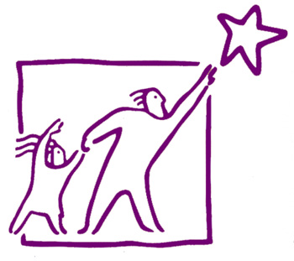
Directors Institute Development Circles
Organizational Readiness Building
Testing County | Buddy County
Calaveras | Stanislaus
Kings | Alameda
Los Angeles | Santa Clara
Orange | Ventura
Sacramento | Sonoma
Shasta | San Francisco
Sonoma | Sacramento
Notes:
This work would not be possible without the involvement of the following counties in the ORB testing process. Again, with this work being a developmental process, counties paired up to learn together whether they we directly testing things or not. Testing was tailored to context of each county – so each pair adds a rich perspective based on where they are that can be helpful to guide the work of other counties.
[refer to ORB County Summary docs]

Slide 59

Let’s Hear from and Learn With You
Framed by your county’s experience using ORB resources/tools,
What was the most the valuable aspect of the process for you (doing the testing) and participants (in the testing process)?
How would you encourage your peer directors (in the audience) to approach learning about how to build organizational readiness for implementing the CPM in their own counties?
Notes:
Leslie Ann

Slide 60

Calaveras County
We tested some key messages with our staff, Board Supervisors, and community stakeholders using several strategies. We facilitated a “mock CFT” focused on implementation with staff, who developed four (4) goals and action steps through this process! We also tested the organizational readiness assessment survey with key community partners and got some great feedback.
Notes:
Leslie Ann

Slide 61

Kings County
We tested ways to share four (4) key messages about CPM and why “Organizational Readiness Building” is essential for successful CPM implementation. We also tested an Organizational Readiness Assessment tool (tailored for Kings) that looks at six (6) key factors of readiness. We chose to test these strategies with a focus group comprised of multiple levels of staff.
Notes:
Leslie Ann

Slide 62
Los Angeles County, El Monte Office
El Monte Office tested a modified version of the Organizational Readiness Tool with the Design Team and the Implementation Team. The assessment survey was reviewed by these teams and then tailored to fit the context of the El Monte Office. Feedback from the survey has helped to inform planning and next steps.
Notes:
Leslie Ann

Slide 63
Orange County
We tested key messages about CPM through a PowerPoint, first to the Executive Team and to the managers. We incorporated their feedback to improve our message. We also tested an organizational readiness assessment tool and received feedback about that tool as well.
Notes:
Leslie Ann

Slide 64


We (four Division Managers) tested a process to identify and share messages about the CPM and ORB for implementing it. First, we used existing meetings to clarify our own key messages. Then, we incorporated and modeled them via into monthly meetings with our Executive Management Team (EMT). Using a parallel process, we asked Managers “What messages are important for Supervisors to hear? What do you think they want to know?” Then over the next month, we provided coaching and support to managers as they began to share messages with staff.
Notes:
Leslie Ann

Slide 65

San Francisco County (Buddy)
Our role was to support the testing county and to offer up any experience that we had that would assist them in the testing efforts. This was a very helpful process as I we were able to learn from the testing county and were able to get new ideas about how to move this forward in SF. Since readiness assessments should be continuously done, we learned many new ideas and approaches. It was great!
Notes:
Leslie Ann

Slide 66

Shasta County
We tested CPM & ORB Key messages. We worked to align these messages to make sure that they honor the work that is happening in the county, that they describe specific behaviors and that they are focused on our vision. We also tested an ORB Assessment tool. We tailored this tool to inquire about areas that are a priority for Shasta. Our tool explores fit & priority of implementing CPM in Shasta County, the organizational climate and leadership’s role.
Notes:
Leslie Ann

Slide 67
Sonoma County
We tested some key messages about CPM and its implementation through an elevator speech, a PowerPoint presentation, and a modified version of the Organizational Readiness Assessment survey. To prepare our audience for the messages from our PowerPoint presentation, our Division Director shared his CPM elevator speech to give a snapshot of what CPM means in Sonoma County. Our CPM implementation team utilized a PowerPoint presentation to share information about CPM first with our managers and then with our supervisors.
Notes:
Leslie Ann

Slide 68

Some Overall Takeaways
Context matters! Pace & tailor the process to your needs
The focus is NOT on the resources/tools, per se. Instead, the focus is on figuring out how the resources/tools may help you
  Model the CPM Leadership Behaviors
  Advance your own CPM implementation assessment, planning, and capacity building activities
Notes:
Leslie Ann

Slide 69
ORB slides here
Notes:
Robin

Slide 70

LUNCH!!
Please return by 1:00pm

Slide 71
Workforce Development
CPM Implementation Toolkit
Facilitators: Susan Brooks (RTA); Anita Barbee (Faculty), Karen Lofts-Jarboe (Faculty), Mark Lapiz (Faculty), Sharon Kollar (Faculty), Alison Book (RTA), Linda Martinez (Faculty)
Child Welfare Champions: Marie Brown-Mercadel (Riverside), Michelle Love (Alameda), Anita Ortiz (Tulare)

Slide 72
County Team Representatives
Butte Kern Riverside San Francisco Santa Cruz Tulare
Contra Costa Los Angeles San Bernardino San Joaquin Shasta
Tuolumne El Dorado Mariposa San Diego Stanislaus
San Luis Obispo
Notes:
Final month of testing together, whether your county has tested some key messages, an adapted version of the ORB assessment tool, or even the planning guide resource which uses data gathered from the assessment tool to guide action.
We know that our 7 testing counties have launched some testing, but after our October 30 meeting, we are guessing that many other counties have begun to look at some of these resources as well. Let's plan to share our stories, celebrate learning, and engage in peer support one final time.

Slide 73
What We’re Producing
Focus on helping develop the workforce at all levels as counties implement the CPM. The tools/processes break down into two focused areas:
Recruitment, screening and selection
Training and coaching

Slide 74

Today’s Objectives
Collective sharing of the Workforce Toolkit
  Overview of organization of the tools
  Brief exploration through internet links
  What’s Next?
Making connections with local CPM implementation work and Directors’ Institute resources
Link: https://www.oercommons.org/authoring/26084-workforce-development-tools-for-child-welfare-lead/view
Notes:
final month of testing together, whether your county has tested some key messages, an adapted version of the ORB assessment tool, or even the planning guide resource which uses data gathered from the assessment tool to guide action.
We know that our 7 testing counties have launched some testing, but after our October 30 meeting, we are guessing that many other counties have begun to look at some of these resources as well. Let's plan to share our stories, celebrate learning, and engage in peer support one final time.

Slide 75
Recruitment, Screening & Selection
Tools developed to support candidate self-selection into child welfare positions, and to assist in the selection process include:
Preview Letter
Preview Video (in development)
Selection Protocol

Slide 76
Training and Coaching
Tools developed to ensure staff, at all levels of the organization, are achieving the Values, Practice Elements, Casework Components and Practice Behaviors of CPM are as follows:
Supervision/Coaching Guide (2 Versions)
Supervisor 1-Pagers
Social Worker & Leadership Practice Behavior 1-Pagers
Profiles

Slide 77
Supervision/Coaching
Guide (2 Versions)
The Supervision/Coaching Guide is a form that supervisors can use in regular supervision meetings with their staff.
Notes:
It is intended to help supervisors keep the focus of supervision and coaching on staff’s application and demonstration of the CPM Practice Behaviors. It also aligns with the Practice Profiles by bringing directly into coaching/supervision the process of assessing with staff their developmental use of CPM practice.
Supervisor coaching of staff is critical to front-line implementation of CPM. It is recommended that managers discuss with their supervisors how supervisors will use the Supervision/Coaching Guide to engage in coaching conversations with staff about their use of the Practice Behaviors, in accordance with local models and expectations for coaching.

Slide 78
Supervisor One-Pagers
Supervisor Guide to Supporting All Social Worker Values, Practice Elements, Casework Components & Behaviors
Separate one-pagers for the following:
Supporting Foundational Elements/Behaviors
Supporting Assessment
Supporting Engagement
Supporting Service Planning & Delivery
Supporting Teaming & Transition
Notes:
This set of tools is intended to help serve as a practical bridge between the Values, Practice Elements, Casework Components and Practice Behaviors of the CPM and child welfare supervisory practice. Each document lays out concrete steps that support best practice in child welfare supervision and help supervisors ensure and assess with staff, their use and application of the CPM Values, Practice Elements, Casework Components and Practice Behaviors. Each of the five separate one-pagers show Safety Organized Practice (SOP) tools and strategies that support that specific practice element/behavior.

Slide 79
Social Worker & Leadership
Practice Behavior One-Pagers
User-friendly formats of the CPM behaviors for various levels of the workforce:
Practice Behaviors – Social Workers
Leadership Behaviors – Supervisors
Leadership Behaviors – Managers
Leadership Behaviors – Directors
Notes:
These documents are user-friendly formats of the Practice Behaviors for social workers and Leadership Behaviors for supervisors, managers and directors. They are intended to serve as something child welfare social workers, supervisors, managers and directors can keep close at hand to remind themselves of the CPM behaviors and assess their own use of these behaviors.
It is suggested that counties may use the documents as a resource to help them focus as team on skill-building around a particular Practice or Leadership Behavior; for example, one month, the team could focus on practicing Foundational Behaviors, the next on Engagement, the next on Assessment/Inquiry, and so on.

Slide 80
Profiles
Tools to gauge developmental progress toward using CPM behaviors in practice:
Practice Profiles
Leadership Profiles
Notes:
The profiles allow for staff, in partnership with their supervisor, to assess or scale where they are in their development of the use of the behaviors and what steps they might take to move their development positively. These profiles can be helpful during coaching/supervision at all levels of the organization. The profiles include Practice Profiles and Leadership Profiles

Slide 81


Slide 82

Directors Institute Development Circles
Engagement, Relationships, & Partnerships
Child Welfare Director Champions: Aaron Crutison (Solano), Leslie Griffith (El Dorado), Lori Medina (Monterey), Madeline Roachell (Los Angeles)
Faculty: Jennifer Buchholz, Aprille Flint, Leslie Ann Hay, Gary Taylor
Development Circle representatives from Alameda, Contra Costa, El Dorado, Los Angeles, Madera, Monterey, Riverside, San Bernardino, San Diego, San Francisco, Santa Clara, Shasta, Sonoma, Tulare
Notes:
Lori – opening remarks; Presenters/champions introduce themselves

Slide 83

A Reminder of Our Purpose…
“…Our aim is to develop and test a set tools and strategies to help counties meaningfully engage partners in the process of implementing the CPM. Through these strengthened collaborations, counties can improve safety, permanency and well-being outcomes for vulnerable children and their families.”
- From the ERP Charter
Notes:
Aaron

Slide 84

What We Have Created in Partnership
ERP Toolkit
  Introductory Section: background and intent; goals for the toolkit; why CPM calls for implementation partnerships; how partnership is embodied in CPM leadership behaviors and an outline and scope of the toolkit.
  Sections that span different levels of partnership-building from pre-work and early engagement to working together through implementation barriers and sustaining partnerships
  Links to robust set of tools and resources to support the work
Notes:
Madeline

Slide 85
Toolkit Sections
The Pre-Work
Early Engagement
Barrier Busting
Stronger Together
Sustaining Change
Notes:
Leslie G

Slide 86
The Pre-Work: Preparing to share CPM with the child welfare partner community
Model CPM behaviors that build value for ERP
Emphasize broad, inclusive and intentional engagement
Adapt CPM key messages
Understand system biases that pose barriers
Invite stakeholders to participate in local system review
How Well Are We Partnering? An Assessment Tool
Who’s at Our Table? Exercise
Culture & Diversity in Building Communities
Détente & Decorum for Child Welfare Leaders
TOOLS
Notes:
Aaron
Pre-Work
8
Early Engagement
Sharing Values Exercise
Foundational Engagement Tip Sheet
Community Engagement Spectrum
Listening to Those Who Matter Most
The 6 Rs of Partnership Participation
11
Barrier Busting
CDSS Tribal Consultation Policy
Equity – Testing Assumptions & Bias
The Power of Stories
Café to Go
Sources of Power
15
Stronger Together
Terms of Reference
Inter-System Memorandum of Understanding
18
Sustaining Change
The New Community Collaboration Manual
ERP Recommendations for Aligning CSA with CPM
Partnership Satisfaction Survey

Slide 87
Early Engagement: Laying the foundation for orienting partners to CPM
  Identify and outreach to key partners
  Establish partnership forums for co-creation, shared learning & problem-solving
  Initiate early, targeted communication about CPM
  Co-create the framework for working together
  Explore system data together
Sharing Values Exercise Foundational Engagement Tip Sheet Community Engagement Spectrum Listening to Those Who Matter Most
TOOLS
Notes:
Leslie G.

Slide 88
Barrier Busting: Working together to reduce system barriers to CPM implementation
  Collaborate to establish culturally relevant and trauma-informed services
  Co-create solutions to address system biases
  Partner to adapt CPM to local needs
  Recognize and jointly tackle common partnership barriers
CDSS Tribal Consultation Policy Equity – Testing Assumptions & Bias The Power of Stories Café to Go Sources of Power
TOOLS
Notes:
Madeline

Slide 89
Stronger Together: Aligning partnerships with quality implementation of CPM practice
  Collaborate with leadership to support community input in CWS decision-making
  Set expectations for role of partners in practice level teams with shared accountability for outcomes
  Involve partners in CPM training, coaching and skill-building
Terms of Reference Memorandum of Understanding
TOOLS
Notes:
Aaron

Slide 90
Sustaining Change: Monitoring CPM implementation in partnership with the community
  Establish linked teaming structures with partners
  Ongoing communication and feedback loops
  Evaluate impact of partnership efforts on outcomes
The New Community Collaboration Manual The 6 Rs of Partnership Participation
TOOLS
Notes:
Leslie G

Slide 91
Foundational Engagement Tip Sheet
Set of guidelines for reaching out to existing, emerging and new partners who have a stake in achieving positive outcomes for children and families. Suggests creative approaches to the who, what, when and how of basic engagement with community, system and Tribal partners.
Foundational Engagement Tool
Notes:
Aprille Foundational Engagement Tool

Slide 92
Community Engagement Spectrum
Who is at Our Table? Exercise
Drawing from a best practice in community engagement, this tool offers a method to assess the diversity, equity and inclusion of partners brought to the table for CPM Implementation efforts.
Who is at Our Table?
Notes:
Aprille & Jennifer

Slide 93
Next Steps for ERP
Incorporate feedback from colleagues here today!
Continue to work across Development Circles to further design align, and refine what we have created into one package
What else?
Notes:
Leslie Ann

Slide 94
DC trade show
Come take a closer look at the DC wares!
Please return by 4:15pm
Notes:
Leslie Ann

Slide 95
BREAK
Development Circle | Room
Quality Outcomes & System Improvement | Mariposa
Organizational Readiness Building | Amador
Workforce Development | Quarter Deck
Engagement, Relationship & Partnerships | Quarter Deck
Return from Trade Show by 4:15pm
Notes:
Leslie Ann

Slide 96
Fitting it all together
A Leadership Self-Reflection Session
Notes:
Renee

Slide 97
Reflection on Leadership
In what ways has your identity as a leader evolved since the beginning of your involvement with the Directors’ Institute?
What are some things you learned today that affect how you might lead or engage differently with your team going forward?
What tools or resources do you see as most useful to support your role as a leader in implementing CPM?
Notes:
Renee

Slide 98
Wrap up
Please join the Reception at 5:30pm in Bayview Ballroom…
Notes:
Stuart

