Slide 1
CA Child Welfare Core Practice Model (CPM)
Directors Institute Webinar
Organizational Readiness Building
What It Is & Why It Matters!
Thursday, March 15 | 10am – 11:30am
Notes:
Mia
Reminder to mute phones; use chat feature for questions during presentation
What happens if disconnected or a technology problem
Presentation followed by ‘open line’ for Q & A
Parking Lot for issues/questions needing follow-up
[announce and begin recording approx. 10:05)
Stuart & Danna: “tees up” Webinar; thanks participants for attending; introduces presenters: (Renee Boothroyd, Andrea Sobrado, Virginia , Karen Gunderson, Mark Lapiz).

Slide 2

“As an organization, how do we understand and address our own strengths and areas of need for supporting use of the CPM?
What is my role in CPM implementation,
even if I am not directly serving children and families?
Notes:
Stuart or Danna

Slide 3

Learning Objectives
Understand key elements of organizational readiness building (ORB)
Identify what they currently look like (yes! You are already doing great at some of them!)
See the value of a local planning team taking a deeper dive for understanding ORB’s key elements “here”
Connect how this ORB “deeper dive” fits into the overall SNAPSHOT tool for CPM implementation planning; and
Explore lessons from each other about taking action and using what you learn to address ORB factors
Notes:
Stuart or Danna
Turn over to Renee …

Slide 4
Organizational Readiness Building (ORB) for CPM Implementation
NOV 2017
Snapshot Webinar
Jan 2018
Messaging Webinar
Feb 2018
Implem Planning
Mar 2018
Org Read Bldg
Apr 2018
May 2018
Jun 2018
Today’s webinar builds on content from past webinars
Notes:
[hope to be here by 10:10]
Renee
Overall - focus is not content, per se, but bringing people together across the agency and community to stimulate local thinking and action

Slide 5
Snapshot Webinar Take-Aways (Nov. 2017)
Empower a planning team to help you steer the process
Engage with others from the start
Involve agency staff who have served on the Development Circles
Make the Snapshot work for your local context
Seek a 360 degree view of “where we are now”
Model CPM Leadership Behaviors
Notes:
[Renee comment on what Jennifer had shared before]
Identify a set of individuals who have the authority and perspective within your agency to help you think through the decisions, opportunities and activities that are involved with the Snapshot self-assessment process.
Talk with those on your planning team and others about how to apply the Snapshot and how it can be useful (both the process and findings) to your local CPM implementation planning efforts.
Reach out to the staff from your agency who have served on the Directors’ Institute Development Circles. They played key roles in describing the capacities contained in the Snapshot assessment questions and can help guide local next steps.
The Snapshot is purposefully designed to be flexible (e.g., adjust language—not meaning—of the questions to resonate with your community, every respondent doesn’t have to answer the entire questionnaire—parse out sub-sets of questions that best fit for the audience involved.
Bring different groups/stakeholders together and use this process to surface various perspectives on answering the question, “Where are we now in implementing CPM?”. Use this range of views to shape ideas for moving ahead.
Embarking on preparing for CPM implementation requires teaming, inquiry, engagement, communication and other leadership behaviors.

Slide 6
Messaging Webinar Take-Aways
Understand strategies for targeting messages to specific audiences
Use resources from Development Circles
Apply important features of effective communication, including feedback loops
Notes:
Renee

Slide 7
CPM Implementation Planning Take-Aways
Build momentum from wherever you are and begin with the end in mind
Let your Snapshot priorities set the focus for your plan of action
Local planning teams strengthen your plan, extend your leadership reach, and build buy-in
Utilize available supports along the way
Notes:
Renee

Slide 8
Organizational Readiness building (ORB)
What It Is & Why It Matters
Notes:
Start here by 10:15?
Renee
(5 minutes for slides 8-13)

Slide 9
“Readiness” is a developmental point at which a person, organization, or system has the capacity and willingness to engage in a particular activity. It is not a pre-existing condition waiting to be found or an enduring aspect of a person. It needs active support to be developed, nurtured, and sustained.
“Organizational readiness” refers to ‘the extent to which organizational members are psychologically and behaviorally prepared and supported to implement organizational change.’
HIGH: More likely to initiate change, exert greater effort, exhibit greater persistence, and display more cooperative behavior.
LOW: More likely to view the change as undesirable, so avoid, or even resist, planning for the effort and participating in the change process.
Notes:
Let us start with definition to remind all of us of why we have been addressing ORB.
[refer to both boxes on the slide and their emphasis points underlined]

Slide 10

Organizational Readiness Building
The Big Idea: Implementation is a process of collective action by people and organizations. Lack of attention to organizational behavior is a major gap in the process of implementation.
The process of implementation happens within and is influenced by the agency and community environments in which it occurs. We tend to focus mostly on the “package” or model and the individuals doing it, and forget about how people, teams, and practices of the organization may be helping or get in the way of effective implementation.
Notes:
Renee

Slide 11
Directors Institute Development Circles
Organizational Readiness Building
VISION
People specifically resourced and tasked to come together, attend to day-to-day tasks of implementing the CPM
Teams of executive leaders, staff, and partners have functional roles and dedicated resources for implementation
Organizational practices create a climate that facilitates progress and problem-solves challenges to improve CPM implementation

Slide 12
Organizational Readiness: Key Elements
Notes:
Leadership (e.g., demonstrated commitment, ongoing support by people to remove barriers, foster pathways, streamline approaches)
Communications (defined feed-forward and feed-back loops among multiple groups for specific reasons)
Using Data for Understanding and Improvement
Functional Team Structures and Processes
Organizational Culture and Climate
Values, assumptions (importance of innovation in practice, confidence in own skills, leadership support for change)
Policies, practices, procedures, behaviors, resources

Slide 13

To support practice with Children & Families
Dedicated people, resources, roles for implementation
Mapping, messaging, making connections with CPM
Involving, inquiring, facilitating discussion
INSTALL: Strengthen system resources and abilities to support CPM implementation
LEARN

Slide 14

Come to the Polls!
Use the polling feature you’ll see on your screen. If you’re
sitting with a number of people, answer as a collective
    Right now, what do you think is the most important thing to “get right” in your county for CPM implementation? (pick one)
      Workers trained in the CPM on the line-level
      Demonstrated leadership buy-in and involvement
      Clear messaging about the “CPM” and “implementing the CPM”
      Early & follow-up ways to measure, understand, and improve it
      Having teams and communication processes to keep people engaged, connected, and informed
Notes:
[hope to be here by about 10:20] The poll and processing should take about 10 mins, until 10:30.
Mark
[intro blurb]
[MIA: ADD THESE SELECTIONS TO THE QUESTION IN THE POLL, allow to only pick one]
[Virginia, behind the scenes, please write down a few descriptors of the poll spread as you will bring them back into the process for POLL II
Mark - Make some comments based on the spread . . . . Then segue in us “making things more concrete.”

Slide 15

Making Organizational Readiness Building Tangible
Notes:
[be here by about 10:30 -- (20 minutes)
Andrea (and Lucia)
Prompts TBD
NOTE: Virginia regularly reviews CHAT to lift up feedback and questions from participants.

Slide 16

Think about your own story . . .
Think about a time when your organization was “ready” for change, and the change process was successful (even on the smallest scale) . . .
What things, factors, conditions, actions, contributed to that change being successful? What did you notice?
Notes:
Andrea
Prompt notes TBD
Ask participants to share their thoughts in chat – or can raise their hand to add verbally! ☺ Ventura will raise their hand!
NOTE: can lift up previous county feedback to fill in some space, prompt people . . . . we asked the ORB DC this same question is 2017.
people asking questions; teams structures are in place; engage staff, leadership – define what this really means, allowing and encouraging voice; identify fit; dedicated staff; plan-ful and ongoing feedback; practices that strengthen climate for implementation – break down heirarchy via how hold and facilitate meetings, etc. – your actions as a leader; leadership and management understand “it” (& how it fits) first in order to message and model; defining what progress, success (i.e., accountability) look like from multiple perspectives (staff, leaders, partners, etc) (managers ask sups, sups ask workers); clarify shared expectations; being able to describe what “this” looks like (lots of “this’s”) (link to communication)
Based on participant feedback, you can generate and verbally share 2-3 brief examples of what ORB looks like. Then use this to kick off Lucia leveraging feedback from county profiles/ORB DC experiences.

Slide 17
Directors Institute Development Circles
Organizational Readiness Building
Testing County | Buddy County
Calaveras | Stanislaus
Kings | Alameda
Los Angeles | Santa Clara
Orange | Ventura
Sacramento | Sonoma
Shasta | San Francisco
Sonoma | Sacramento
Notes:
Lucia
Grateful for involvement from and involvement with ORB County Teams.

Slide 18

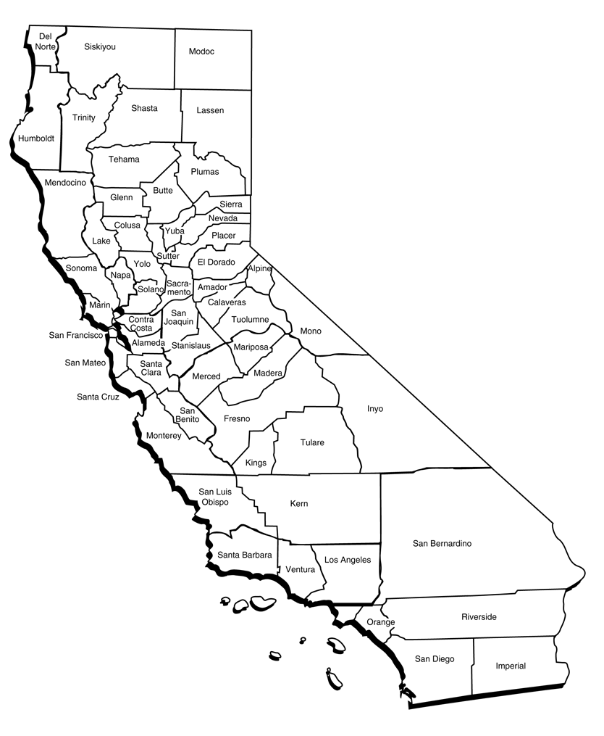

Building Organizational Readiness for Implementing CPM
Notes:
Lucia

Slide 19

Some ORB Approaches . . . .
Calaveras: CFT with staff group to develop goals for where to start
Kings: 8-person focus group with staff at multiple levels to gather feedback
Sonoma: Engaged management team in mapping current practices related to CPM values
Shasta: Co-created CPM vision embodied at all levels of the organization and community
LA/El Monte Office: Discussion/feedback with staff subgroups
Orange: Narrowed assessment and asked 3 questions per element using online survey
Sacramento: Division Managers model and “call out” leadership behaviors with each other
Notes:
Lucia

Slide 20
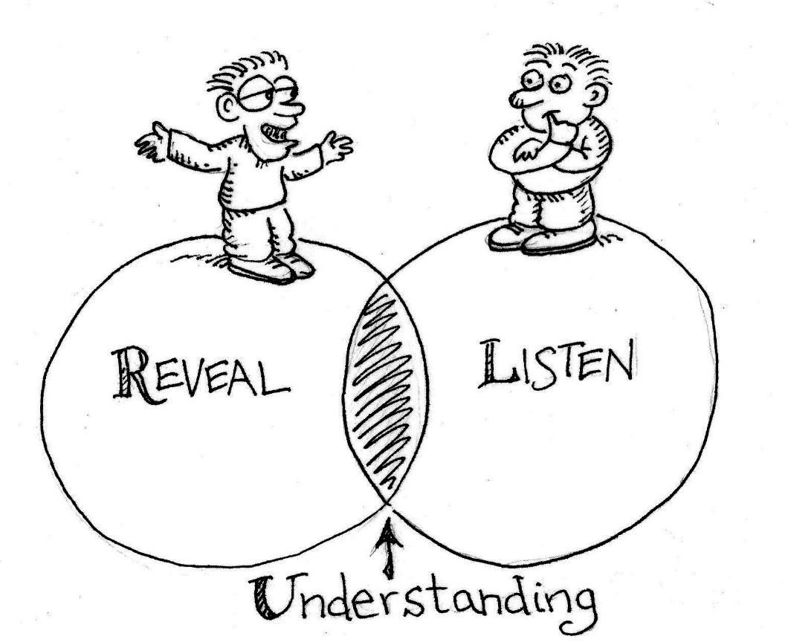
Some Reflections & Highlights . . .
Engage diverse groups (staff, communities, Board of Supervisors) with prompts (e.g., “I Believe” video) to start conversations, gather feedback, share messages
Co-create messages that speak to all staff, including clerical
“Tag” and “name” Leadership Behaviors when you see them naturally active in real-time
Reduce number of questions to tailor ORB assessment to county culture, climate, and priorities
Notes:
Lucia

Slide 21

Let’s Go Back to the Polls!
Use the polling feature you’ll see on your screen. If you’re
sitting with a number of people, answer as a collective
    Now that you heard some ORB learning from your peers . . . . At this point, what do you think is the most important thing to pay attention to in your county’s CPM implementation? (pick one)
      Workers trained in the CPM on the line-level
      Demonstrated leadership buy-in and involvement
      Clear messaging about the “CPM” and “implementing the CPM”
      Early & follow-up ways to measure, understand, and improve it
      Having teams and communication processes to keep people engaged, connected, and informed
Notes:
[Get here by 10:50?] 10 min total
Karen (5 min)
[intro blurb]
[MIA: ADD THESE SELECTIONS TO THE QUESTION IN THE POLL, allow to only pick one]
Virginia, based on your notes/descriptors of the previous POLL I spread, share a few thoughts about what you see now . . . .
[Coordinate this with Mia] Ask participants to raise their hand (a) if they selected the same option; clear raised hands; then ask participants to raise their hand if (b) they selected a different option. Share any reflections

Slide 22

ORB Resources and Tools
Communication for Engagement Strategies/Resources
  Key messages, messaging approaches, feedback loops for the CPM and how the organization is actively supporting it with implementation best practices
  Keeping people engaged and connected
ORB Assessment (hear from multiple voices)
to measure elements of organizational readiness to implement change
Planning Strategies/Resources (to use assessment findings)
“What do we do now based on what we just learned? Where can we start?”
County Profiles
Notes:
Andrea
Aim to start here at 11:00 (15 min)
Brief comments about process for developing tools

Slide 23
OBB Assessment: “Deeper dive” from more general, cross-cutting Snapshot

Slide 24
ORB Resources & Tools

Slide 25
ORB Assessment: Key Element Excerpts
Check-In: Where are we in our county CPM implementation planning process (including ORB)?

Slide 26
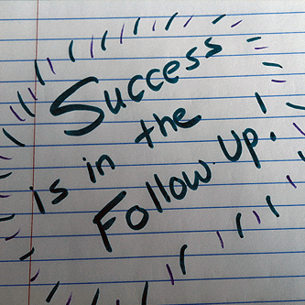
ORB Assessment: Key Element Excerpts
Follow-up questions
  What ideas or actions surfaced in your conversation?
  Who else needs to be involved in this kind of conversation?
  What may be a smart next step for you?

Slide 27
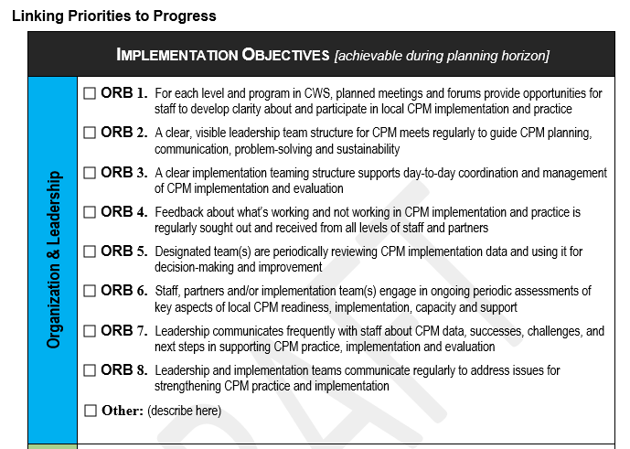
Connections Across Snapshot, ORB Assessment, and Implementation Plan
X
X
X
Notes:
[aim to get here by 11:15?]
Renee (2 min) set up
Refer back to fit of ORB Assessment into SNAPSHOT (tools and processes) and the Implementation Plan Template.
Revisit how attention to ORB adds value, reinforce will things may fit with county CPM implementation assessment and planning

Slide 28

Let’s Go Back to the Polls!
Use the polling feature you’ll see on your screen. If you’re
sitting with a number of people, answer as a collective
    At this point . . .
      To what extent are you taking away more than when you started this webinar about what organizational readiness means and why it is important?
      To what extent did you hear something that affirms or gives you ideas about your role in addressing ORB to support CPM implementation?
Notes:
[Get here by 11:17?] 5 min total
[MIA: ADD THESE SELECTIONS TO THE QUESTION IN THE POLL, scaling]
Mark – Remember, each of you are likely in very different stages of this ORB work, and all that makes complete sense based on your own local context.
Do question 1
Do question 2
THEN ASK
What do you see as your role in supporting your county’s CPM implementation planning? [have participants type in the chat]
Then Do Question 3 (we need to determine choices, then have participants identify top 2)
[Coordinate this with Mia] Ask participants to raise their hand (a) if they selected the same option; clear raised hands; then ask participants to raise their hand if (b) they selected a different option. Share any reflections

Slide 29


What is My Role in ORB?
How might you describe your role in building and maintaining organizational readiness for CPM implementation?
Notes:
Ask participants to type in the chat box . . .
Reinforce that readiness is part of the process of implementation.
Getting engaged in this is actually getting started with implementing CPM – doing so extends beyond the line level of practice to include a huge organizational role to support practice.

Slide 30
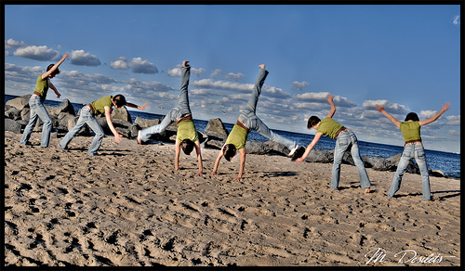

RTAs want to help!
    As your SNAPSHOT suggests taking a deeper dive into ORB resources and abilities for . . . .
      Understanding and Messaging the CPM and its implementation
      Demonstrated Leadership Support
      Defined Communication & Feedback Loops
      Processes for Understanding and Using Data for Ongoing Improvement
      Functional Leadership and Implementation Teams and Processes
      Ensuring organizational climate to host implementation
Notes:
[Get here by 11:20?] 5 min total
[MIA: ADD THESE SELECTIONS TO THE QUESTION IN THE POLL, scaling]
Mark – Remember, each of you are likely in very different stages of this ORB work, and all that makes complete sense based on your own local context.
Do question 1
Do question 2
THEN ASK
What do you see as your role in supporting your county’s CPM implementation planning? [have participants type in the chat]
Then Do Question 3 (we need to determine choices, then have participants identify top 2)
[Coordinate this with Mia] Ask participants to raise their hand (a) if they selected the same option; clear raised hands; then ask participants to raise their hand if (b) they selected a different option. Share any reflections

Slide 31
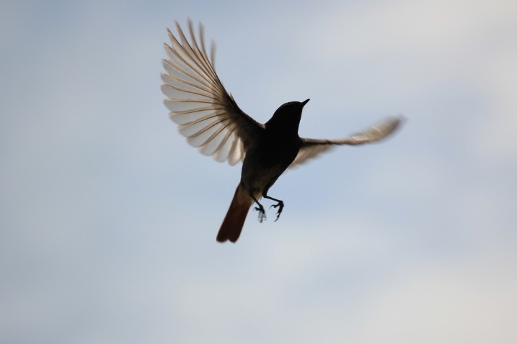
Organizational Readiness Building (ORB) Webinar Take-Aways
Pay attention to ORB because it paves the way and supports actual practice.
Explore and reach out to others to assess and build readiness. This work involves all of us.
Integrate a “deeper dive” into ORB factors in ways that make sense to you. Make the process your own! (who, what, how much, how)
Start with and keep a focus on using what your learn to guide planning priorities
Attention to readiness is ongoing!
Notes:
Renee

Slide 32

Finding What You Need
Implementation Planning Guide
CPM Implementation Snapshot
CPM Survey
CPM Implementation Plan Template
Webinar Recordings
Additional Resources (including resources and tools from the Directors Institute)
http://calswec.berkeley.edu/cpm-implementation-planning-materials
Notes:
Renee or Andrea
Everything we discussed today is easily accessible on the CalSWEC website. You can either download a PDF of the Guide with all its hyperlinks to the documents listed here (and more), or you can page through the CPM Implementation Planning pages on the CalSWEC website to find everything you need.
Special thanks to Karen Ringette and Virginia Rondero Hernandez of CalSWEC for providing this on-line platform for easier access and sharing of these materials across the CPM learning community.

Slide 33
Next Webinar
A Closer Look at CPM Toolkit:
  CPM Logic Modeling
  Wednesday, April 18 | 10am – 11:30am
Notes:
Stuart / Danna

