Slide 1
Resource Family
Pre-Approval Training
Class 1

Slide 2

Agenda for Tonight
Introductions/Housekeeping Items (food
drinks/bathrooms/late policy/no phone usage,
paperwork)
Icebreaker Activity
Presentation of material (Child Welfare Data/Overview about child abuse/neglect/Effects of child abuse/neglect/Overview of the Child Welfare/Dependency court system)
Break (10 minutes)-optional/class vote
Video (Removed part 1)
Finish presentation of material (Indian Child Welfare Act (ICWA)/Role of the Resource Family (record keeping/prudent parent)/Permanency Options/Foster Youth personal rights )
Notes:
This is a sample agenda.

Slide 3
The magnitude…
In 2015 approximately 4 million referrals were made to CPS agencies around the country
Of those about 2.2 million (58.2%) reports met standards for CPS response
Of those about 18 % of the children were found to be victims of abuse/neglect
Notes:
This slide and the next 3 present nationwide data about FC system so that applicants can understand the magnitude of FC and this info can be related to specific Sac County numbers.

Slide 4
AFCARS Nationwide Data from 2015
Notes:
Trainer can explain what AFCARS is

Slide 5

Important details..nationwide
Children birth to 1 year old had highest rate of victimization
50.9 % were girls, 48.6% were boys
75.3% neglect, 17.2% physical abuse, 8.4% sexual abuse, 6.2% emotional abuse
Approximately 1,670 children died due to abuse or neglect (neglect 72.9% and physical abuse 43.9%)
74.8% of those who died were younger than 3 years old
Who are the perpetrators of child fatalities?
54.1% were women, 45% were men
77.7% of abuse fatalities were committed by parents
26.7% mother, 14.7% father , 22.3% both parents, non-parents 18.7%
Notes:
This can be tied into how vulnerable 0-5 population is. Also dispel myths about who the main perp is in fatalities.

Slide 6

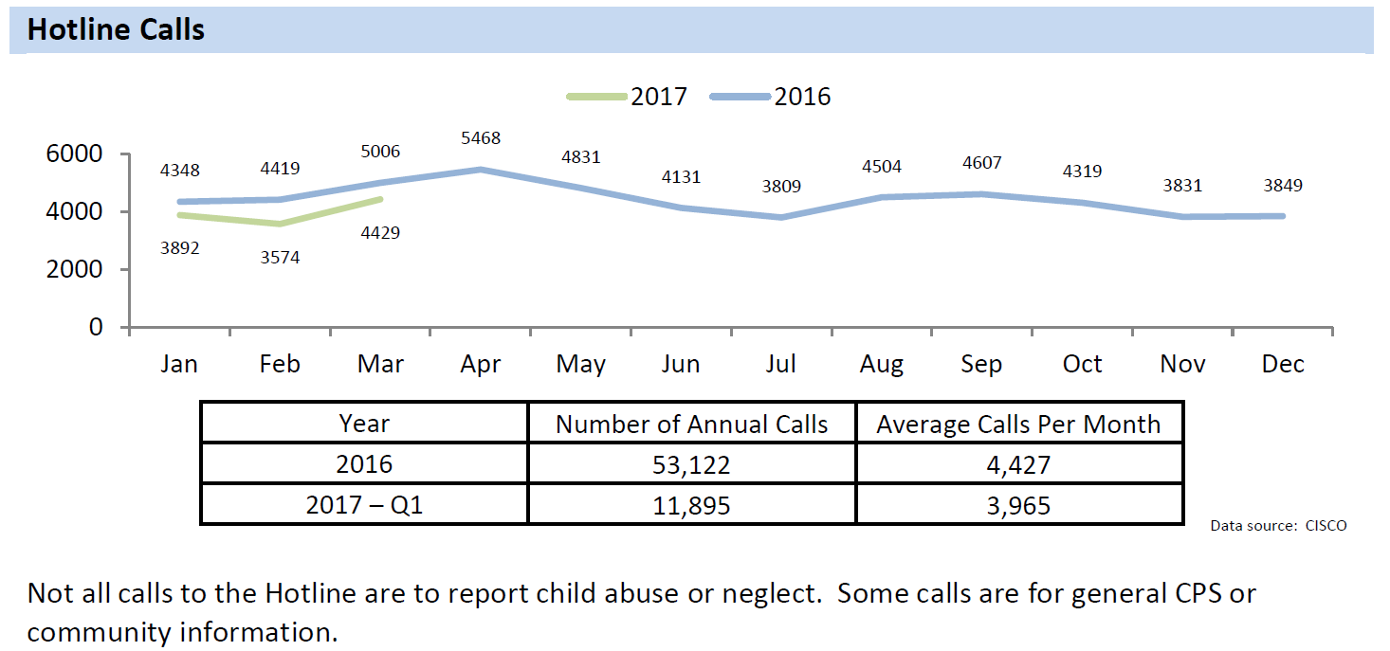
How many calls does Sacramento County CPS hotline receive?
Notes:
This slide provides good info for applicants to see the volume of calls to the hotline on year and monthly basis.

Slide 7
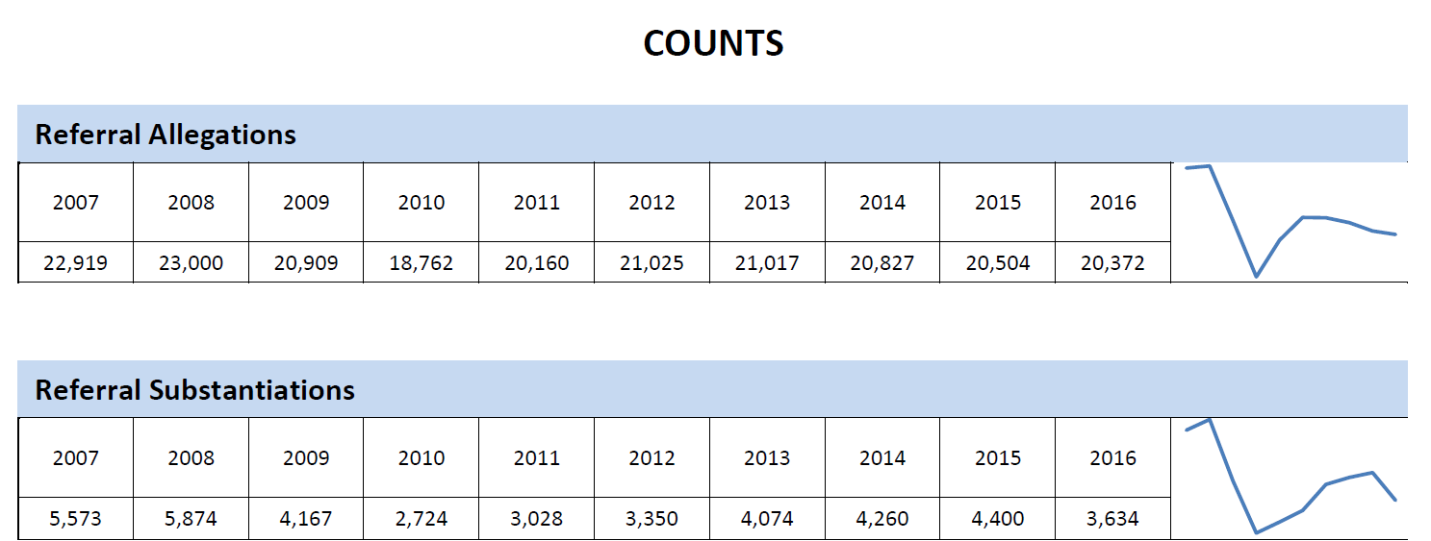
How many reports of child abuse/neglect does Sacramento County receive?
Notes:
Use this slide to provide comparison between allegations received per year and how many referrals are actually substantiated. A note to point out that just because a referral is substantiated does not mean a petition is filed.

Slide 8
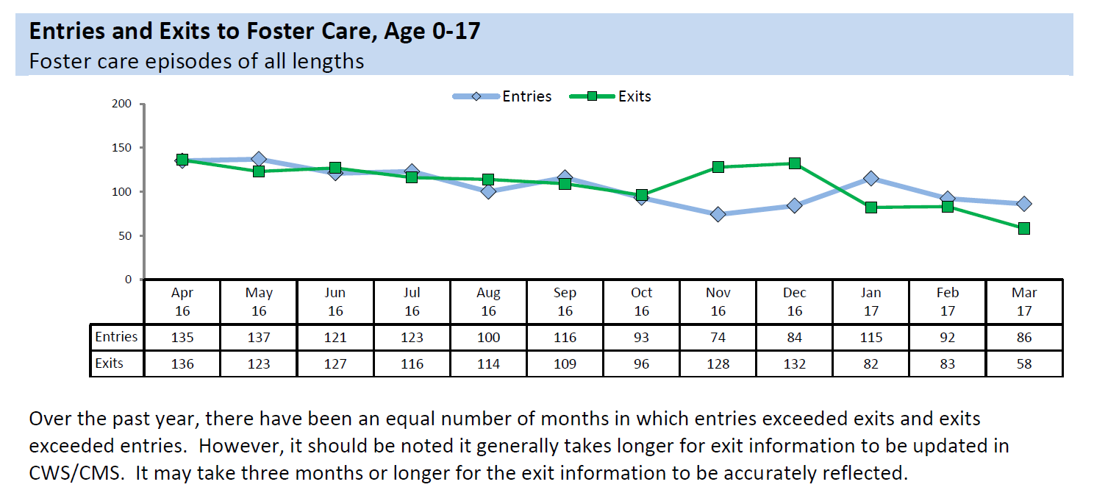
Number of children that entered FC and exited FC in Sacramento County in the last year…
Notes:
This data provides applicants a comparison of entries and exits into/from FC in the county.

Slide 9
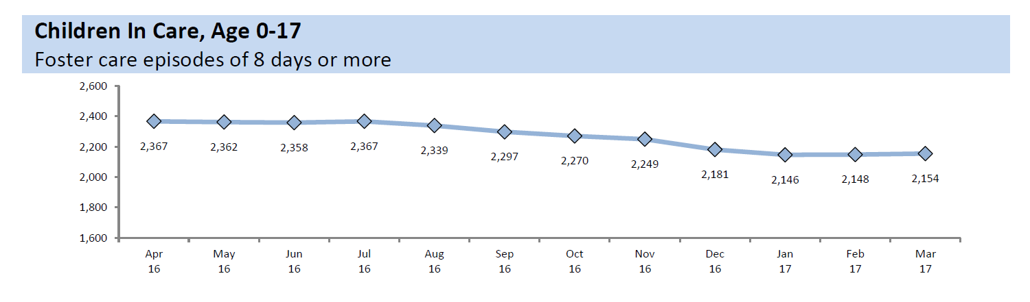
Children in care in the last year….
There are approximately 2,070 children currently in foster care in Sacramento County (latest data)
Notes:
This slide provides info of our numbers of children in care decreasing. The 2,070 number is the latest as of summer 2017

Slide 10

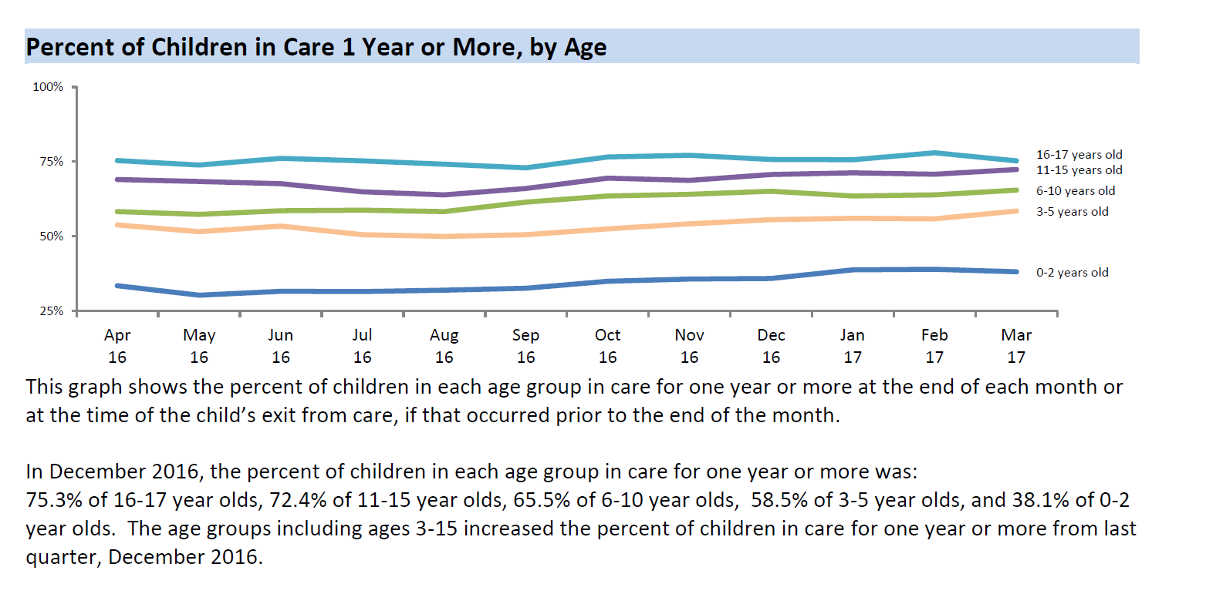
In care by age
Notes:
This chart provides the numbers by age which shows applicants that the majority of our children are school aged/teens

Slide 11
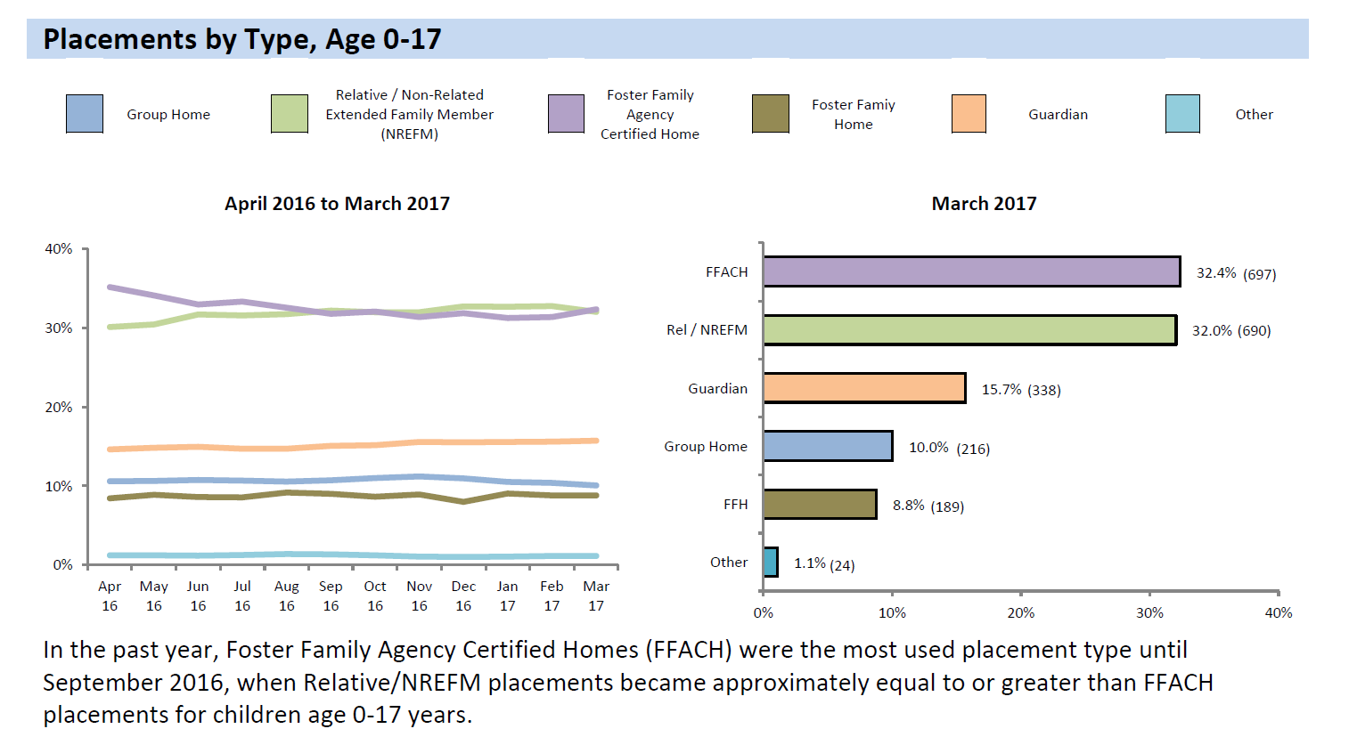
Where our children are placed..
Notes:
Use this chart to demonstrate to applicants that we are increasing relative/NREFM placements/ and want to continue increasing and also want to increase county RFA home placements.

Slide 12
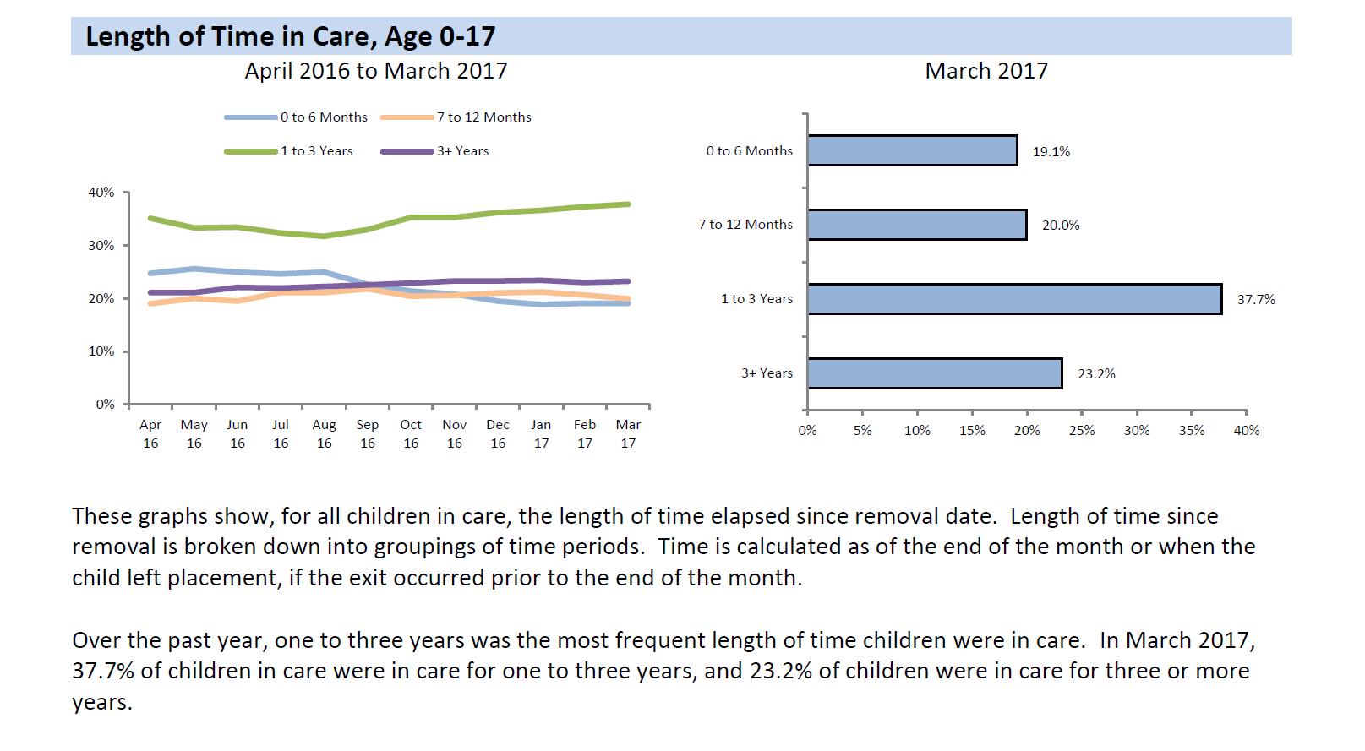
How long do they stay in FC?
Notes:
Use this chart to show how long are children are staying in foster care and can correlate to the legal timeframes for reunification

Slide 13
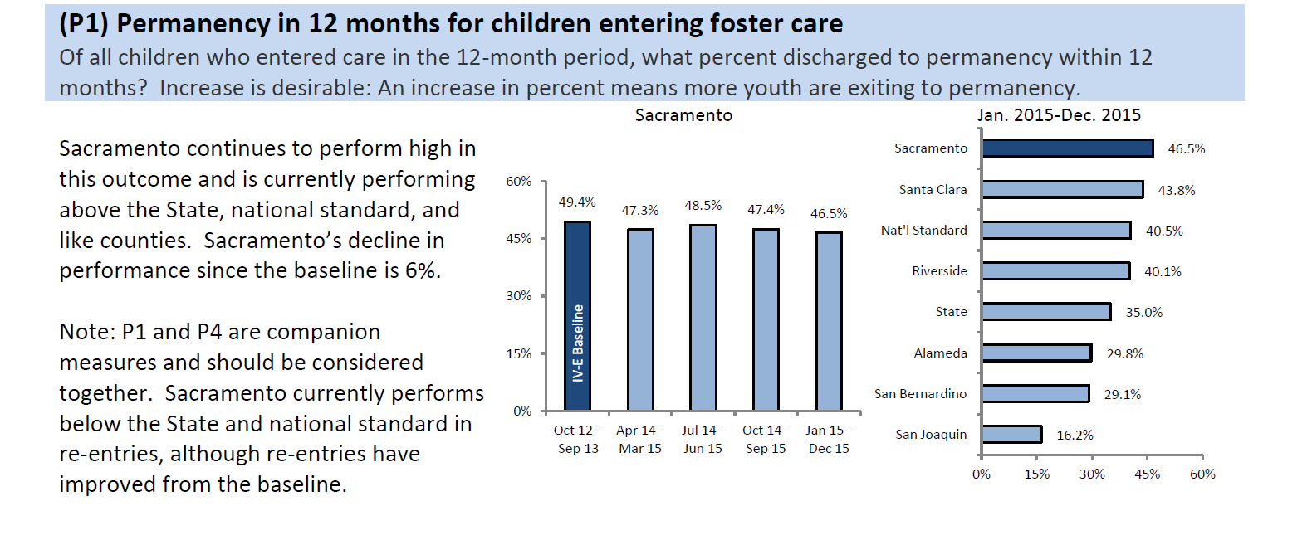
Permanency outcomes in 1 year (permanency means FR/adoption/guardianship)
Notes:
Use this chart to provide information to applicants about permanency outcomes for our children after 1 year of coming into FC. Ensure to mention permanency is either reunification/adoption/guardianship

Slide 14
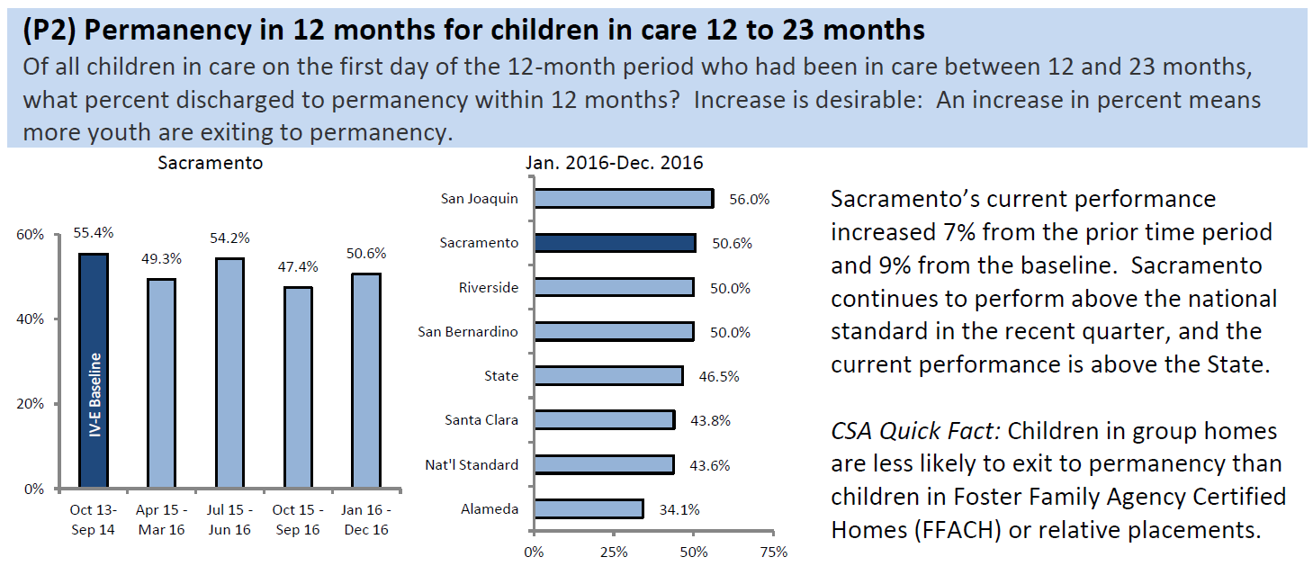
Permanency outcomes in 1-2 years..
Notes:
Use this chart to show applicants the outcomes for permanency after 1-2 years of coming into FC

Slide 15
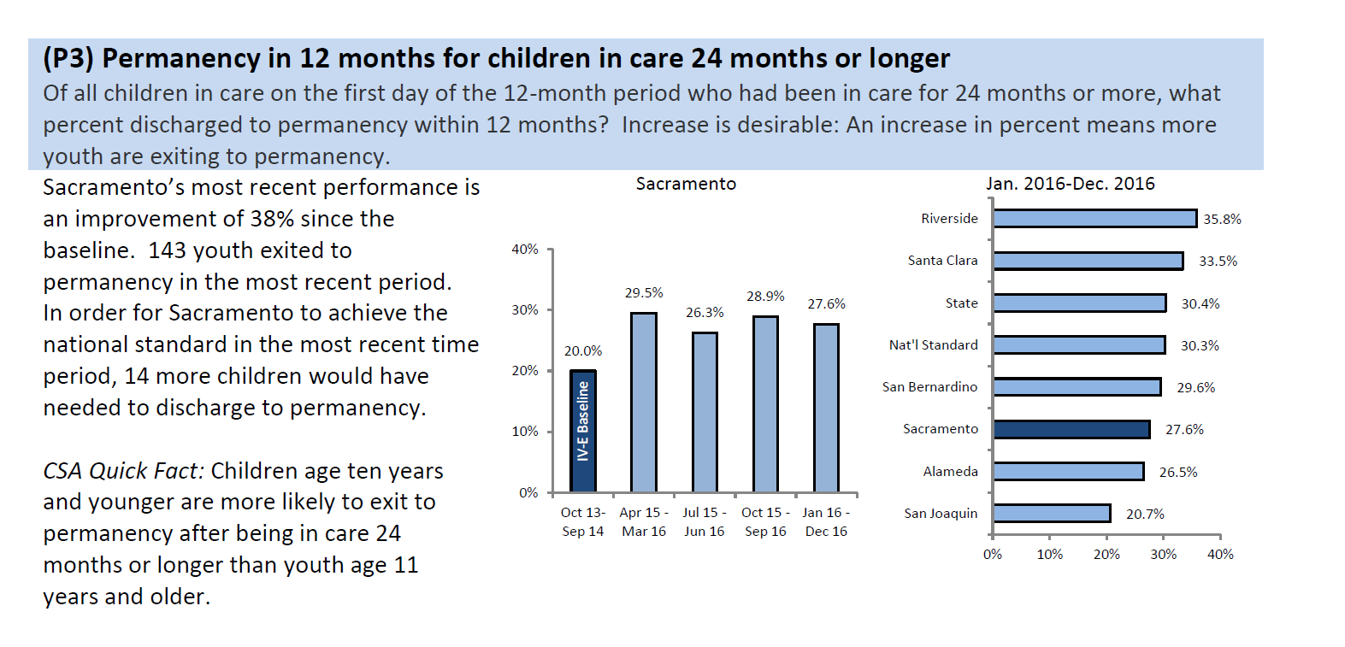
Permanency outcomes in 2 years or longer
Notes:
Use this chart to demonstrate how permanency outcomes significantly decrease after 2 years or more…

Slide 16
Alumni of Foster Care
Mean length of time in Foster Care was 6.1 years
Placement change rate was 1.4 placements per year
Alumni of Foster Care show disproportionate numbers of mental health disorders, more likely to have completed high school through GED, 7 or more school changes from ES to HS, less likely to complete advanced degree, higher unemployment rate.

Slide 17

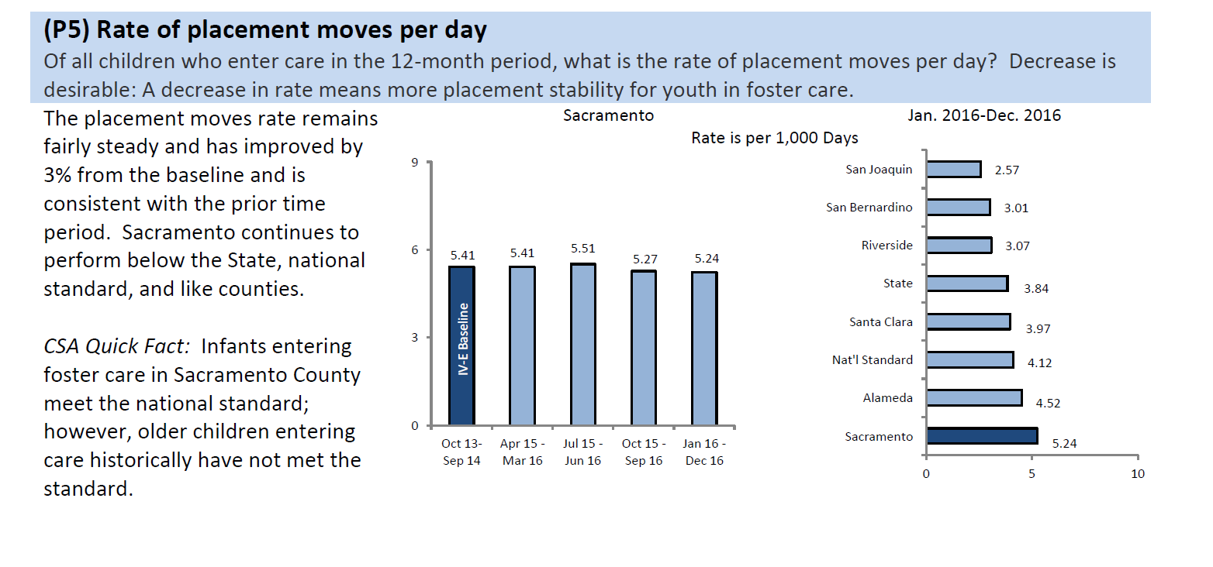
Placement changes….
Notes:
Use this chart to show the number of placement changes per day for our children.

Slide 18

How can we make things better?
Low number or no placement changes
Shorter time in foster care
Low or no school changes
Educational resources
Basic needs when exiting foster care

Slide 19

Major types of abuse/neglect
Neglect (physical, medical, educational, emotional)
Physical abuse
Sexual abuse
Emotional abuse

Slide 20
Possible Indicators of abuse/neglect
Physical Abuse: unexplained burns, bites, bruises (different stages of healing), broken bones, black eyes, frightened of parent, reports injury caused by caregiver
Neglect: frequent absences from school, lacks medical/dental care, consistently dirty/body odor, inappropriate clothing for the weather, uses alcohol/drugs, states no one is home to provide care
Sexual Abuse: may refuse to change or participate in PE, nightmares/bed wetting, change in appetite, sexualized behavior that is not appropriate for age, runs away, difficulty walking or sitting
Emotional Abuse: extremes in behavior, physical/emotional development, suicide attempts, lack of attachment to parent

Slide 21
What are the long term consequences of abuse/neglect?
Physical: shaken baby syndrome, impaired brain development, poor physical health
Psychological: low self esteem, depression, withdrawal, relationship difficulties, anxiety, eating disorders, suicide attempts, other mental health disorders, cognitive difficulties- lower language development and lower academic achievement, social difficulties- antisocial traits/violent behavior
Behavioral: delinquency, teen pregnancy, poor school performance, drug use, sexual risk taking, more likely to be arrested for criminal bx as juvenile and adult, alcohol/drug use, more likely to victimize their own children
Societal: high cost of maintaining CWS, high cost of LE, health, mental health systems, long term costs (juvenile/adult criminality, mental illness, drug use, domestic violence, loss of productivity/unemployment/under-employment)

Slide 22
Child fatalities in Sacramento County
During the period of 2010-2012, 413 children, birth through 17 years of age, died in Sacramento County. Deaths by natural causes were 79% (325 of 413); injury related deaths were 19% (80 of 413) and undetermined deaths were 2% (8 of 413).
During this report period, 11 of the injury related deaths (14%) were the result of a child abuse and neglect homicide. Half of the injury related deaths (40 of 80) were youth 10 to 17 years of age. Of these, 19 deaths were third party homicides, two were child abuse and neglect homicides and 10 were suicides.

Slide 23
Other major findings include:
The majority of perpetrators of child abuse and neglect homicides in Sacramento County are biological parents.
Nearly half of child abuse and neglect homicide perpetrators have a known history of involvement with Child Protective Services as children.
Three-fourths of child maltreatment deaths occurred in children five years of age or under.
African-American children died at a rate more than two times higher than that of all children in Sacramento County.

Slide 24
How does CWS work?
Anyone can make a report of suspected child abuse/neglect
The majority of reports are made by Mandated Reports
In Sacramento County the hotline is staffed 24/7, (916) 875-5437 (KIDS). Intake SW’s and Sup’s determine whether the information reported meets the legal criteria for investigation (IR or within 10 days)
If the referral is investigated the SW with all the information gathered must make a determination whether to remove the child (exigent circumstances or ask Court for PC warrant), or for the child to remain in the home (SW may still file a Petition with the Court to ask for intervention). Other scenario is the family is referred to preventive voluntary services or community programs

Slide 25
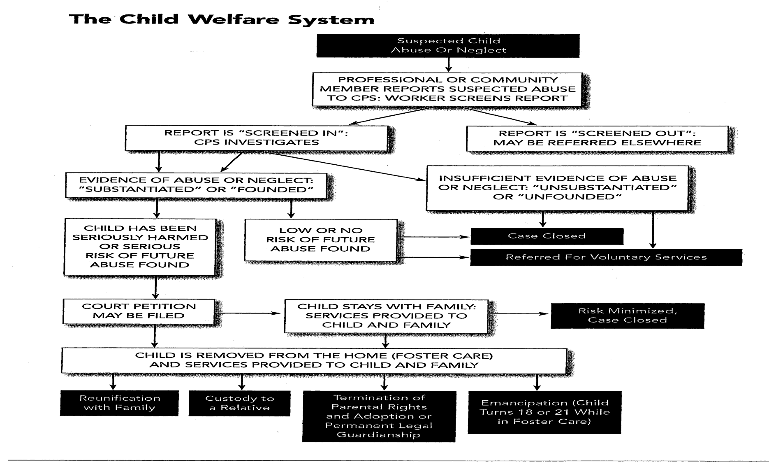

CWS flow chart

Slide 26

What is a Mandated Reporter?
Described in Penal Code Sections 11164-11174.3 9 (take a look at page 51)
“Reasonable” suspicion of abuse/neglect must be reported! Page 53
Report to police or sheriffs department or county child welfare agency (CPS)
Report within 36 hours of receiving the information/follow up with SCAR
Mandated Reporters have immunity from criminal/civil liability for making a report as long as it was in good faith
If Mandated Reporter fails to make a report they may be held liable

Slide 27
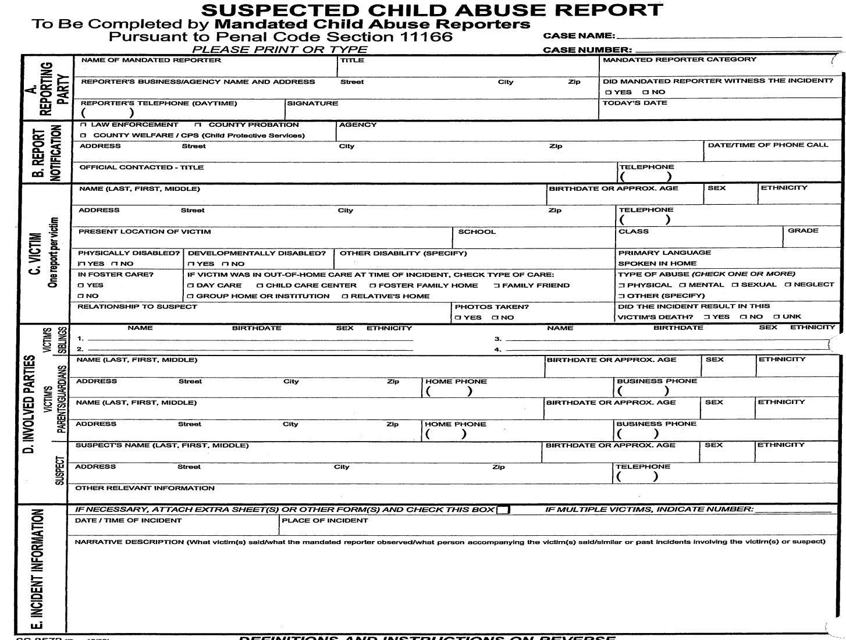
SCAR

Slide 28

Juvenile Dependency Court System

Slide 29
A social worker or law enforcement officer can place a child into protective custody either through exigent circumstances or PC warrant
Protective Custody
Within 48 hours the social worker must file a
petition
Before the Court and within 72 hours the Initial/Detention Hearing takes place.
PETITION:
  A legal document that states the allegations that can be supported by evidence and demonstrate to the Court the reasons necessary for protection of the child.
INITIAL/DETENTION REPORT:
  A report prepared by the social worker indicating the preventive services offered to the family along with the reasons that they are asking the Court to intervene for the child’s safety.
Initial/Detention Hearing

Slide 30
INITIAL/
DETENTION HEARING
15 days
Jurisdiction/Disposition Hearing
(Evidence for Court to take Jurisdiction and what will be the plan)
Audiencia de
(Audiencia de pruebas )

Slide 31
The Department prepares a report for the Court with the recommendations
DISPOSITION
3 options: FM/ FR/ PP
FAMILY MAINTENANCE/
DEPENDENT SUPERVISION
The child remains in the home with parents
This is the least restrictive plan
FAMILY REUNIFICATION
The child is placed in out of home placement (relative/NREFM/resource family), while the Department offers the parents services to address the reasons they came to the attention of CPS/Court.
PERMANENT PLACEMENT
This is the most restrictive plan

Slide 32
Substantial progress for a child less than 3 years old or sibling group with one child less then 3 years old
If all the children are over the age of 3 years old, the minimum length of services is 12 months
Family
Reunification
SW must evaluate the progress made by the parents
If the parent makes substantial progress they may continue in services
6 month review hearing
If there is no progress?
SW must recommend to terminate services
How is this determined?
12 month review hearing
The parent does not make adequate progress
Permanent Placement:
This is addressed at the Disposition Hearing or at any of the review hearings
The Department may recommend either of:
The parents are not offered services at Disposition
Termination of services at any of the review hearings
The parent does not make adequate progress
18 month review hearing
Family Maintenence status is also reviewed every 6 months!
Hearing

Slide 33
Concurrent Planning
= 2 pathways-CPS is responsible for developing both plans!
Reunification Plan
-This is the primary goal
Other option for legal permanence for the child
-If reunification cannot happen

Slide 34
Selection and Implementation Hearing, WIC 366.26
Hearing that determines whether parental rights are terminated:
If the Court terminates parental rights this allows for the child to be considered “legally free”, for adoption proceedings to begin.

Slide 35
How can caregivers provide input to the Court?
Read “Caregivers and the Courts” Page 59
You may attend the child’s court hearing
You may provide information to the child’s attorney
You may provide information to the Court in writing by using form JV-290 “caregiver information form” (file at Court window)
You may provide information to the child’s social worker

Slide 36

Break Time..please return on time

Slide 37

Removed Part 1
Notes:
Discuss important part of video, ask their thoughts/feelings

Slide 38
Indian Child Welfare Act (ICWA)
Enacted in 1978
Federal law to keep Native children with Native families
This was a response to disproportionate rates of Native children being removed from their homes/families
Only applies to child welfare proceedings, juvenile probation and adoptions proceedings that involve Native children who is a member or eligible for membership in a federally recognized tribe

Slide 39
Record Keeping…best practices
Report unusual incident/injury ASAP to the child’s SW (follow up with written report see page 72)
Keep child’s binder/folder up to date with all pertinent documentation (this binder/folder goes wherever child goes)
Separate records for each child
Pre-placement questionnaire-good tool to use when called for placement
Health & Education passport-contains all educational, medical and dental information that CPS has for child

Slide 40

Prudent Parent Standards
It is getting better!
AB 408 and SB 358
All County Letter No. 05-39–Extra curricular enrichment and social activities for children in foster care
All children must participate in age appropriate activities (sleep over w/friends, social events, school sponsored field trips, scouting, birthday parties)
Use prudent parent standards that are reasonable when making decisions and providing permission for activities

Slide 41

Prudent Parent continued…
This does not allow for unsupervised contact with adults
Keep in mind risk factors depending on the activity, age and development of the child
This law, SB 358 Scott, exempts from those requirements individuals engaged by a licensed or certified foster parent to provide short-term care to a foster child for periods not exceeding 24 hours
This bill holds caregivers to a reasonable and prudent parent standard in the selection of babysitters, as specified.

Slide 42
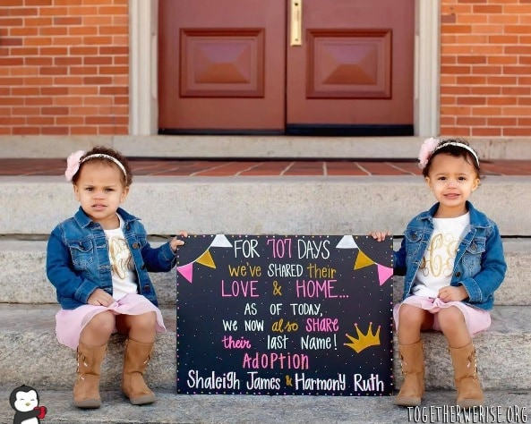
Permanency Options (page 85)
Adoption:
Transfers parental rights to the adoptive family. This is the most permanent plan for a child that is not able to reunify with their biological parents.
Guardianship:
This plan suspends the parental rights of the parents. Some of those rights may be transferred to the guardian, and some may be kept by the Court. A guardianship may be terminated by the Court.

Slide 43
AB 458 Foster Care Non-Discrimination Act
Prohibits discrimination in CA foster care system on the basis of actual or perceived race, ethnic group, ancestry, national origin, color, religion, sex, sexual orientation, gender identity, mental or physical disability, HIV status.
Have rights to fair and equal access of all available services, placement, care, treatment and benefits
Not subjected to discrimination or harassment on the basis of actual or perceived sexual orientation or gender identity

Slide 44

Foster Youth have rights!
THEY HAVE THE RIGHT TO LIVE IN A SAFE, COMFORTABLE HOME WITH:
  enough clothes and healthy food
  their own place to store their belongings
  an allowance (group home)
  a phone that they can use to make confidential calls (unless a judge says they cannot)
THEY HAVE THE RIGHT TO:
  be treated with respect
  go to religious services and activities of their choice send and get unopened mail (unless a judge says someone else can open their mail)
  contact people who are not in the foster care system (like friends, church members, teachers, and others)
  make contact with social workers, attorneys, probation officers, CASAs, foster youth advocates and supporters, or anyone else involved with the case
  be told about their placement by their social worker or probation officer

Slide 45
Continued…
NO ONE CAN:
  lock them in a room or building (unless they are in a community treatment facility)
  abuse them physically, sexually or emotionally for any reason
  punish them by physically hurting them for any reason
  look through their personal belongings unless they have a good and legal reason
CONNECTION WITH A CARING ADULT:
  they have the right to identify and maintain relationships with appropriate people who are important to them, as long as it's in their best interest. The intent of current law is that no child shall leave foster care without a permanent, caring relationship with an adult.

Slide 46
More…
THEY HAVE RIGHTS AT COURT TOO. THEY CAN:
  go to court and talk to the judge
  see and get a copy of their court report and case plan
  keep their court records private, unless the law says otherwise
  be told by their social worker or probation officer and their attorney about any changes in the case plan or placement
THEY HAVE HEALTH RIGHTS. THEY CAN:
  see a doctor, dentist, eye doctor, or talk to a counselor if they need to
  refuse to take medicines, vitamins or herbs (unless a doctor or judge says they must)
  if they are 12 years old or older, they have the right to information about their sexual health in a way that they understand. This includes learning about the way sexually transmitted infections and diseases (STDs) are spread and how they can prevent them; how they can prevent pregnancy and what to do if they are pregnant

Slide 47
And more…
THEY HAVE SCHOOL RIGHTS. THEY CAN:
  go to school every day
  go to after-school activities right for their age and developmental level
THEY HAVE THE RIGHT TO DO SOME THINGS ON THEIR OWN. THEY CAN:
  have their own emancipation bank account (unless their case plan says they cannot)
  learn job skills right for their age
  work, unless the law says they are too young, manage the money they earn (if right for their age, developmental level and it’s in their case plan)
  go to Independent Living Program classes and activities if they are old enough

Slide 48
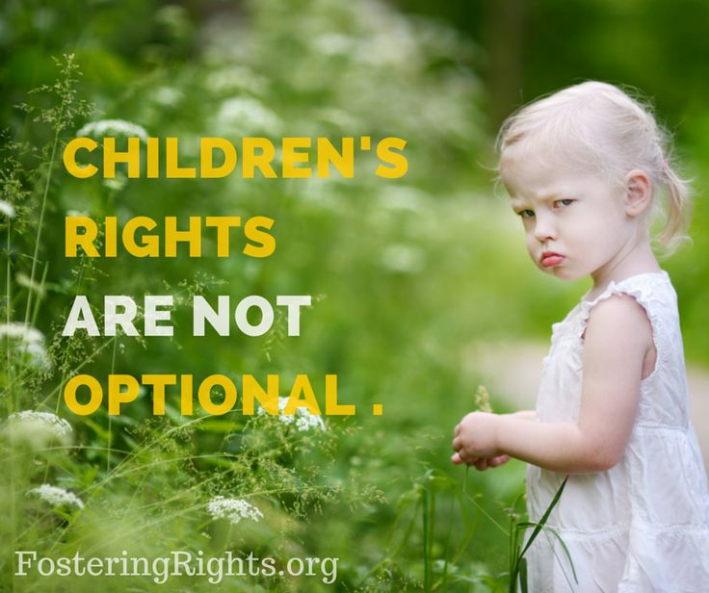
And even more…
THEY HAVE FAMILY RIGHTS TOO. THEY CAN:
  visit and contact their brothers and sisters (unless a judge says they cannot)
  contact parents and other family members, too (unless a judge says they cannot)
THEY HAVE OTHER RIGHTS TOO. THEY CAN:
  tell the judge how they feel about their family, lawyer, and social worker
  tell the judge what they want to happen in their case
  have their own lawyer
  live with a family member if that would be a safe place
  call the Foster Care Ombudsman Office and Community Care Licensing at any time
  get help with school if they need it
THEY CAN PARTICIPATE IN SOCIAL ACTIVITIES:
  they have the right to participate in age-appropriate extracurricular, enrichment, and social activities such as church, school and community activities, sleepovers with friends, scouting and 4-H, without requiring criminal background checks of chaperones, friends and friends' parents/supervisors.

Slide 49

That is all for tonight..Good Night..see you Thursday…

