Slide 1
Resource family Pre-Approval
Class 3

Slide 2
Agenda for Tonight
Housekeeping Items
Icebreaker Activity
Presentation of material (Mental Health, Medication, Attachment)
Break (10 minutes)-optional/class vote
Video (Removed Part 2)
Finish presentation of material (Visitation/Working with Birth Families, Cultural Best Practices, LGBTQ)
Notes:
This is a sample agenda.

Slide 3
Foster Youth Mental Health Bill of Rights
Can participate in decisions about diagnosis and treatment , medication
12 years or older can seek and consent to Medical Health service on their own (except for psychotropic meds)
Have the right to only take meds prescribed by their doctor
Be informed of risks and benefits of psych meds
Can disagree with the recommendation for meds
Have the right to tell the judge they disagree
Can contact their MH providers
Right to confidentiality
Continue receiving MH services regardless of placement changes, even out of county

Slide 4
MH services for children in CWS
Should include pediatric assessment to check for medical conditions/recommendations
Further tests and health screenings, if required
Developmental assessment
Mental health assessment (family history, social, behavior, response to stress, signs of maltreatment
SW’s complete initial and ongoing mental health screenings also
If it is needed or requested the SW will complete a referral to county ACCESS team to begin the assessment process

Slide 5
THERAPY CAN OCCUR IN DIFFERENT SETTINGS…
Individual Therapy (assists children/teens experiencing mental health issues such as, depression, anxiety and/or behavioral problems/usually ages 4 and up)
Group Therapy (assists children with social/behavioral problems)
Family Therapy (helps children/
families build healthy relationship/communication/problem solving/healthy coping strategies)

Slide 6
SOME EXAMPLES OF TYPES OF SERVICES….
In-Home Behavioral Therapy (can improve daily living skills, routine, reduce disruptive bx)
Infant Mental Health (focuses on building strong/nurturing relationship between child and caregiver)
Parent Child Interaction Therapy (PCIT)-(ages 2-7 and can help improve the quality of the parent/child relationship by teaching parents the skills/tools to manage their child’s behaviors)
Trauma Focused Cognitive Behavioral Therapy (can help children overcome trauma related difficulties)
Therapeutic Behavioral Services (TBS)-(identifies interventions/strategies to change a child’s behavior)
Expressive Art Therapy

Slide 7
What are psychotropic medications?
Any medication capable of affecting the mind, emotions, and behavior.
Some examples are….abilify, adderall, concerta, lamictal, lexapro, paxil, prozac, risperdal, ritalin, strattera, trazodone, valium, xanax, zoloft…among others…

Slide 8
IMPORTANT!
Dependent children cannot take psychotropic medications without a Court order!
If a doctor/psychiatrist recommends psychotropic medications please speak to the child’s SW so they can assist with securing court order to administer medication.

Slide 9
Best practices about medication…
Refer to pages 7-10 in the binder for more information on best practices at the child’s first medication/follow up medication appointments
JV-220(A)- (copy in binder) this form the doctor/psychiatrist must fill out and submit to the Department if recommending psychotropic medication
Does not mean child can begin taking medication….they cannot until it is approved by the Court

Slide 10
JV 218 form is for the child to provide their opinion about the medication, or they can tell the SW, and the Judge in Court (copy in binder)
JV 219 form is for a caregiver, CASA or parent to provide their opinion (copy in binder)

Slide 11
What is attachment?
Evolutionary emotional tie
Reciprocal process by which an emotional connection develops
Intense affection bond
Instinctual process

Slide 12
Basic Principles: Forming Attachments
The child is highly motivated from birth to form and maintain attachments to a few caregivers
Attachment has survival value
Children will do whatever is necessary to maintain their attachments and to achieve security
The baby uses the attachment figure as a “secure base”

Slide 13
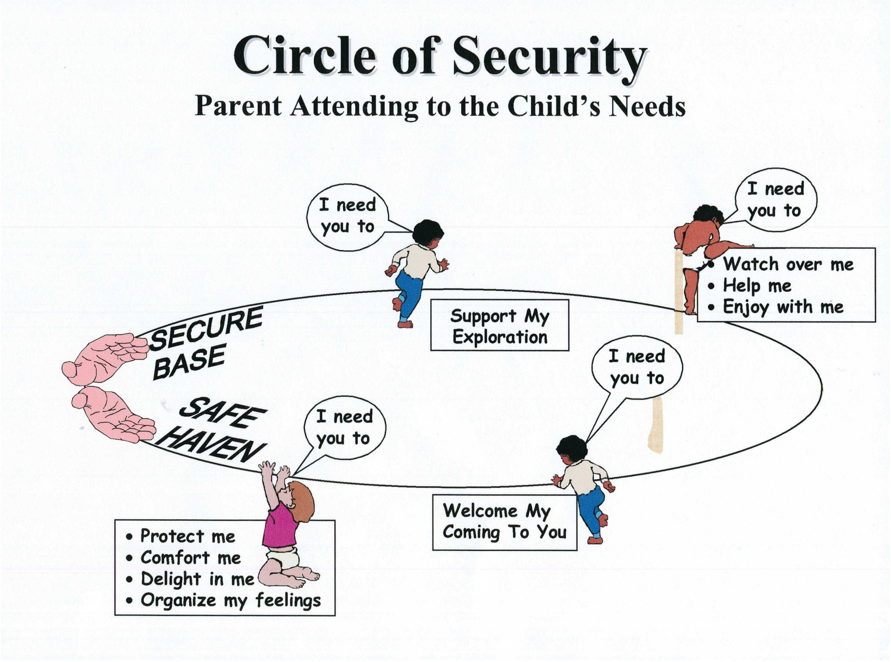
Cooper, Hoffman, Marvin &Powell , 2000

Slide 14
More basic principles: Attachment Security
Attachment figures become “psychological parents”
All babies attach but the security of the attachment depends on the caregivers responses to the child
Sensitivity: Reading the infant’s signals accurately and responding to them appropriately
Insightfulness: Seeing things from the child’s point of view; empathic understanding of the child’s experience

Slide 15
Attachment: Infancy and Beyond
Early attachments lay the groundwork for later development
Children form Internal Working Models of their attachment relationships
The legacy of early attachment is reflected in children’s relationships with others, self-regulation, emotional openness.

Slide 16
Separations from attachment figures
Are challenging for young children – and for all of us!
The child experiences separation as a threat to the availability of the secure base.
The degree of challenge will depend on the degree of threat
Often involves separation not only from the parent but from everything familiar
Strong reactions will occur when separating from nurturing parents - but also from abusive parents!
Under certain conditions separations can be traumatic and have devastating consequences.

Slide 17
Separation reactions
Follow the sequence of:
Protest: anxiety, anger
Despair: sadness, withdrawal
“Detachment” : recovery, renewed interest in the world

Slide 18
Patterns of attachment
Secure attachment
Proper cycle: infant/child feels threatened, needs help/has need and elicits help/comfort from caregiver. Caregiver correctly reads the needs and tends to the need. The child is satisfied.
Insecure attachment
Resistant (child is uncertain)
Avoidant (child expects rejection from caregiver)
Disorganized (child is confused)

Slide 19
What you may encounter with a child who has attachment problems…
Different ranges of developmental delay (motor, language, emotional, social, and cognitive)
Eating (hoarding food, hiding food, or excessive eating, may have failure to thrive diagnosis, other eating disorders
Soothing (may use very primitive soothing behaviors/biting, head banging, rocking, chanting, scratching, cutting)
Emotional (depression, anxiety, indiscriminant attachment, aggression/cruelty/
poor impulse control)

Slide 20
How to re-build attachment
Eye contact, smiling
Comforting, holding, rocking
Feeding
Warming/cooling
Verbal assurances
Singing, reading
Good smells
Games
Listening/talking
Spend time together (one on one)
Introduce activities that are joyous
Dance
Play child’s favorite game or do favorite activity
Praise
Remembering together favorite memories

Slide 21
SOME EXAMPLES…

Slide 22
Break Time…

Slide 23
Movie time…Removed part 2

Slide 24
The importance of visitation
Facilities reunification and improves reunification odds
Allows for assessment of how visits are going
Maintains relationships
Guides parents in a controlled setting
Both mother and father have right to visit with child
Grandparents and other relatives can visit child as well (this is at the SW’s discretion as well as whether this is unsupervised/observed/unsupervised/overnight)
Only the Court can stop visits
Visitation is one of the best indicators of reunification between child/parent

Slide 25
Resource family’s responsibility
Arrive early or on time
If a parent does not show up you must wait 15 minutes and can then leave
Visitation must be made up to parents if a visit was cancelled/missed due to no fault of their own
Be flexible
Be prepared
Prepare the child for visit in regards to clothing, food/snack/drink, take activities or school items, homework (depending on age of child)
A Resource Family can never use loss of visits as discipline

Slide 26
HOW DOES VISITATION WORK?
Visitation recommendation is made by CPS to the Court/Court has the ultimate decision in what the visitation order is
Usually the progression of visits is Supervised, Observed, Unsupervised, Overnights-this is line with the progress toward reunification
The details of the visits such as, time, place and manner are at the SW’s discretion
You may be asked by SW if you are comfortable supervising/observing visits
If you are not comfortable supervising/observing you can still be a support for the child during this time by providing transportation

Slide 27
JUVENILE COURT STANDING ORDER ABOUT VISITATION STATES:
Child’s Desires: The social worker may consider the child’s desires in administration of the visits, but the child shall not be given the option to consent to, or refuse, future visits.
Under the Influence: The parent/guardian, relatives and non-related extended family members shall not be under the influence of alcohol or controlled substances at any visit.
Subjects Discussed: During visitation, the parent/guardian, relatives and non-related extended family members shall not discuss the following subjects with the child:
1. court proceedings;
2. the allegations in the petition;
3. promises or predictions about the outcome of the case; or
4. promises or predictions about placement issues.

Slide 28
After visits you may feel or see this from the child….
FEELINGS:
Happy, less afraid, more afraid, confused, excited, rejection, hostility, guilt, sadness, shame, fear of the unknown…
BEHAVIORS:
Quiet, talkative, hyperactive, clinging to parent, clinging to RP, regressive, aggressive, wetting the bed, talking about going back home/parent, relieved, relaxed

Slide 29
Please Always Remember…
Birth parents love their children
Our children in care love their parents
Visitation is a part of being a Resource Parent
Do not ever speak negatively/ill of the child’s parent or make them feel that visitation is a burden for you/or their fault

Slide 30
Working with birth parents…THIS MAY BE DIFFICULT…
Parents may resort to coping in unhealthy ways
They may have a hard time controlling their emotions
Loss of control
They may find it difficult to trust others-especially those in power-social workers/judges/Resource Parents
More vulnerable to trauma reminders (during visits, court hearing, or interactions with Resource Parents or authority figures)
They may mistrust or be jealous/they may second guess you or question your discipline or caretaking choices

Slide 31
Working with the birth parents…
Can be the hardest aspect for a RF and working out issues with the birth parents/family
Work to develop an understanding and respect for the family of origin
Understand that birth parents often times may have many issues/trauma they are dealing with
A good relationship between RF and parents can promote child safety, permanence and well being
It can create a sense of safety, security and support for the child

Slide 32
Cultural best practices
Know the culture of foster care
Be warm, welcoming and respectful
Look inside yourself for any of these (assumptions, bias, prejudice)
Find yourself and then move forward (denial, defense, minimization, acceptance, adaptation, integration)
Write your script after each experience
Acknowledge culture
Don’t be overconfident
Consensus on family matters
Use good words
Cultural elements that matter
Use the communication style that fits
Answer questions about differences

Slide 33
Other things to keep in mind….
Diet
Personal hygiene
Dress/clothing
Environment
Male-female relationships
Parent-child relationships
Religious beliefs/practices
Language
Cultural traditions/holidays
Life views
Sexuality
Moral/social practices
Extended family

Slide 34
LGBTQ
FY ages 0-18 who identify as Lesbian, Gay, Bisexual, Transgender, Queer/Questioning
Typical age range for those in need is 12-18
LGTBQ youth are more than 2x as likely as their non-LGBTQ peers to report being treated poorly by the foster care system
More likely to run away from placement due to hostility they face
More likely to experience verbal harassment or physical violence in placement
Experience more frequent placement changes
May receive fewer services

Slide 35
What’s the difference?..THERE IS ONLY 1…THESE YOUTH ARE LGBTQ
Issues impacting teens in FC
Trauma of abuse/neglect
Removal from their family
Separation from siblings
Stigma of foster care
Being involved in the dependency system
Having them repeat their story multiple times
Going through adolescence with strangers watching every move
Placement changes
Labeling behavior problems
Isolation
Embarrassment
Issues impacting LGBTQ youth in FC
Trauma of abuse/neglect
Removal from their family
Separation from siblings
Stigma of foster care
Being involved in the dependency system
Having them repeat their story multiple times
Going through adolescence with strangers watching every move
Placement changes
Labeling behavior problems
Isolation
Embarrassment
GOING THROUGH A COMING OUT PROCESS

Slide 36
HOW YOU CAN HELP…
Educate yourself and community of support about experiences and needs of LGBTQ youth in care
Have an open mind to the trauma they have gone through
Provide nurturing safe environment
Have clear expectations
Talk with youth openly and support them
Allow choices
Ask for help
Find out about resources to help support LGBTQ youth
Send clear signals of acceptance
Allow youth to wear clothing/hair style that expresses the way they feel inside and to participate in activities that let them express themselves
Provide age appropriate activities and support their involvement in LGBTQ activities
Consider opening your home to an LGBTQ youth

Slide 37
Good Night…see you Thursday!

