Slide 1
Resource Family Approval Training
Day 1: Overview of RFA
Version 6.0|August 1, 2019

Slide 2
Purpose of this Training
To provide County staff with information on the Resource Family Approval (RFA) program.
This program directly impacts counties and foster family agencies by creating a new foster caregiver approval process that replaces the previous processes of licensing or certifying foster homes and approving relatives and prospective adoptive parents and guardians.

Slide 3
Learning Objectives
Learning Objective Ice Breaker Activity

Slide 4
Day 1 Training Overview
Goals and Objectives of RFA
Review of E-learning
RFA Key Messages
Focus on Permanency
Cultural Humility
Home Environment

Slide 5
E-Learning Review
Jeopardy Game

Slide 6
RFA Key Messages
Focuses on Lifelong Relationships & Quality Parenting
No additional approvals for adoption or guardianship
Considers ability to meet the needs of vulnerable children
Achieves Results for Children and Families
Families are better prepared and supported
Training and support for all families → more stability, fewer moves
Improves Efficiency
Eliminates duplicative processes

Slide 7
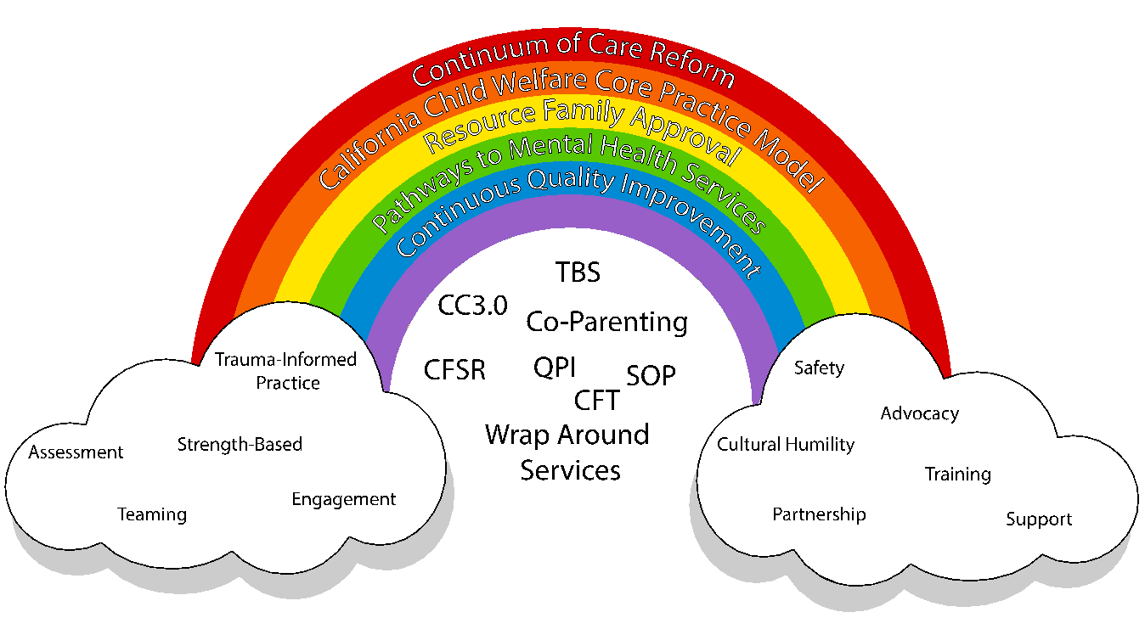

Slide 8
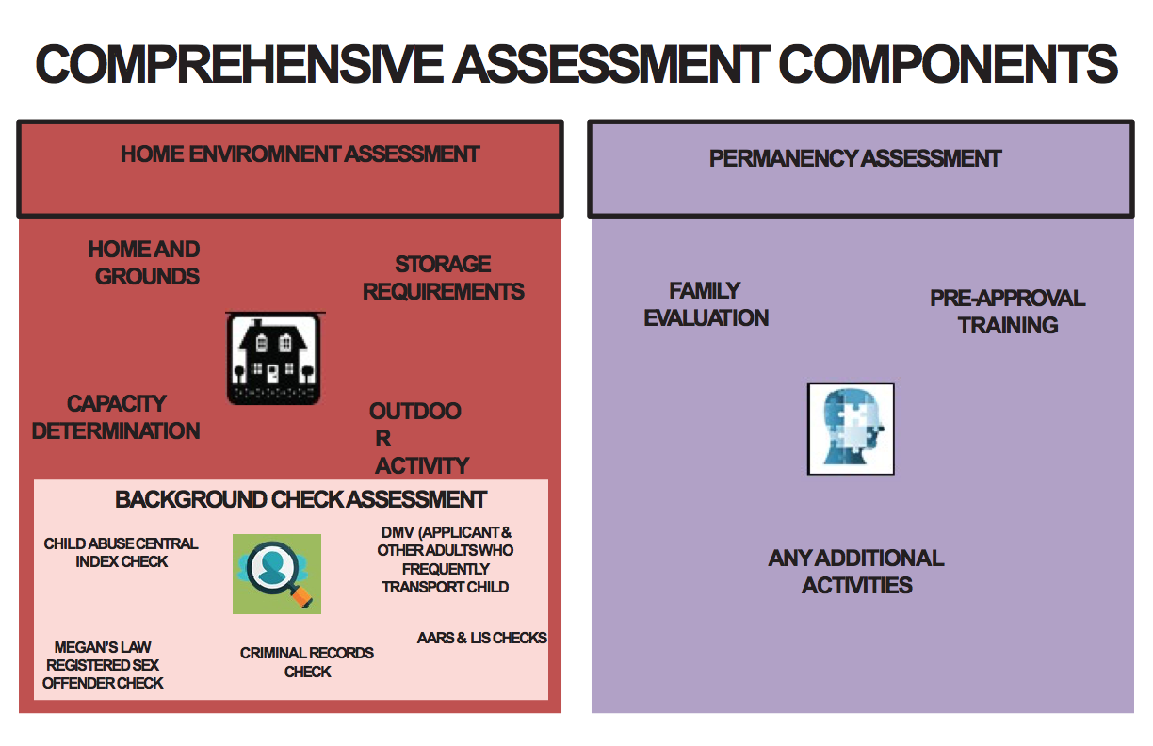

Slide 9
Thinking about Permanency
VIDEO

Slide 10
Permanency: What is it?
Reunification
Adoption
Guardianship
Lifelong committed parents
Lifelong connections
Mentors

Slide 11
How Does RFA Support Permanency
RFA focuses on quality relationships and lifelong parenting
Considers ability to meet the needs of vulnerable children
Ensuring Native American Children are being placed within their tribes via Tribally Specified Homes. (ACL 19-17)
Families are better prepared and supported
Training and support for all families = more stability
No additional approval for adoption or guardianship

Slide 12
Activity: Looking at Engagement
Role Play: The James Family

Slide 13
Culture Video
VIDEO
Notes:
https://www.youtube.com/watch?v=76BboyrEl48

Slide 14
Group-Table Activity
Discussion:
What are some things observed in the video you perceive as culturally bias?
How might similar biases come up when working with resource families?

Slide 15
Practicing Cultural Humility
Those who practice cultural humility view others as capable and work to understand their worldview and any oppression or discrimination that they may have experienced as well.
They use their best communication skills—open-ended questions and reflective listening—to explore their concerns, thoughts, and ideas.

Slide 16
Activity: Engaging around Culture
Having the Conversation
Read June and Jon Sun Scenario (pg. 39-40)
How would you engage this family and be culturally sensitive?
Complete a role play activity in groups of three.
Observer questions:
How did you know the Resource Family felt heard?
What were some examples of engagement?

Slide 17
RFA Application
An Applicant must be 18 years of age
An Applicant must be in good physical and mental health
RFA Application (RFA 01)
Supporting Documents
Proof of ID
Consent to a DMV Record check
Health Questionnaire (RFA 07)
Verification of current employment
Verification of income
Verification that an applicant owns, rents, or written permission to reside in home.
History as an approved, licensed, or certified family home or as an employee in a license facility.

Slide 18
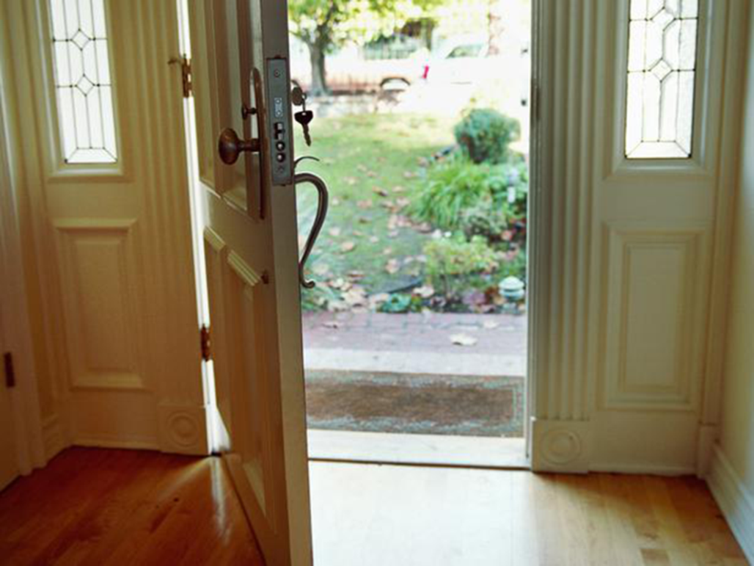
Home Environment
Home Environment Assessment is conducted

Slide 19
Capacity Determination
There cannot be more than six (6) children in the home, including bio, adoptive, and guardianship children, unless there is a sibling group placed.
Sibling groups may exceed six (6) children when the home is sufficient in size and each child’s social worker has determined their needs will be met.
When capacity determination is less than applicant’s request, County must provide justification in writing to applicant, including a right to request a review of the decision.
See WD 10-04 for additional reasons.

Slide 20
Home and Grounds
Outdoor Activity Space
Storage Requirements
Emergency Procedures
Reporting Requirements
Records for Children and Non-Minor Dependents
Personal Rights
Telephones
Transportation
Food and Nutrition
Reasonable and Prudent Parent Standard
Responsibility for Providing Care and Supervision
Cooperation and Compliance

Slide 21
Flag Activity: Written Directives
Homes and Grounds:
Home and grounds are clean, safe, sanitary, and in good repair
Smoke and Carbon Monoxide Detector
Indoor and Outdoor Passageways clear of obstruction
Fireplaces, open faced heaters, woodstoves are safe
Adequate lighting

Slide 22
Group Discussion
What does clean, safe, sanitary, and in good repair mean to us?
How long would it take you to learn and implement all of the components of clean, safe, sanitary, and in good repair as defined by the Written Directives?

Slide 23
Flag Activity: Written Directives
Bedroom Requirements are discussed:
How to evaluate what is considered “in the best interest of the child”
No more than four children OR non-minor dependents (NMD) OR one child and one NMD per room
No more than two infants sharing the room with a Resource Family
changes to the age requirements
A bedroom cannot be a room that is commonly used for other purposes WD 11-01(b)(2)

Slide 24
Documented Alternative Plan (DAP)
The County may approve a Documented Alternative Plan (DAP):
On a case-by-case basis
Bedroom area only
DAPs now include for a child to share a room with an adult and for adults sleeping in a common area such as the living room WD 10-03
Applicable to all Resource Family homes
The County must ensure that the (DAP):
Provides an alternative plan that meets the same standards in terms of safety, sanitation, and personal rights of each child and nonminor dependent in the home.
Is not detrimental to the child’s health and safety
A written request with supporting evidences is submitted by the program staff for approval by the County.

Slide 25
Group Discussion
How will it be different for the RFA worker having up to four (4) children in a bedroom?
Will the assessment look different between relatives/NREFM and unrelated homes?
What might be some examples of assessment questions an RFA worker would use to determine appropriate room capacity?

Slide 26
Home and Grounds
VIDEO
Why Moms Get Nothing Done!
Notes:
https://www.youtube.com/watch?v=_bP0Uf3Shd0(0:37)

Slide 27
Flag Activity: Written Directives
Outdoor Activity Space:
If there is a yard or activity space, must be free of hazards
For Resource Families with a swimming pool or hot tub or other bodies of water applying for children under age 10 and/or developmentally, mentally, or physically disabled
Must be fenced or covered
There must be an adult who knows how to swim and provides continual supervision.

Slide 28
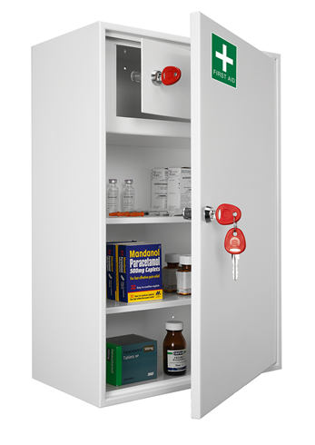
Flag Activity: Written Directives
Storage Requirements:
Poisons and firearms must be locked.
Resource Family may use trigger locks, cable locks, or other firearm safety devices.
Ammunitions shall be stored and locked separately from firearms.
Medicines, disinfectants, and cleaning solutions must be inaccessible (Reasonable and Prudent Parenting Standard - RPPS).

Slide 29
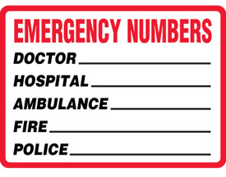
Flag Activity: Written Directives
Emergency Procedures:
2 telephone numbers and, if available, two email addresses as 24-hour contact information to the County, including contact information for alternative caregivers and place in a prominent location
Resource Family will need to discuss with the family Emergency procedures every six (6) months.

Slide 30
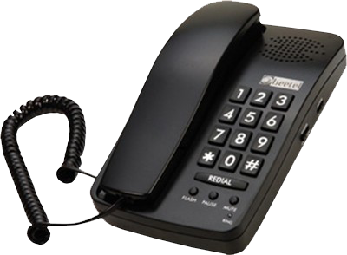
Telephones
Telephone service includes cellular, internet, or landline.
If cellular phone is being used, RFA staff shall ensure there is access to telephone service at all times.

Slide 31
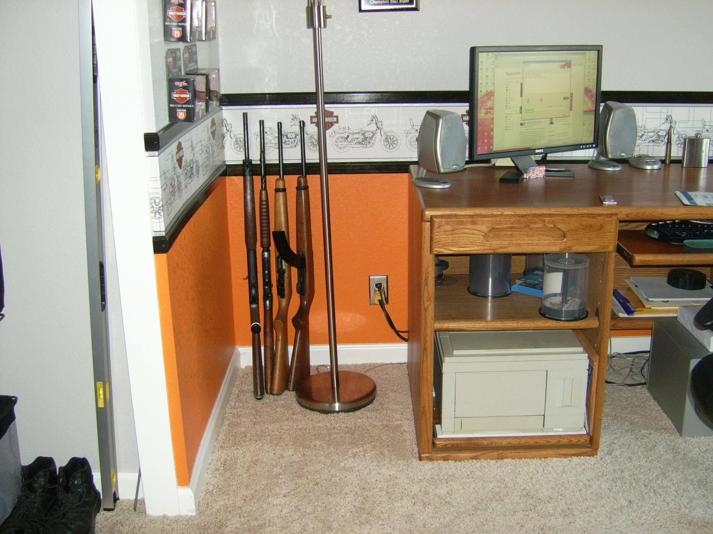
Deficiency Exercise

Slide 32
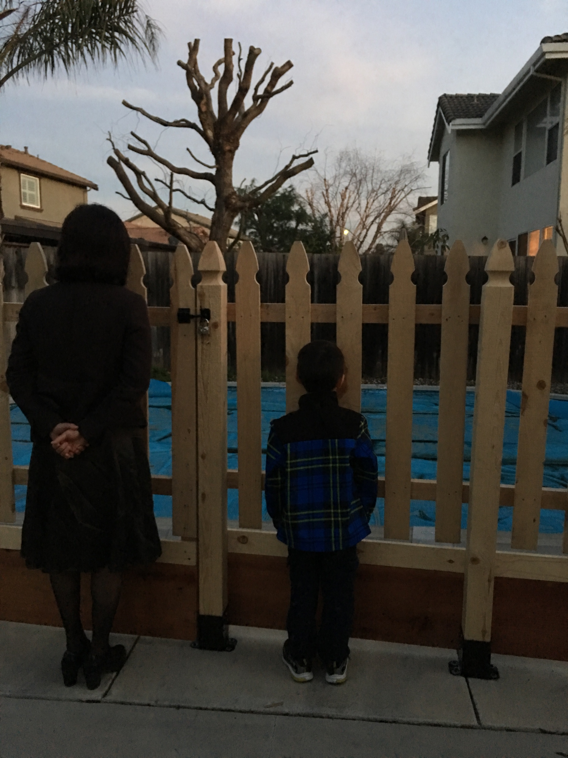
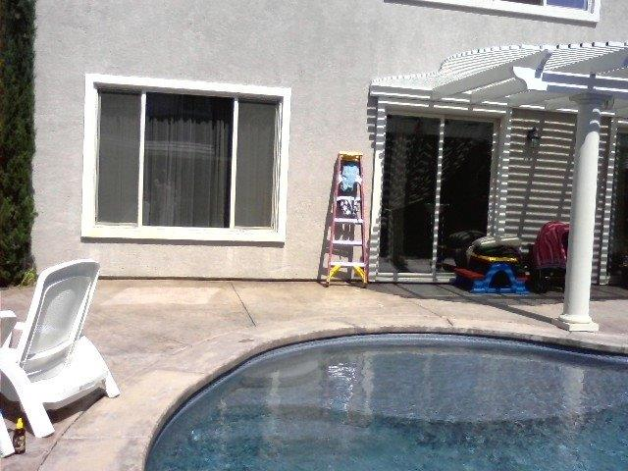

Slide 33
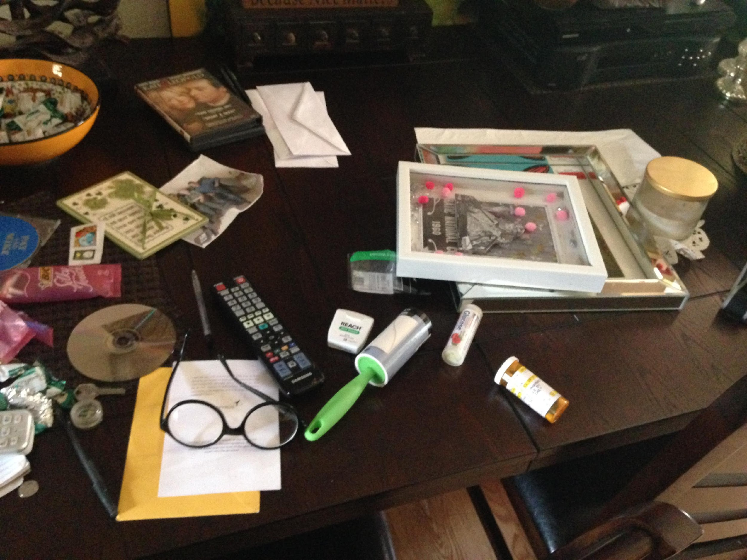

Slide 34
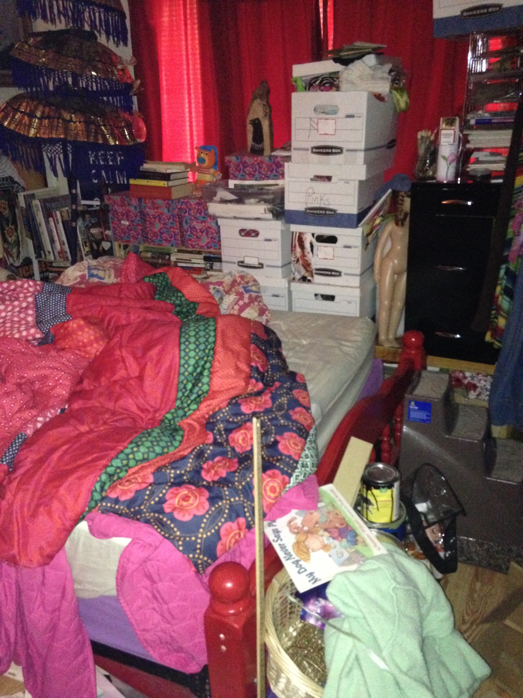

Slide 35
Flag Activity: Written Directives
Background Check
W & I Code 16519.5(d)
All adults residing or regularly present in the home.
Criminal records check
Child Abuse Central Index check
Megan’s Law check
DMV
AARS System (Administrative Action Records System)
Licensing Information System
Rap back
Background Assessment Guide (BAG)

Slide 36
Flag Activity: Written Directives
Exemption Criteria
WD 6-03B
Review BAG
Consider factors for evidence of good character and rehabilitation.
Certain crimes cannot be exempted.
The county may place conditions on the approval.
Ability to transfer exemptions.

Slide 37
Discussing a Criminal Record
The nature of the findings
Time frames
Circumstances surrounding the findings
Activities since the findings
Character references
Pardons
Court certification of rehab
Other

Slide 38
Flag Activity: Written Directives
Confidentiality
“W & I code section 10850” All applications and records concerning any individual made or kept by any public officer or agency.......relating to any form of Social Services........shall be confidential....

Slide 39
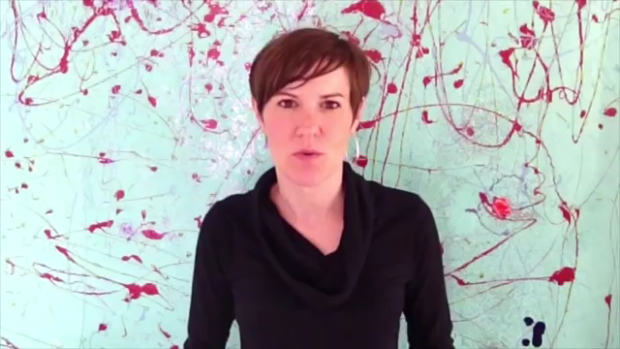
Confidentiality

Slide 40
The Resource Family File Requirements
Maintain a central RFA file for each applicant.
Records shall be maintained securely for at least 5 years following the date of application withdrawal, denial, recession, approval, criminal record exemption denial or recession, exclusion or forfeiture or surrender of approval. (WD-10-05)
Please see WD 10-05 for the list of items to remain in the confidential section of the Resource Family file.

Slide 41
Wrap up
What have you learned?
What questions do you still have?

Slide 42
Just Stop It!!
Coping with your worries!
https://vimeo.com/10880189

