Slide 1
Understanding Child & Family Team (CFT) Meetings

Slide 2
Agenda Overview
General Timeframes: Morning/Mid-day/Afternoon/Adjournment
Toys, books, CFS “Alphabet Soup”
“Trainers”= impart new info, reinforce prior learning, ACT as Facilitator, be transparent, refer to Coaches
Coaches= Ongoing application/transfer of learning & support for facilitating CFTMs
Day One: Overview of Child & Family Team Meetings & demonstration/practice of a meeting

Slide 3
Learning Objectives
Understand the 3 dimensions of facilitated practice
Increase skills on building shared understanding and shared agreements
Understand basic facilitation skills
Understand respectful engagement of participants in CFTMs
Facilitate exploration of worries, what’s working well and what needs to happen
Facilitate exploration of safety networks and collaboratively plan with families

Slide 4
Group Agreements
How will we work together?
What tools or strategies are helpful for effective dialogue?
“The Four Agreements”
Don’t take anything personally
Don’t assume
Do your best
Be impeccable

Slide 5
Gradients of Agreement (Scale)
Veto Endorsement
1 2 3 4 5
No way, No How! | Not comfortable, but won’t stand in way of plan. | Could go either way. | I like it. | I love it!
Notes:
Review Building Consensus: Gradients of Agreement (emphasize when we all say we agree we may not mean the same thing)
Families often think we have to be a “5” to please the Department. In this model everyone must be a 2-5 to have reached “consensus.”
When someone gives their level of agreement we can always ask the follow-up question: “What would it take to move you up one?” or “What would it take to move you from a 3 to a 4, etc.?” This allows the facilitator to embrace the “naysayer” and respect that there might be resolvable barriers to success.
i.e., If the agency is a 5 on a safety plan but the family is a 2, what’s the likelihood of a successful outcome? LOW! We need to pause to check for agreement on each task we ask families to do.
This is a form of a solution focused scaling question. Is there anything being left unsaid here? On a scale of 0 – 10, where 0 is child is completely unsafe and 10 is child is completely safe, if the family rates themselves a 9 and social worker gives it a 4 we can have a discussion about the discrepancy. How many times does the agency have this feeling but doesn’t directly discuss it with the family?

Slide 6
Overview of Katie A Core Practice Model

Slide 7
Who is Katie A?
Katie A was a 14 year old girl at the time the lawsuit was filed She was placed in foster care at the age of 4
She moved through 37 different placements in the 10 years she spent in foster care
Early assessments indicated services were needed, but she did not receive trauma treatment or individualized mental health services
Notes:
Katie A was a 14 year old girl at the time the lawsuit was filed. She was placed in foster care at the age of 4. She moved through 37 different placements in the 10 years she spent in foster care including four group homes, 19 stays in psychiatric facilities and 7 stays in shelter care. When she was 5 years old her caregiver asked for help to address her needs and early assessments indicated that Katie had been exposed to trauma and needed specialized services to address emotional and behavioral needs. She did not receive trauma treatment or individualized mental health services.
One of the key worries highlighted by Katie A’s story and by the law suit is the fact that children in need of behavioral and mental health treatment often move to higher levels of care including group homes or institutions such as psychiatric facilities if they do not receive services to help reduce their symptoms. The lawsuit highlighted negative consequences of using these types of care as placements instead of as interventions to help children return to a family setting. When sending a child to a group home or an institution which may be trained to respond to their needs, we have to ask ourselves what happens when that child goes back home? If the goal is to get them back home and we stabilize them in the facility what can happen when they return to their home or a home-like setting? The environment is different so the behaviors or original needs may arise again and the parent or caregiver is has not learned tools for responding to the needs of that child. The Plaintiffs set out to change this cycle.
Katie A is not the only child who has experienced high numbers of placements or not received behavioral health and mental health services while in care. While there are a large number of children and youth who are maintained either in their homes with their parents or in stable placements and who also receive services to support their behavioral and mental health and well-being. However, the lawsuit and Katie A’s story have acted as a lever to help child protection and behavioral health deepen and enhance their collaboration and communication in support of improving the work we do with children and families.

Slide 8
The Lawsuit
July 2002: Katie A. et al v. Diana Bonta et al. filed against CDSS, DHCS and the County of Los Angeles
Lawsuit filed by young adults who had aged out of foster care in LA county on behalf of a class of children in California
Seeking improved access to Wraparound services and Therapeutic Foster Care for children in or at risk of placement in foster care or group homes
Dec-2011: Settlement agreement reached, subclass members identified, and the State is asked to take specific actions
Notes:
In 2002 the Katie A. class action lawsuit was filed against the California Department of Social Services (CDSS), the California Department of Health Care Services (DHCS), and the County of Los Angeles (LA). It was filed by young adults who had aged out of foster care in Los Angeles County. The plaintiffs alleged foster children do not receive adequate assessment and referral for mental health services and that they suffer multiple unnecessarily restrictive foster care placements. They voiced concerns regarding an overuse of congregate and shelter care.

Slide 9
Class and Subclass
Class members include: children in foster care, children at risk of placement in foster care, children with a mental health condition, children in need of individualized mental health services, and children in an open CWS case (in this county “all our kids on our caseloads, 0-21” w/a few exceptions, e.g.- not safely-surrendered)
Subclass includes: children with an open CWS case who are full scope Medi-Cal eligible and have an open CWS case AND meet the medical necessity criteria for Specialty Mental Health Services
Notes:
The settlement agreement identified the class and a subclass of children to be served. The class members include: children at risk of placement in foster care, children with a mental health condition, children in need of individualized mental health services, and children in an open CWS case. The subclass of children include: children with an open CWS case who are full scope Medi-Cal eligible and have an open CWS case AND meet the medical necessity criteria for Specialty Mental Health Services.

Slide 10
CFS and DBH Collaboration
Co-location of DBH Clinicians in CFS Offices
Mental Health Screenings and Assessments
Identification of Katie A Subclass Members
SART
Health Homes
Wraparound
Success First
Other DBH Contracted Services/Providers
Need Assistance? Call (909) 387-7000

Slide 11
Mental Health Screening Tools
Universal Referral Form (URF) 234
URF 235
URF 235
If Child Not Currently Receiving Mental Health Services THEN Screening Is:
Conducted Initially
Every Six (6) Months or at Case Plan Update
Documented in Health and Educational Passport (HEP)

Slide 12
The State of California Response: The Core Practice Model (CPM)
The Core Practice Model (CPM) articulates a family-centered approach that is intended to improve coordination and collaboration among mental health, child welfare and children and families involved with the child welfare system who have mental health needs
Notes:
The Core Practice Model articulates a family-centered approach that is intended to improve coordination and collaboration among mental health, child welfare and children and families involved with the child welfare system who have mental health needs.

Slide 13
Core Practice Model (CPM) Elements
Teaming with families for collaborative planning
Trauma-informed practice
What’s happened vs What’s wrong
CPM components, standards & activities include:
Engagement
Assessment
Service Planning & Implementation
Monitoring & Adapting
Transition
For Subclass Members:
ICC, IHBS, Therapeutic Foster Care
Notes:
The Core Practice Model is built on several key elements including the value of teaming with families and utilizing trauma-informed practice. The CPM is comprised of five primary components and activities including: engagement, assessment, service planning and implementation, monitoring and adapting and transition. For subclass members, three specific services shall be available to children/youth with more intensive needs: Intensive Care Coordination (ICC), Intensive Home Based Services (IHBS), and Therapeutic Foster Care (TFC)
Reference page 2 of CPM

Slide 14
California Core Practice Model (CPM) Initiatives
Working Together To Improve Outcomes for Children and Families
Shared Responsibility
Collaboration
Cultural Competence/Humility
Child Centered/Family Focused/Driven System
Permanency
Evidenced Based Practice
Transparency
Disproportionality/Disparity
Accountability

Slide 15
CPM Values and Principles
Children and protected from abuse/neglect and maintained safely in their homes
Services are:
Needs driven, strengths based, family focused
Individualized/tailored to the strengths/needs of the child/family
Multi agency approach/community based
Formal/informal resources
Culturally competent
Child(ren) to have permanency/stability in living situations
Parent/child voice assured throughout the process

Slide 16
CPM: Teaming With Families
Collaboration
Diverse Team Membership
Guided by the Family’s input, their needs and preferences
All Members Participate in the Development and Implementation of the Plan

Slide 17
CFT Meeting Defined
Team meetings are the vehicle through which ongoing assessment of needs, case planning, and intervention, monitoring and adapting are facilitated
Decisions should be made within the context of the team
A CFTM should occur regularly and consider:
Risk Assessment/Safety Planning
Team Membership (who else should be on the team?)
Team member roles/responsibilities in between meetings
The effectiveness of the plan in meeting the needs and goals of the family

Slide 18
CFT Best Practice
Child and Family Teams must be delivered for every child/youth identified as a subclass and class member
CFT must include at least:
CFS Social Worker
Mental Health Clinician (if child is receiving mental heath treatment)
Child
Other Family Members
Others
CFT continues throughout the life of the case and ends when the case closes

Slide 19
CFT Meeting Guidelines
For Subclass:
must have the initial CFT meeting within 30 days of the membership designation date
subsequent CFT meetings must occur every 90 days or as needed to meet the child and family’s needs or until the child/youth no longer has subclass membership designation
For Class:
have initial CFT meeting as soon as possible
subsequent CFT meetings must occur every 90 days or as needed to meet the child and family’s needs

Slide 20
Social Worker Role in a CFT Meetings
For Class Members
Social Worker to coordinate/assist with
coordination of CFT meetings
Social Worker to facilitate CFT meetings
Social Worker can wear “multiple hats” during CFT meetings
For Sub-Class Members
Participate in CFT Meetings
DBH partners responsible for facilitating CFT meetings
Social Worker could be the facilitator/co-facilitator of CFT meetings
Notes:
Class Members:
SW might be responsible to coordinate the initial CFTM and then delegate it to other CFT members.
SW might have to facilitate the CFTM and scribe for the meeting.
SW might have to serve as the authority in legal matters, a “concerned” team member, a scribe, a facilitator, etc.

Slide 21
Social Worker Duties in a CFT Meetings for Class Members
Maintain risk assessment/ safety planning as the priority
CFS SW is the “subject matter expert” in risk assessment, safety planning and all CFS matters
Ensure everyone on the team has a voice
Explore/Identify: the needs of the family, their goals, their plan and potential challenges of them reaching their goal
Coordinate/schedule follow up CFT meetings
Complete all the necessary paperwork
Ensure team members get copies of Individual Care and Safety Plan
Advocacy
Documentation
Others?

Slide 22
Social Worker Duties in CFT Meetings for Subclass Members
CFS SW is the “subject matter expert” in risk assessment , safety planning and all CFS matters
Attend CFT meetings
Be part of the team
Obtain necessary paperwork
Document
Others?

Slide 23
Overview of child and Family Teams

Slide 24
Who Needs to Be Involved
People who care, but don’t get paid to
People who wear a badge
Notes:
No network… no plan.
Nothing about us, without us.

Slide 25
Appropriate Types of Discussions in a CFT Meeting
Safety
(Harm & Danger Statements, Safety Goals)
Permanency
(Stay Home, Return Home, Find a Home)
Wellbeing
(mandated in the Settlement)
NOT: Why did you run away?
NOT: What are you doing wrong?
How can I do a better job for this child and family?
Notes:
BIGGEST QUESTION IS NOT: why did you run away? What are you doing wrong? Vs What’s MY responsibility & commitment?

Slide 26
TDM vs CFT
TDM
CFT
About a placement change
About the family & child/youth needs & goals
Seeks consensus regarding a placement decision
Addresses the risks, needs & strengths of the family & child/youth
The Agency maintains responsibility for case decisions if consensus cannot be reached
No individual or entity works independently-- decisions are made by the team, including the family

Slide 27
How Are They Related?
CPM
CFT/CFTMs/TDMs/TCs
SOP
CAT

Slide 28
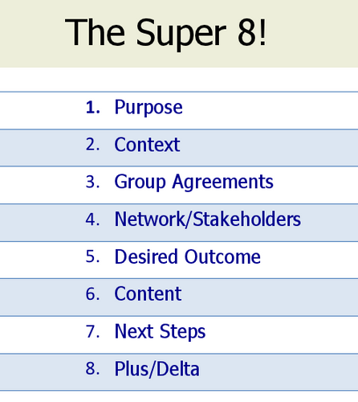
Three Dimensions to Attend To
CONTENT
PROCESS
RELATIONSHIPS
Notes:
DIMENSIONS:
CONTENT
PROCESS
RELATIONSHIPS

Slide 29
Structure of Child and Family team Meetings
Notes:
Handout #2
First: PRIOR to the meeting, with handout/flyer, purpose, etc….. Their desired outcome

Slide 30
Structure of a Child and Family Team Meeting… Pre-Meeting and then:
Notes:
Who knows what SOP Module this comes from?
Purpose – “Why are you meeting?” and Desired Outcomes
Context assessment – constraints; pressures, org changes, politics, org goals? Acknowledging them matters!
Attendees – “Who needs to be there?” Stakeholders. Pre-mtg prep of families.
Room arrangement – Boardroom, U of tables; Is it welcoming? Can everyone see each other and the notes?
Decision making – levels of involvement
Getting confirmation from attendees
What Worked, What Could We Do Better?

Slide 31
Our Process to Review the Pre-Meeting & Super 8
Discuss, demonstrate
Discuss, demonstrate, practice
Discuss, demonstrate….
FOCUS: Peters/Jackson Family

Slide 32
Peters/Jackson Family
Stakeholders
Monica Peters – Mom, 28 , Caucasian
Jimmy Jackson – Step-Dad, 30, African-American
Doris Jackson – Jimmy’s Mom, 53, African American
Ronnie Wilcox – School Counselor/Case Mgr, 37, Caucasian
Joshua – Child, 8, Caucasian
CFS worker
Notes:
PRE-ASSIGN Refer to Handout #07 – Peters-Jackson Family Scenario – Part 1

Slide 33
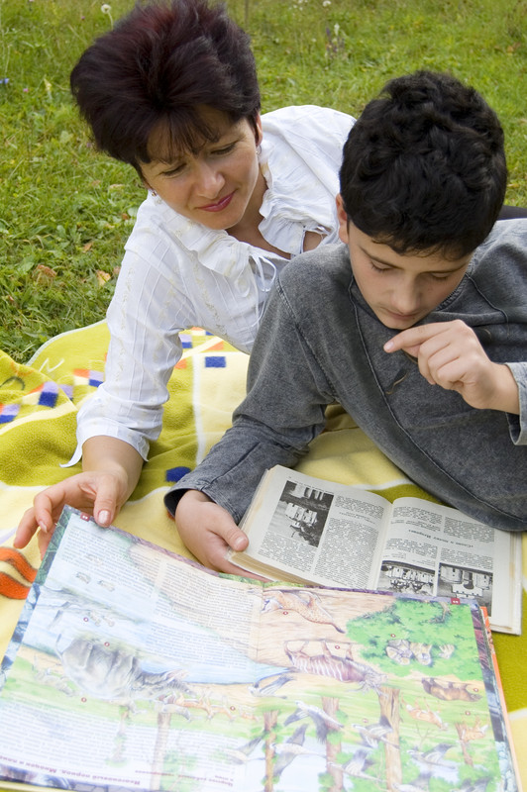
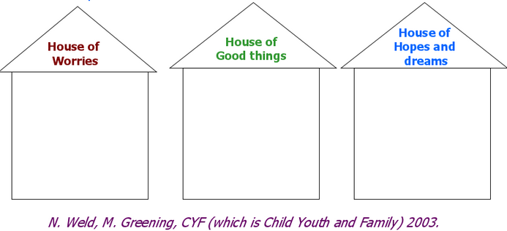
Prior to the Meeting
Prepare Individuals for the Meeting
Notes:
Raise your hand if you’ve done a mapping with a family already?
Raise your hand if you have used the Three Houses or a Safety House?
Provide Parents with a “Map” of what to expect.
Refer to Handout #02 – Dialogue Structure of a Child and Family Team Meeting

Slide 34
In Advance of the Meeting
Actively screen for and identify in advance any known propensity for violence
Explore with each family participant if there are any court orders that prohibit contact with anyone
Who are “Offenders”– verbally, physically… with each other/child
Options for participation….
Phone?
Separate meeting for each care provider?
Notes:
Workers and supervisors actively screen for and identify in advance any known propensity for violence by an individual who might attend a Safety Mapping meeting.
Workers and supervisors schedule separate Safety Mapping meetings for a DV offender and non-offending parent (NOP).
Because a NOP’s perception of her safety or the safety of her children can change between a planning conversation and the time of the actual meeting, in ALL cases in which more than one family member is present at a CFTMS meeting, a private pre-meeting safety check-in should be conducted with each family participant present. Ask each family participant:
Are there any court orders in place that prohibit contact between you and anyone else who is here for the meeting?
Is there anything we need to be aware of related to your personal safety in the meeting?
(If yes) How can we proceed safely? Separate meetings? Avoid certain topics? Exclude children or other family members from meeting?
(If no) Do we need to have a signal that you can use to let me know you need a break because you’re worried about your safety or the children’s safety?
What other situations could be considered safety issues?

Slide 35
DEMO: PRE-MEETINGS with Monica
Prepare the Family for the Meeting
Purpose of the meeting
How long it will last
What will happen if they choose not to participate
Prepare the family to tell their story
Explore what the goal of the initial CFTM will be
Group Agreements
Who to invite
Safety check-in
Notes:
Refer to Handout #02 – Dialogue Structure of a Child and Family Team Meeting
Purpose – “Why are you meeting?”
Context assessment – constraints; pressures, org changes, politics, org goals? Acknowledging them matters!
Desired Outcomes – products/knowledge
Attendees – “Who needs to be there?” Stakeholders. Pre-mtg prep of families.
Room arrangement – Boardroom, U of tables; Is it welcoming? Can everyone see each other and the notes?
Decision making – levels of involvement
Getting confirmation from attendees

Slide 36
Safety Check-in: After the Meeting
If there are ANY concerns about the impact of the meeting on safety, the worker should check in privately with family members about any violence or threats that occurred after the meeting

Slide 37
Family Safety Circles
Notes:
1. Talking about the need for a safety network
The first step in the process of using the Family Safety Circles tool flows directly out of the conversation with parents/caregivers about what we mean by a safety network and the fact that a safety network needs to be in place for safety planning to progress.
2. The Inner Circle
“Who are the people in your life and your child’s life who already know about what has happened that led to your child/children being in care (or to child protection services being involved with your family)?”
Giving compliments
Pay attention to what parents/caregivers have already done that will help to build future safety and acknowledge this with compliments, wherever and whenever possible.
3. The Middle Circle
“Who are the people in your life and the kids’ lives who know a little bit about what has happened; who don’t know the whole story but maybe know some of what has happened? Or maybe they know that something has happened but don’t know any of the details?”
4. The Outer Circle
“Who are the people in your life and your children’s lives who don’t know anything about what has happened?”
5. Moving people from the outer circles to the inner circle
• “Who else from these outer circles do you think needs to be part of this inner circle?”
• “Is there anyone in these two outer circles who you have thought about telling or come close to telling, but you haven’t quite gotten there yet?”
• “Who would Grandma (for example - pick a person already in the inner circle) say needs to be in this inner circle with her?”
• “Who would the kids want to have in this inner circle?”
• “You know all of these people, I don’t know them yet, but who do you think I would want to have in this inner circle?”
• “Who of all of these people do you feel most comfortable with/most understood by and think would be important to have as part of the safety network?”
6. Discussing the following:
- What is the role of the safety network?
- How many people do we need in the safety network?
- What we mean by ‘safety’ people and how is this decided?
- What do people need to know to be part of the safety network?
How do we ensure that everyone is informed about the concerns?
No network, no plan

Slide 38
Dyads
Try it out
Role 1= CFS Worker
Role 2= “Monica”
Worker, help Monica to identify members of her family safety circle… which might help to inform who might be asked to be part of the CFT…. And possibly the CFTM!

Slide 39
Introductions/Welcome
Allow family to introduce themselves first and to tell their story
Others in the room should introduce themselves and tell how they are connected to the child/family
Agency/Professional staff should introduce themselves last and explain what their roles are to the CFT
One suggestion would be to have staff standing up and talking to each other as family enters the room, and then continue

Slide 40
DEMO First Stages & Key Questions
Introductions/Welcome: Who is in the room & how are you connected to the child?
Review Purpose and Desired Outcomes of Meeting*: Why are we meeting? What do we want to walk away with?
*Already id’d in pre-meeting with some stakeholders

Slide 41
Ensure There Is Agreement About
What will the group be doing together?
What do people want to walk away with?
Overall, why are we meeting today?

Slide 42
During the Meeting
Introduce the Safety Agreement: “This meeting is a place of physical and emotional safety for all who participate. Examples of how we ensure safety are that we respect court orders prohibiting contact between people, we give permission for each person to keep themselves safe during the meeting, and I might suggest a time-out or a break, or that we move into separate meetings. We adhere to “Nothing about us without us” except when there is a safety concern for a participant.”
Facilitators & participants pay attention for any behavioral indictors that someone in the meeting is feeling unsafe, and respond accordingly
Agreed-upon “signals” for fear/anxiety/triggers
“Seating arrangement” ideas?
Notes:
Introduce the Safety Agreement: All CFS meetings are a place of physical and emotional safety for all who participate. Explain:
“This meeting is a place of physical and emotional safety for all who participate. Examples of how we ensure safety are that we respect court orders prohibiting contact between people, we give permission for each person to keep themselves safe during the meeting, and I might suggest a time-out or a break, or that we move into separate meetings. We adhere to “Nothing about us without us” except when there is a safety concern for a participant.”
Facilitators and participants pay attention for any behavioral indictors that someone in the meeting is feeling unsafe, and respond accordingly.

Slide 43
DEMO: Context
Provide Context of Meeting: Is there anything that might distract our focus?

Slide 44
Set the stage for effective dialogue
What is happening outside the room that pulls attention away from what we are doing together?
What power dynamics/imbalances are present that need to be made explicit? Be sure to “call out” the power of the worker in writing a report, etc
Despite this power imbalance, the goal is to include the family’s perspective to get to overall better outcomes, using family connections, etc
Is there anything that might pull our attention away from our focus today?
What are the cultural/diversity issues that may be present in the meeting?
If family already had TDM… point out differences w/CFT.
Notes:
Disproportionality

Slide 45
Discuss & Practice: Group Agreements
HOW do we want to work with each other?

Slide 46
Establish Working Agreements
This is an agent of change– especially for first time!
Great process for observation & “data collection” about this family
Explore how the group will work together in this meeting and after this meeting
Explore what agreements are needed for effective dialogue
Push group to come up with positive reframes that state what to do, as opposed to what not to do
The last agreement should always be that the group takes shared responsibility to hold each other accountable for the agreements
Be prepared with suggested agreements

Slide 47
Group Agreements Action: at your tables
Roles id’d
CFS Facilitator
Monica
Jimmy
Doris
Joshua
Ronnie
Create a list of group agreements
“Flesh out” as necessary
Don’t assume everyone defines term the same!

Slide 48
DEMO: Review Network/Stakeholders
Is everyone here…. That NEEDS to be here? If not, what should we do to get them here?

Slide 49
Networks/Stakeholders
Assess if everyone is here who needs to be here
If not, what should we do to get them here
Explore with the CFTM if the family was given the opportunity to invite support people
The family should be provided the opportunity to speak first and last if they choose to do so

Slide 50
DEMO: Individualized Care Plan/Safety Plan
What do we we want to talk about? (Consider actual safety mapping, safety circles, case consultation, etc)
What’s working well?
What are our worries?
What ideas do we have for next steps?

Slide 51
Helpful Types of Questions to Ask
Three Questions
Solution Focused Questions
Open ended questions
Who, what when, where, and how questions
Coping questions
Relationship questions
Exception seeking questions
Scaling questions
Miracle/Hoped for future question
Notes:
Refer to Handout #05 – Helpful Types of Questions for Finding Solutions
TRAINING POINTS:
Solution-focused questions are part of the foundation on which effective CFTMs occur. Child protection assessment has, in the past, focused too narrowly on problems within the family rather than balancing those worries with an exploration of existing strengths and acts of protection that are equally relevant to accurately assessing danger and risk and planning for safety. CFTMs help CFS staff hold the balance between danger and safety more explicitly, and by shifting the focus helps workers engage more effectively with families in the development of solutions.
Specific types of questions focus our attention on caregiver behaviors and exploration of strengths on which to build safety
Who, what, when, where and how questions (no “why” questions)
Coping questions
Relationship questions
Exception-seeking questions
Scaling questions
Miracle question

Slide 52
ACTION: Individualized Care Plan/Safety Plan
Roles Id’d
CFS Facilitator
Monica
Jimmy
Doris
Joshua
Ronnie
What’s working well?
What are our worries?
What ideas do we have for next steps?

Slide 53
DEMO: Review Next Steps
What steps do we need to take from here? Who does what? By when? Next meeting date?

Slide 54
Next Meeting
Next prioritized steps/actions to “try on”
Anyone else need to be invited to next meeting?
Foster families
Schedule the next meeting

Slide 55
LAST STEP…. Of the CFTM
PLUS/DELTA
(We’ll pause that right now…. To return soon….)

Slide 56
Plus/Delta Feedback
Draw two columns on flip chart paper
Plus = Strengths of the Meeting
Delta (Greek symbol for change) = upgrades that are not necessarily negative…it’s just something participants suggest to change
All responses are TRUE… Facilitator/Scribe needs to refrain from “arguing” or “correcting” or “defending”
Notes:
Draw two columns on flip chart paper to capture what the group felt were the pluses or strengths of the training today, as well as the deltas (Greek symbol for change) or upgrades. Deltas don’t necessarily mean a negative, just something they’d like to change.
Again, be clear about the value of giving transparent feedback as a group v. written evaluation forms – it helps everyone get more comfortable sharing their thoughts and feelings and helps to avoid a “meeting after the meeting about the meeting.”

Slide 57
This presentation is brought to you by:
Public Child Welfare Training Academy
PCWTA is a program of the Academy for Professional Excellence at San Diego State University School of Social Work in collaboration with our University partners, CSU San Bernardino, Loma Linda University and CSU Fullerton

