Slide 1
Online Learning
Common Core 3.0
Field Activities
Classroom Skill Building

Slide 2
Writing Behavioral Objectives California Common Core May 06, 2019

Slide 3
Learning Objectives
Agenda

Slide 4
Group Agreements
Notes:
Collaboration: We need partnership to have engagement and that works best if we trust each other and agree we are not here to blame or shame. We are here because we share a common concern for the safety and well-being of children. Remind them how this skill will be needed when working with families as they are the experts on their family. Social workers must be able to foster collaboration in order to complete a thorough assessment of the situation. Families need to feel trust before they honestly examine themselves and be able to look at a problem and their part in it.
Ask lots of questions: Point out that the trainer can’t make the training relevant for each person because there are many people in the room with different experiences and different needs. Trainees have to make it relevant for themselves by asking lots of questions and deciding how the experience might be helpful or not helpful to them.
Be Open to Trying New Things: As professional we feel more comfortable and competent sticking with what we know. We don’t always like it when new things come along. Sometimes it feels uncomfortable to try new things so we tend to back away from the new thing telling ourselves things like “she doesn’t know what she’s talking about…she has never worked in our community with the people we work with…” But to learn something new we have to do through the uncomfortable stage to get to the other side where it feels natural and comfortable. With this group agreement, they are agreeing to try new things even if they feel uncomfortable.
Make Mistakes: As professionals we don’t like to make mistakes. And when we make mistakes we feel discouraged and beat ourselves up. But, if we are going to learn new things, we have to make mistakes. Even more important than the willingness to make mistakes is the willingness to admit we are wrong even when we don’t want to be. Growth requires that we are open to changing our minds based on new information received. We must also be willing to put our own ideas aside to fully hear the views of others.
Confidentiality: This is just a reminder that information about families or other trainees shared in the training room should be kept confidential.
Be responsible for your own learning: As adult learners we realize you come with knowledge, skills and experience. The intention of this curriculum is that you will have an opportunity to share this via large and small group discussions. Please come prepared to training having taken any prerequisite eLearning or classroom trainings. Set aside this day for your learning, please do not bring work into the classroom, this is distracting to other trainees as well as to the trainer/facilitator. This includes being on time, sharing the floor, cell phones off…
Use chart pad paper to add agreements or modify the agreements that were previously established. As you are charting, model for the group the reframing of ideas to the affirmative. For example, if someone offers the agreement “no side conversations” – ask, “what is it that you would like participants to do instead”? Do this at any time an agreement is offered that states “what not to do” as opposed as “what to do” Explain how this parallels developing behavioral based case plan objectives. All of our plans aim to identify those caregiver actions that will resolve safety and risk concerns – safety is the “presence of” as opposed to the “absence of”.

Slide 6
Team-Based Learning (TBL)
Consult the handout - S.M.A.R.T. Objectives
Individually complete the quiz.
Complete the exact same test as a team, reaching consensus as to the best response.
Tally the number of correct responses.
Be prepared to offer a rationale for your responses.

Slide 7
Wilson Family Genogram

Slide 8
Wilson Family Scenario
Read the following handouts:
Screener Narrative
Investigation Narrative
SDM Safety Assessment
SDM Risk Assessment

Slide 9
A Word about CWS/CMS
It is a templated system that has not evolved as quickly as child welfare practice documentation has changed over the years

Slide 10
Writing Behavioral Objectives for the Initial Case Plan
S.M.A.R.T
Actions
Service Objective: Identification of the priority need goals for clients.
Family Voice
Linked to SDM tools
Positively worded

Slide 11
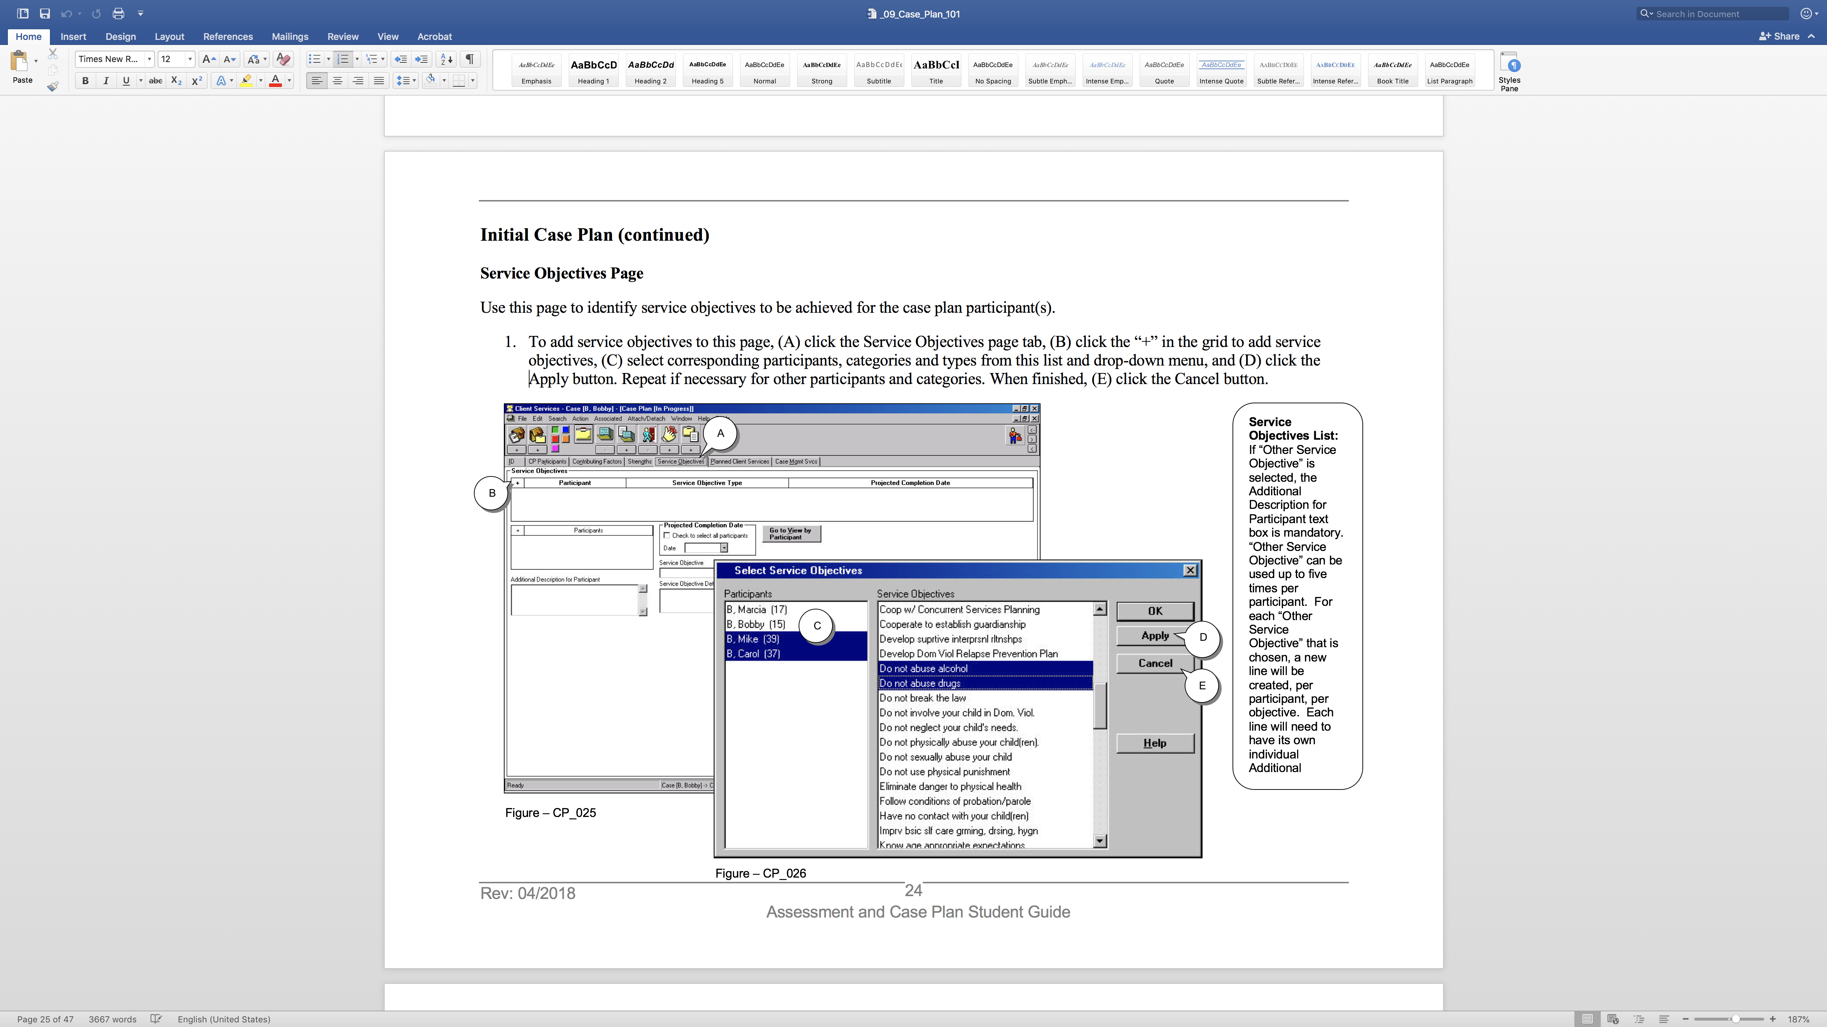

Slide 12
Writing Behavioral Objectives for the Initial Case Plan
Supports new behavior
Duration
Planned Client Services / Client Responsibilities: the action, activity or service to meet the service objective
Frequency
S.M.A.R.T
Number of events

Slide 17
Trainer Example
CWS/CMS Drop Down–Do not physically abuse your child.
Reworked Goal– For the next 6 mos. Mr. Wilson agrees to always discipline Omar and Alejandro in ways that do not injure them. Behavioral Objectives:
Within two weeks, Mr. Wilson will be able to list five ways to discipline Omar and Alejandro, other than using physical discipline.
Within 30 days, Mr. Wilson will practice one skill learned in a parenting class when he is struggling to get Omar and Alejandro to follow directions and log the results in his journal.
Mr. Wilson will demonstrate to two people in his safety network the ability to set firm limits with Omar and Alejandro other than physical discipline.

Slide 18
Client Responsibility
Client Responsibility
Activity |  | Times | Frequency | Completion Date
Education Services | Parenting Program | 1 | Weekly | 9/30/16
 | Description
 | Mr. Wilson will attend and demonstrate progress in learning non-physical disciplining strategies that are developmentally age appropriate for Omar and Alejandro.
Counseling | Parent Child Therapy | 1 | Weekly | 9/30/16
 | Description
 | Mr. Wilson will attend therapy with Omar to interpret and respond to his behaviors in nurturing and supportive ways.

Slide 19
Activity
Work individually to write a service objective and client responsibility for:
Mrs. Wilson
Mr. Wilson
Omar
Review with team for feedback
Write it up and post
Walk About:
“Dot” those items that meet the criteria of S.M.A.R.T. objectives as discussed today.
“Tweak” the items that do not meet criteria by making them S.M.A.R.T.er.
Large group report out

Slide 20
Evaluation
Notes:
11:20-11:50 – Embedded Evaluations
11:50-12:00 Participant Evaluations

Slide 21
Preliminary Evaluation Materials
ID codes:
First 3 letters of MOTHER’S MAIDEN NAME
The first 3 letters of MOTHER’S FIRST NAME
The NUMERAL FOR THE DAY YOU WERE BORN
Example: November 9, 1970 or 11/09/1970
The NUMERAL FOR THE YEAR YOU WERE BORN
Example: November 9, 1970 or 11/09/1970
Informed Consent
ID code assignment instruction sheet
Demographics Survey
Trainee ID Code

